Slide 1
Statistical Significance and Performance Measures
Just a brief review of confidence intervals since you had these in Stats – Assume you've seen t-tests, etc.
Confidence Intervals
Statistical Significance
Permutation Testing
Other Performance Measures
Precision
Recall
F-score
ROC
Notes:
Short Version – 1,2,13-19, 26

Slide 2
Statistical Significance
How do we know that some measurement is statistically significant vs being just a random perturbation
How good a predictor of generalization accuracy is the sample accuracy on a test set?
Is a particular hypothesis really better than another one because its accuracy is higher on a validation set?
When can we say that one learning algorithm is better than another for a particular task or set of tasks?
For example, if learning algorithm 1 gets 95% accuracy and learning algorithm 2 gets 93% on a task, can we say with some confidence that algorithm 1 is superior in general for that task?
Question becomes: What is the likely difference between the sample error (estimator of the parameter) and the true error (true parameter value)?
Key point – What is the probability that the differences in our results are just due to chance?
Notes:
sample error is the 95 and 93 above
ShShort Version – 1,2,13-19, 26

Slide 3
Confidence Intervals
An N% confidence interval for a parameter p is an interval that is expected with probability N% to contain p
The true mean (or whatever parameter we are estimating) will fall in the interval ± C_{N}σ of the sample mean with N% confidence, where σ is the deviation and C_{N} gives the width of the interval about the mean that includes N% of the total probability under the particular probability distribution. C_{N} is a distribution specific constant for different interval widths.
Assume the filled-in intervals below are the 90% confidence intervals for our two algorithms. What does this mean?
The situation below says that these two algorithms are different with 90% confidence
Would if they overlapped?
How do you tighten the confidence intervals? – More data and tests
93%
95%
1.6
1.6
92 93 94 95 96
Notes:
More Data
Brief here – just review

Slide 4
Central Limit Theorem
Central Limit Theorem
If there are a sufficient number of samples, and
The samples are iid (independent, identically distributed) - drawn independently from the identical distribution
Then, the random variable can be represented by a Gaussian distribution with the sample mean and variance
Thus, regardless of the underlying distribution (even when unknown), if we have enough data then we can assume that the estimator is Gaussian distributed
And we can use the Gaussian interval tables to get intervals ± z_{N}σ
Note that while the test sets are independent in n-way CV, the training sets are not since they overlap (Still a decent approximation)
Notes:
Skip 4-10, go straight to permutation testing

Slide 5
Binomial Distribution
Given a coin with probability p of heads, the binomial distribution gives the probability of seeing exactly r heads in n flips.
A random variable is a random event that has a specific outcome (X = number of times heads comes up in n flips)
For binomial, Pr(X = r) is P(r)
The mean (expected value) for the binomial is np
The variance for the binomial is np(1 – p)
Same setup for classification where the outcome of an instance is either correct or in error and the sample error rate is r/n which is an estimator of the true error rate p

Slide 6
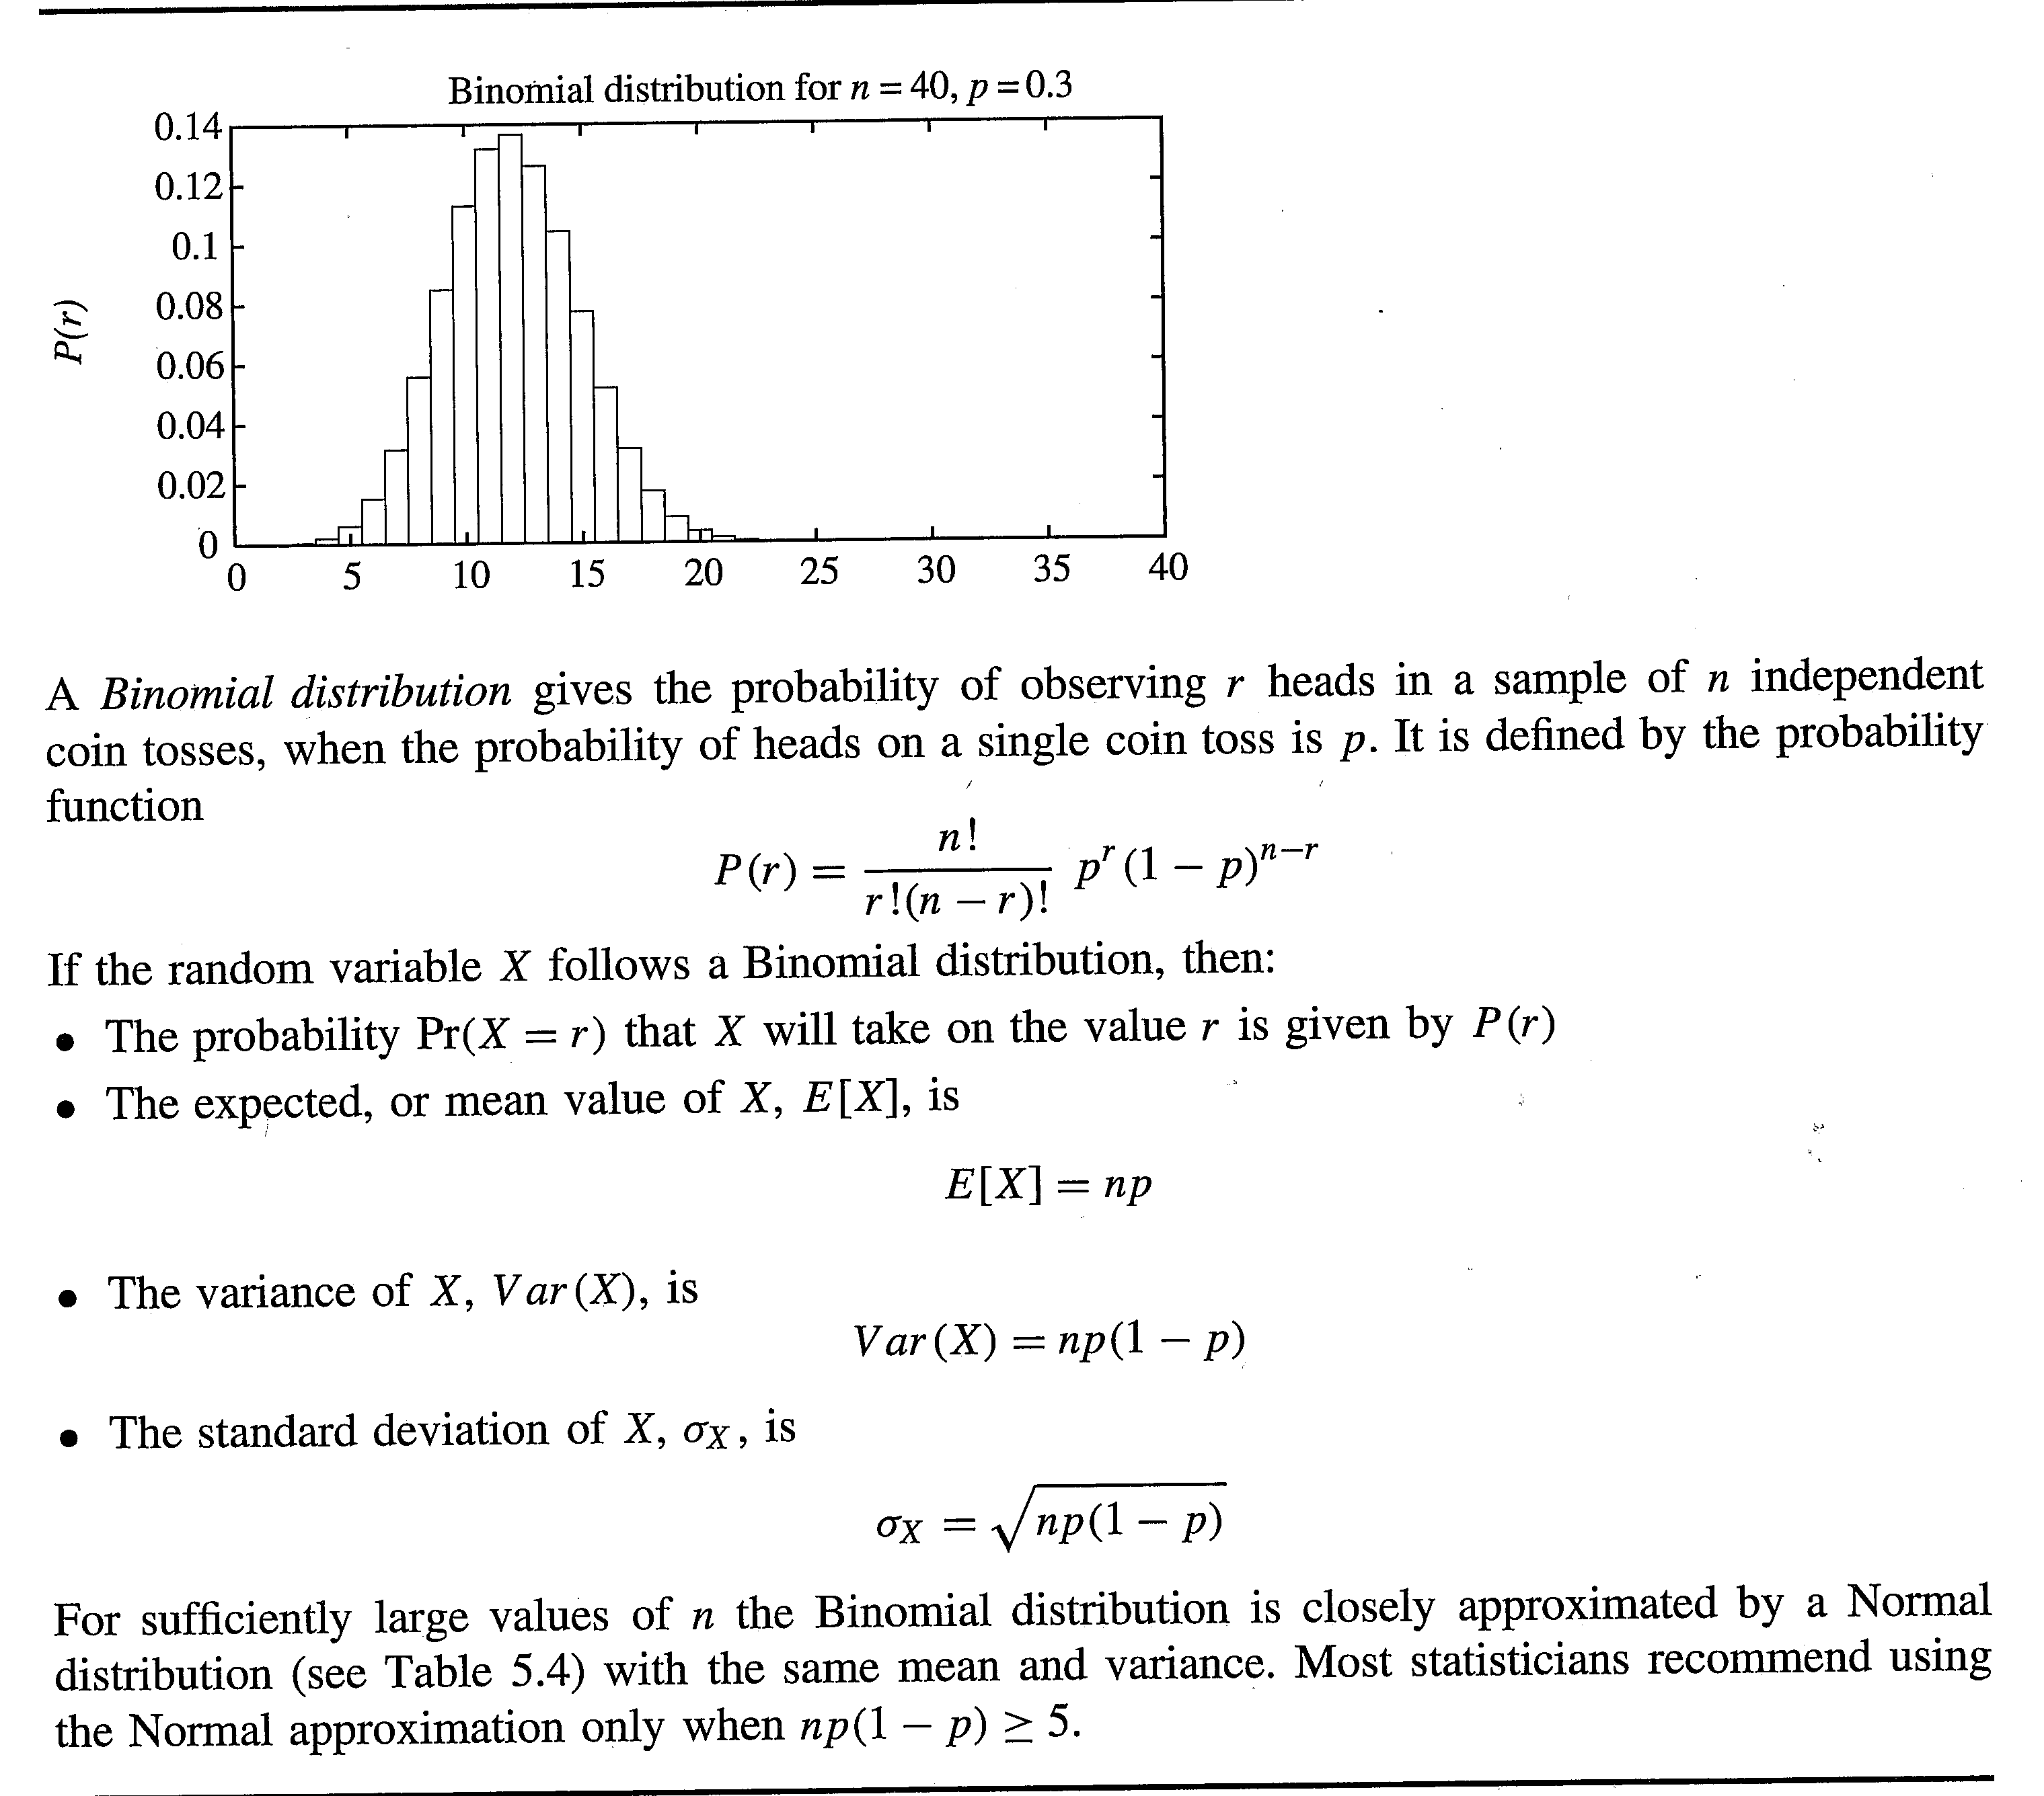

Slide 7
Binomial Estimators
Usually want to figure out p (e.g. the true error rate)
For the binomial the sample error r/n is an unbiased estimator of the true error p
An estimator X of parameter y is unbiased if E[X] - E[y] = 0
For the binomial the sample deviation is

Slide 8
Comparing two Algorithms - paired t test
Do k-way CV for both algorithms on the same data set using the same splits for both algorithms (paired)
Best if k > 30 but that will increase variance for smaller data sets
Calculate the accuracy difference δ_{i} between the algorithms for each split (paired) and average the k differences to get δ
Real difference is with N% confidence in the interval
δ ± t_{N,k-1} σ
where σ is the standard deviation and t_{N,k-1} is the N% t value for k-1 degrees of freedom. The t distribution is slightly flatter than the Gaussian and the t value converges to the Gaussian (z value) as k grows.

Slide 9
Paired t test - Continued
σ for this case is defined as
Assume a case with δ = 2 and two algorithms M₁ and M₂ with an accuracy average of approximately 96% and 94% respectively and assume that t_{90,29} × σ = 1. This says that with 90% confidence the true difference between the two algorithms is between 1 and 3 percent. This approximately implies that the extreme averages between the algorithm accuracies are 94.5/95.5 and 93.5/96.5. Thus we can say that with 90% confidence that M₁ is better than M₂ for this task. If t_{90,29} × σ is greater than δ then we could not say that M₁ is better than M₂ with 90% confidence for this task.
Since the difference falls in the interval δ ± t_{N,k-1}σ we can find the t_{N,k-1} equal to δ/σ to obtain the best confidence value

Slide 10
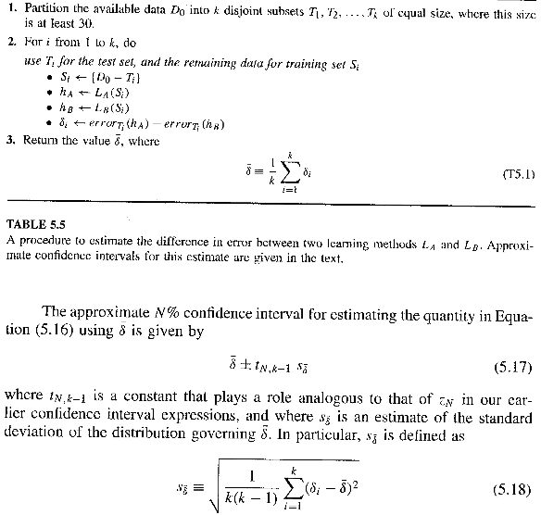

Slide 11
Permutation Test
With faster computing it is often reasonable to do a direct permutation test to get a more accurate confidence, especially with the common 10 fold cross validation (only 1000 permutations)
Menke, J., and Martinez, T. R., Using Permutations Instead of Student's t Distribution for p-values in Paired-Difference Algorithm Comparisons, Proceedings of the IEEE International Joint Conference on Neural Networks IJCNN’04, pp. 1331-1336, 2004.
Even if two algorithms were really the same in accuracy you would expect some random difference in outcomes based on data splits, etc.
How do you know that the measured difference between two situations is not just random variance?
If it were just random, the average of many random permutations of results would give about the same difference (i.e. just the task variance)
Notes:
Could skip P-test if time is tight, to leave plenty of time for ROC

Slide 12
Permutation Test Details
To compare the performance of models M₁ and M₂ using a permutation test:
1. Obtain a set of k estimates of accuracy A = {a₁, ..., a_{k}} for M₁ and B = {b₁, ..., b_{k}} for M₂ (e.g. each do k-fold CV on the same task, or accuracies on k different tasks, etc.)
2. Calculate the average accuracies, μ_{A} = (a₁ + ... + a_{k})/k and μ_{B} = (b₁ + ... + b_{k})/k (note they are not paired in this algorithm)
3. Calculate d_{AB} = |μ_{A} - μ_{B}|
4. let p = 0
5. Repeat n times (or just every permutation)
a. let S={a₁, ..., a_{k}, b₁, ..., b_{k}}
b. randomly partition S into two equal sized sets, R and T (statistically best if partitions not repeated)
c. Calculate the average accuracies, μ_{R} and μ_{T}
d. Calculate d_{RT} = |μ_{R} - μ_{T}|
e. if d_{RT} ≥ d_{AB} then p = p+1
6. p-value = p/n (Report p, n, and p-value)
A low p-value implies that the algorithms really are different
 | Alg 1 | Alg 2 | Diff
Test 1 | 92 | 90 | 2
Test 2 | 90 | 90 | 0
Test 3 | 91 | 92 | -1
Test 4 | 93 | 90 | 3
Test 5 | 91 | 89 | 2
Ave | 91.4 | 90.2 | 1.2
Notes:
Question: Is 1.2 statistically significant or just by chance.
Note if our initial columns were randomly split we would expect a fair amount (not all the way to half) of the arbitrary partitions to be greater than 1.2
But if almost all are less than 1.2, then 1.2 is statistically significant.

Slide 13
Statistical Significance Summary
Required for publications
No single accepted approach
Many subtleties and approximations in each approach
Independence assumptions often violated
Degrees of freedom: Is LA₁ still better than LA₂ when
The size of the training sets are changed
Trained for different lengths of time
Different learning parameters are used
Different approaches to data normalization, features, etc.
Etc.
Author's tuned parameters vs default parameters (grain of salt on results)
Still can (and should) get higher confidence in your assertions with the use of statistical significance measures
Notes:
Short Version – 1,2,13-19, 26

Slide 14
Performance Measures
Most common measure is accuracy
Summed squared error
Mean squared error
Classification accuracy

Slide 15
Issues with Accuracy
Is 99% accuracy good; Is 30% accuracy bad?
Depends on baseline and problem complexity
Error reduction (1-accuracy)
Absolute vs relative
99.90% accuracy to 99.99% accuracy is a 90% relative reduction in error, but absolute error is only reduced by .09%.
50% accuracy to 75% accuracy is a 50% relative reduction in error and the absolute error reduction is 25%.
Which is better?
Above assumes equal cost for all errors
Often have different error costs – e.g. Heart attack or not
Notes:
Do this through quick ROC

Slide 16
Binary Classification
Predicted Output
1
0
True Positive (TP)
Hits
False Negative (FN)
Misses
1
True Output (Target)
0
False Positive (FP)
False Alarm
True Negative (TN)
Correct Rejections
Accuracy = (TP+TN)/(TP+TN+FP+FN)
Precision = TP/(TP+FP)
Recall = TP/(TP+FN)
Notes:
Accuracy: 4 numbers combined into 1, loses information
SAVE precision/recall explanation for next slides

Slide 17
Recall
Predicted Output
1
0
True Positive (TP)
Hits
False Negative (FN)
Misses
1
True Output (Target)
0
False Positive (FP)
False Alarm
True Negative (TN)
Correct Rejections
Recall = TP/(TP+FN)
The percentage of target true positives that were
predicted as true positives, minimize false negatives How to maximize?
Notes:
Accuracy: 4 numbers combined into 1, loses information
Heart attack – Recall is the goal, don’t want to miss any, and would rather err towards accepting some false positives and minimize false negatives.
Google search – Recall not an issue, because we never get to the millionth page, rather have precision
How to maximize recall – classify everything as true

Slide 18
Precision
Predicted Output
1
0
True Positive (TP)
Hits
False Negative (FN)
Misses
1
True Output (Target)
0
False Positive (FP)
False Alarm
True Negative (TN)
Correct Rejections
Precision = TP/(TP+FP)
The percentage of predicted true positives that are
target true positives, minimize false positives
How to maximize?
Notes:
Accuracy: 4 numbers combined into 1, loses information
Heart attack – Recall is the goal, don’t want to miss any, and would rather err towards accepting some false positives and minimize false negatives.
Google search – Precision is goal, don’t what false positives, there are plenty of sites anyways and we don’t need to get all
How to maximize precision – only classify the one or few most confident candidates as true

Slide 19
Other measures - Precision vs. Recall
Find appropriate balance of Precision vs Recall for the task at hand, rather than just accuracy
Can adjust ML parameters to accomplish the Precision vs Recall balance – Heart attack vs Google search
Break even point: precision = recall
F₁ or F-score = 2×(precision × recall)/(precision + recall) - Harmonic average of precision and recall
One especially useful situation is when there is highly skewed data output, where accuracy may be misleading
Notes:
Just take single or few best instance(s) for precision
For recall make everything true to make sure don't miss any
Google search – High precision, so many hits that recall not so critical
FBI search for possible criminal matches: want high recall
Ancestry: High recall to support searchers on names, High precision for those who browse your records
HA: Usually high recall

Slide 20
Cost Ratio
For binary classification (concepts) can have an adjustable threshold for deciding what is a True class vs a False class
For MLP it could be what threshold activation value is used to decide if a final output is true or false (default .5)
Could use .8 to get high precision or .3 for higher recall
For ID3 it could be what percentage of the leaf elements need to be in a class for that class to be chosen (default is the most common class)
Could slide that threshold depending on your preference for True vs False classes (Precision vs Recall)
Could measure the quality of an ML algorithm based on how well it can support this sliding of the threshold to dynamically support precision vs recall for different tasks - ROC

Slide 21
ROC Curves and ROC Area
Receiver Operating Characteristic
Developed in WWII to statistically model false positive and false negative detections of radar operators
Standard measure in medicine and biology
True positive rate (sensitivity) vs false positive rate (1- specificity)
True positive rate (Probability of predicting true when it is true) P(Pred:T|T) = Sensitivity = Recall = TP/P = TP/(TP+FN)
False positive rate (Probability of predicting true when it is false)
P(Pred:T|F) = FP/N = FP/(TN+FP) = 1 – specificity (true negative rate) = 1 – TN/N = 1 - TN/(TN+FP)
Want to maximize TPR and minimize FPR
How would you do each independently?
Notes:
Skip to 23, 25, 26
After false pos rate, go back to matrix
For BP how do maximize TP rate (recall) – set threshold to 0, everything is positive
and how minimize FP rate – set threshold to 1, no examples are positive
neither acceptable, want a balance, but that will differ for each task

Slide 22
ROC Curves and ROC Area
Neither extreme is acceptable
Want to find the right balance
But the right balance/threshold can differ for each task considered
How do we know which algorithms are robust and accurate across many different thresholds? – ROC curve
Each point on the ROC curve represents a different tradeoff (cost ratio) between true positive rate and false positive rate
Standard measures just show accuracy for one setting of the cost/ratio threshold, whereas the ROC curve shows accuracy for all settings and thus allows us to compare how robust to different thresholds one algorithm is compared to another

Slide 23
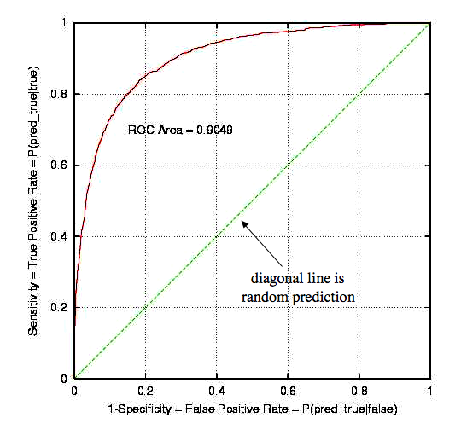
Notes:
perfect model would have area of almost 1,
worst case area is .5
If threshold is low FPR is great (way left) but TPR is bad (low)
If threshold is low TPR is great (way high) but TPR is bad (way right)

Slide 24
Assume Backprop threshold
Threshold = 1 (0,0), then all outputs are 0
TPR = P(T|T) = 0
FPR = P (T|F) = 0
Threshold = 0, (1,1)
TPR = 1, FPR = 1
Threshold = .8 (.2,.2)
TPR = .38 FPR = .02
- Good Precision, but recall (TPR) is low
Threshold = .5 (.5,.5)
TPR = .82 FPR = .18
- Better Accuracy/balance
Threshold = .3 (.7,.7)
TPR = .95 FPR = .43
- Better Recall, worse precision
.3
.5
.8
Accuracy is maximized at point closest to the top left corner. Note that Sensitivity = Recall and the lower the
false positive rate, the higher the precision.
Notes:
Could sweep along the parameter values and rates would follow the curve.
Threshold points are along diagonal
Perfect classification is straight up to 0,1 with Recall = 1 and False positive rate = 0.
Accuracy (a+b/(a+b+c+d)) is maximized at point closest to the top corner.

Slide 25
ROC Properties
Area Properties
1.0 - Perfect prediction
.9 - Excellent
.7 - Mediocre
.5 - Random
ROC area represents performance over all possible cost ratios
If two ROC curves do not intersect then one method dominates over the other
If they do intersect then one method is better for some cost ratios, and is worse for others
Blue alg better for precision, yellow alg for recall, red neither
Can choose method and balance based on goals

Slide 26
Performance Measurement Summary
Other measures (e.g. Precision vs Recall, ROC, F-score) gaining popularity
There are extensions to multi-output cases
However, medicine, finance, etc. have lots of two class problems
Accuracy handles multi-class outputs and is still the most common measure but often combined with other measures like those above

