Slide 1
Unsupervised Learning and Clustering
In unsupervised learning you are given a data set with no output classifications (labels)
Clustering is an important type of unsupervised learning
PCA was another type of unsupervised learning
The goal in clustering is to find "natural" clusters (classes) into which the data can be divided – a particular breakdown into clusters is a clustering (aka grouping, partition)
How many clusters should there be (k)? – Either user-defined, discovered by trial and error, or automatically derived
Example: Taxonomy of the species – one correct answer?
Generalization – After clustering, when given a novel instance, we just assign it to the most similar cluster
Notes:
Taxonomy example – partition and hierarchy
Using ML now to refine
k – elbow in % of variance explained graph (between group variance/total variance)

Slide 2
Clustering
How do we decide which instances should be in which cluster?
Typically put data which is "similar" into the same cluster
Similarity is measured with some distance metric
Also try to maximize between-class dissimilarity
Seek balance of within-class similarity and between-class dissimilarity
Similarity Metrics
Euclidean Distance most common for real valued instances
Can use (1,0) distance for nominal and unknowns like with k-NN
Can create arbitrary distance metrics based on the task
Important to normalize the features
Notes:
How might I cluster you all?

Slide 3
Outlier Handling
Outliers
noise, or
correct, but unusual data
Approaches to handle them
become their own cluster
Problematic, e.g. when k is pre-defined (How about k = 2 above)
If k = 3 above then it could be its own cluster, rarely used, but at least it doesn't mess up the other clusters
Could remove clusters with 1 or few elements as a post-process step
Absorb into the closest cluster
Can significantly adjust cluster radius, and cause it to absorb other close clusters, etc. – See above case
Remove with pre-processing step
Detection non-trivial – when is it really an outlier?
Unsupervised Outlier detection algorithms available
Notes:
Clustering algs can also be used for outlier detection, DBSCAN?
Latent variable detection - PCA

Slide 4
Distances Between Clusters
Easy to measure distance between instances (elements, points), but how about the distance of an instance to another cluster or the distance between 2 clusters
Can represent a cluster with
Centroid – cluster mean
Then just measure distance to the centroid
Medoid – an actual instance which is most typical of the cluster (e.g. Medoid is point which would make the average distance from it to the other points the smallest)
Other common distances between two Clusters A and B
Single link – Smallest distance between any 2 points in A and B
Complete link – Largest distance between any 2 points in A and B
Average link – Average distance between points in A and points in B
Notes:
Example on board

Slide 5
Hierarchical and Partitional Clustering
Two most common high-level approaches
Hierarchical clustering is broken into two approaches
Agglomerative: Each instance is initially its own cluster. Most similar instance/clusters are then progressively combined until all instances are in one cluster. Each level of the hierarchy is a different clustering/grouping of clusters. (e.g. HAC)
Divisive: Start with all instances as one cluster and progressively divide until all instances are their own cluster.
You then decide which clustering you want to output.
With partitional clustering the algorithm creates one clustering of the data (with multiple clusters), typically by minimizing some objective function (e.g. K-means)
Note that you could run the partitional algorithm again in a recursive fashion on all the new clusters if you want to build a hierarchy

Slide 6
Hierarchical Agglomerative Clustering (HAC)
Input is an n×n adjacency matrix giving the distance between each pair of instances
Initialize each instance to be its own cluster
Repeat until there is just one cluster containing all instances
Merge the two "closest" remaining clusters into one cluster
HAC varies based on "Closeness definition"
single, complete, and average link distances common
Notes:
2-d example on the board

Slide 7
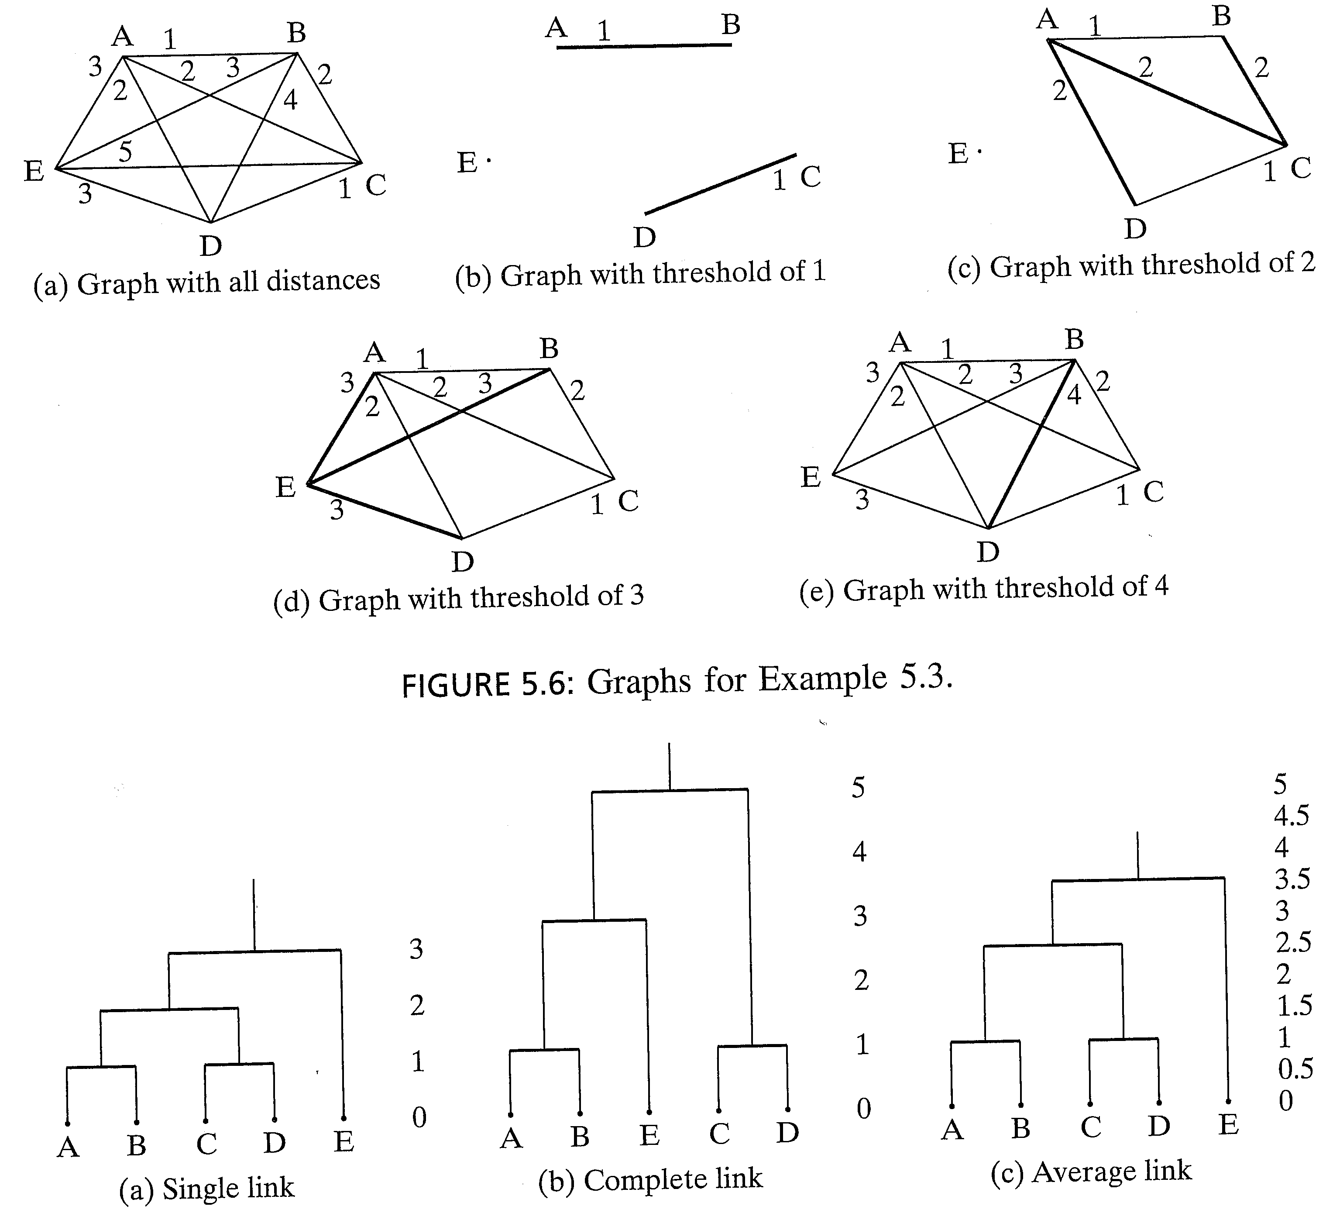
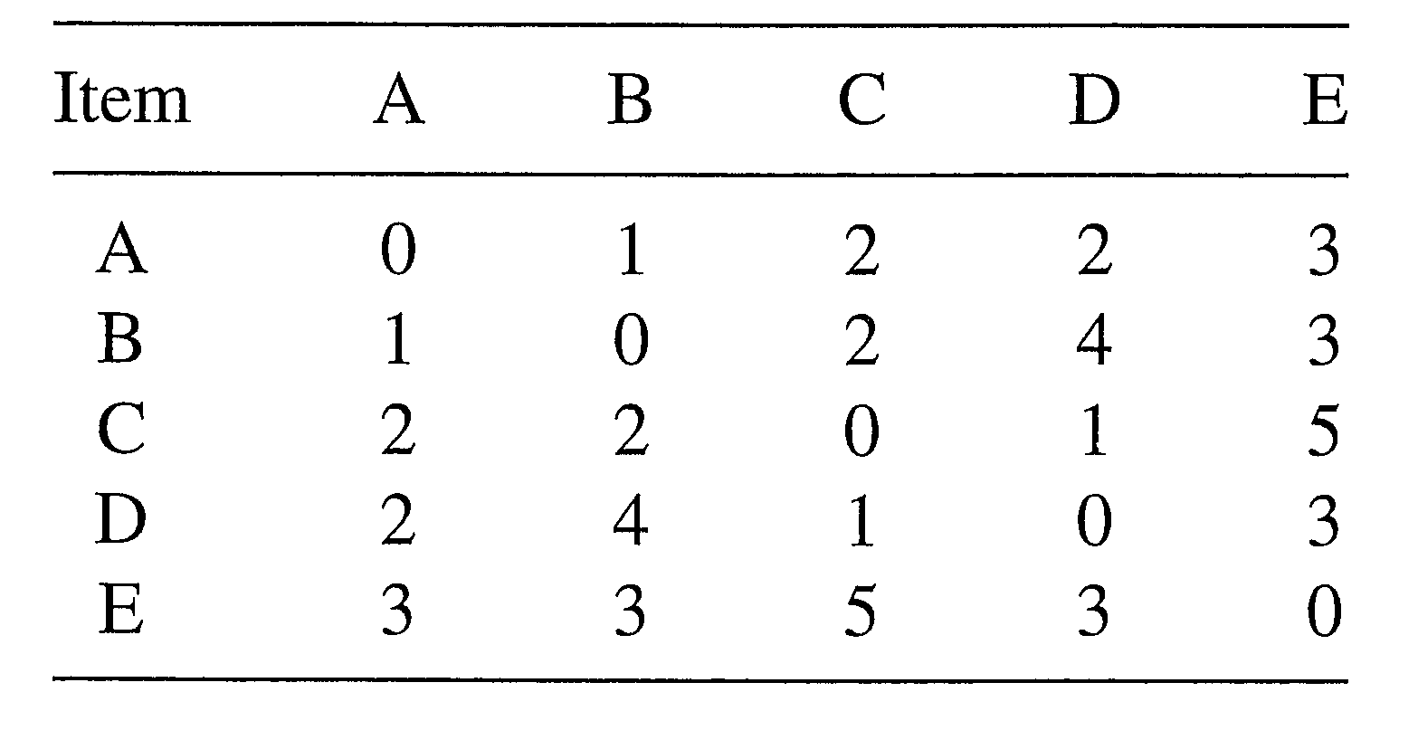
Dendrogram Representation
B
A
C
E
D
Standard HAC
Input is an adjacency matrix
Output can include a dendrogram which visually shows clusters and merge distance
Notes:
Nodes and adjacency matrix are not an exact match, but close enough to create the given dendrograms
The adjacency matrix is actually impossible since d(a,b) = 1, d(a.d) = 2 and d(b,d) = 4
Do sequential example, showing difference in cluster distance mechanisms for single and complete link (and one level of average)
Use picture first to decide clustering, then table to confirm and give dendrogram height, a program would just find min and max distances

Slide 8
Ward Linkage
Ward linkage measures variance of clusters. The distance between two clusters, A and B, is how much the sum of squares distance from each point to its centroid would increase if we merged them. Merge the two clusters with minimum increase.

Slide 9
HAC Linkage Comparisons
Single link – (nearest neighbor) can lead to long chained clusters where some points are quite far from each other
Complete link – (farthest neighbor) finds more compact clusters
Average link – Used less because have to re-compute the average each time
Ward linkage – Can often be the most suitable method for quantitative features
Once you have distances between clusters, always merge the closest clusters in terms of the distance
Notes:
Show that with single and complete still merge the same clusters

Slide 10
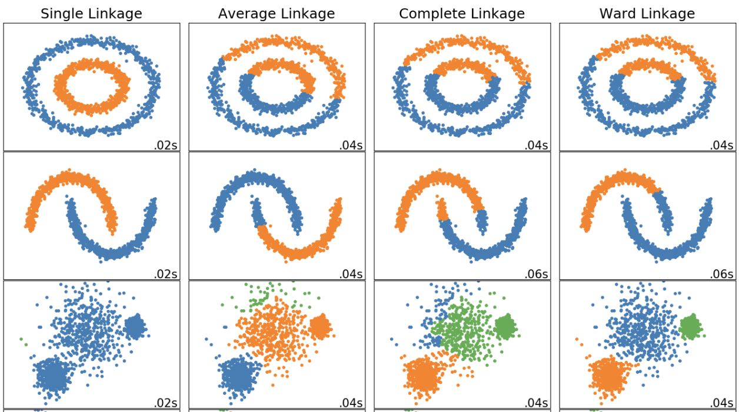
Linkage Methods
Notes:
Ward linkage: Instead of measuring the distance directly, it analyzes the variance of clusters. Ward’s is said to be the most suitable method for quantitative variables.
Ward’s method says that the distance between two clusters, A and B, is how much the sum of squares will increase when we merge them

Slide 11
HAC *Challenge Question*
For the data set below show 2 iterations (from 4 clusters until 2 clusters remain) for HAC complete link (furthest).
Repeat: Merge the 2 nearest clusters (using complete link distance)
Use Manhattan distance
Show the dendrogram, including properly labeled distances on the vertical-axis of the dendrogram
Pattern | x | y
a | .8 | .7
b | 0 | 0
c | 1 | 1
d | 4 | 4
Notes:
A joins C. Distance .2+.3 = .5 on dendrogram
Then b joins cluster (a, c) with distance 2 up from b on dendrogram
Then d joins with distance 8 up from bottom (d) of dendrogram

Slide 12
HAC Homework
For the data set below show all iterations (from 5 clusters until 1 cluster remaining) for HAC single link.
Show work
Use Manhattan distance
In case of ties go with the cluster containing the least alphabetical instance.
Show the dendrogram, including properly labeled distances on the vertical-axis of the dendrogram.
Pattern | x | y
a | .8 | .7
b | -.1 | .2
c | .9 | .8
d | 0 | .2
e | .2 | .1

Slide 13
HAC Summary
Complexity – Relatively expensive algorithm
n² space for the adjacency matrix
mn² time for the execution where m is the number of algorithm iterations, since we have to compute new distances at each iteration. m is usually ≈ n making the total time n³ (can be n²logn with priority queue for distance matrix, etc.)
All k (≈ n) clusterings returned in one run. No restart for different k values. Must then decide which clustering you want.
Divisive – Starts with all the data in one cluster
One approach is to compute the MST (minimum spanning tree - n² time since it’s a fully connected graph) and then divide the cluster at the tree edge with the largest distance – similar time complexity as HAC, different clusterings obtained
Could be more efficient than HAC if we want just a few clusters
Notes:
HAC needs to go through almost all n iterations since usually want a relatively small number of final clusters as compared to number of instances.
Or n^2log^2n if sort adjacency matrix and keep it sorted for next clustering
Connection based clustering

Slide 14
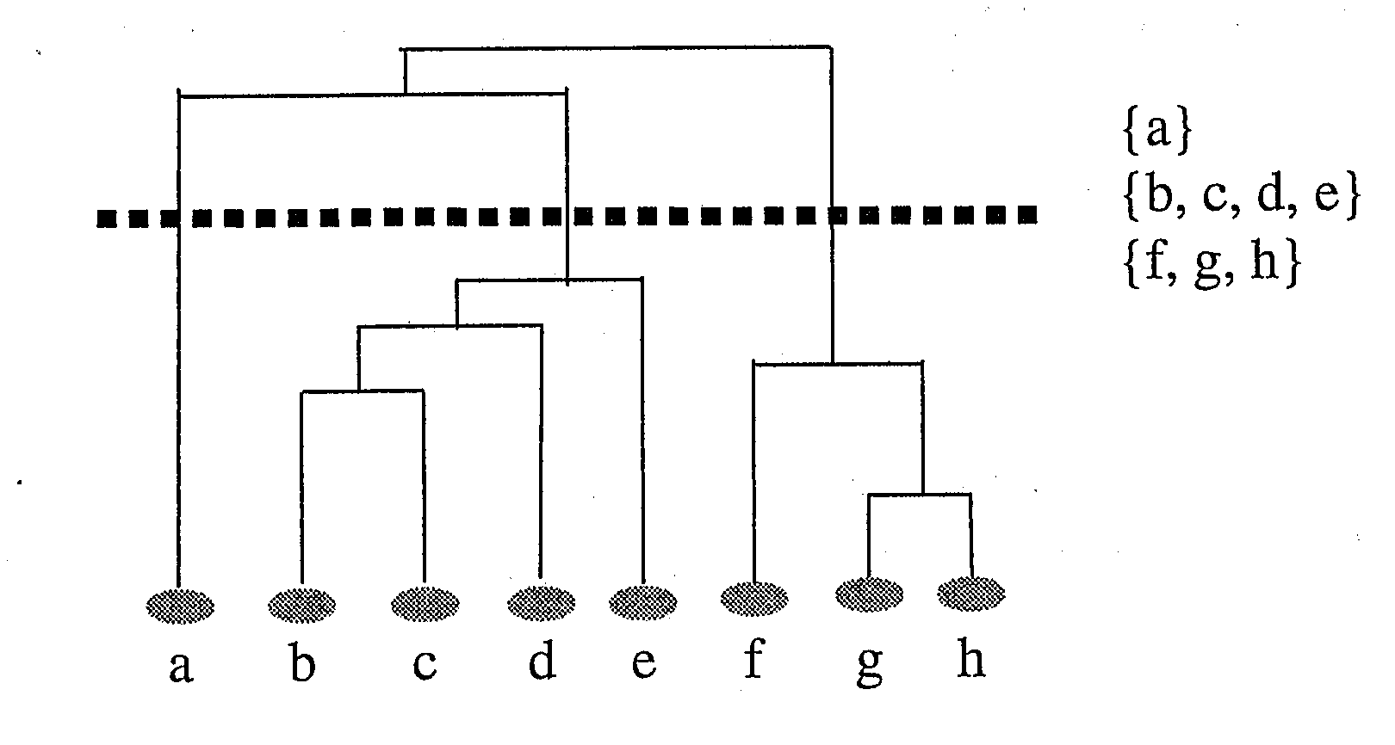
Which cluster level to choose?
Depends on goals
May know beforehand how many clusters you want - or at least a range (e.g. 2-10)
Could analyze the dendrogram and data after the full clustering to decide which subclustering level is most appropriate for the task at hand
Could use automated cluster validity metrics to help
Could do stopping criteria during clustering

Slide 15
Automated Clustering Scores
What would give us higher scores?

Slide 16
Cluster Validity Metrics - Compactness
One good goal is compactness – members of a cluster are all similar and close together
One measure of compactness of a cluster is the sum of squares distance from each point to its cluster centroid (aka SSE)
where c is the centroid of a cluster C, made up of instances X_{c}. Lower is better.
The overall compactness of a particular clustering is the sum of the compactness of the individual clusters
Gives us a numeric way to compare different clusterings by seeking clusterings which minimize the compactness metric
However, for compactness, what clustering is always best?
Notes:
Square the eulclidean distance (distance usually Euclidean)
One cluster per node. However, for a set k and just trying to compare different solutions with that k, then compactness would be a reasonable measure (e.g. k-means comparisons). Save this for k-means discussion.

Slide 17
Cluster Validity Metrics - Separability
Another good goal is separability – members of one cluster are sufficiently different from members of another cluster (cluster dissimilarity)
One measure of the separability of two clusters is their squared distance. The bigger the distance the better.
dist_{ij} = (c_{i} - c_{j})² where c_{i} and c_{j} are two cluster centroids
For a clustering which cluster distances should we compare?
Notes:
Note no square root on distance. Same ranking, just a normalization decision.
The cluster to which each cluster is closest

Slide 18
Cluster Validity Metrics - Separability
Another good goal is separability – members of one cluster are sufficiently different from members of another cluster (cluster dissimilarity)
One measure of the separability of two clusters is their squared distance. The bigger the distance the better.
dist_{ij} = (c_{i} - c_{j})² where c_{i} and c_{j} are two cluster centroids
For a clustering which cluster distances should we compare?
For each cluster we add in the distance to its closest neighbor cluster
We would like to find clusterings where separability is maximized
However, separability is usually maximized when there are are very few clusters
squared distance amplifies larger distances

Slide 19
Silhouette
We want techniques that find a balance between inter-cluster similarity and intra-cluster dissimilarity
Silhouette is one good popular approach
Scores any clustering with an arbitrary number of unique clusters. Clustering can come from any clustering algorithm.
a(i) = average dissimilarity of instance i to all other instances in the cluster to which i is assigned – Want it small
Dissimilarity could be Euclidian distance, etc.
b(i) = the smallest average dissimilarity of instance i to instances in other clusters – Want it large
b(i) is smallest for the best different cluster that i could be assigned to – the best cluster that you would move i to if needed
Notes:
Draw picture here with 3 clusters and show a(i) and b(i). Or just use the picture on the next slide

Slide 20
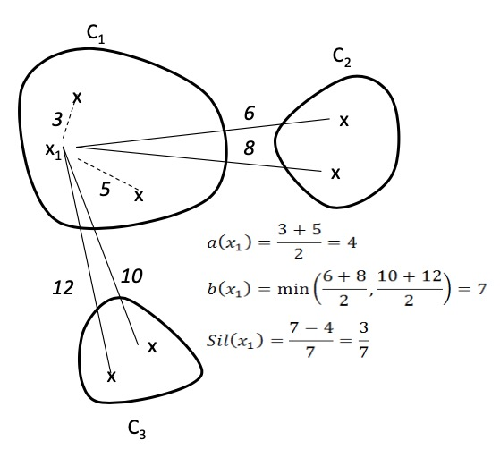
Silhouette
or 1– 4/7 = 3/7
Notes:
Use equation on right, more compact – almost always b(i) will be the max
S(i) = 0 if i is only instance in the cluster, else all nodes by themselves would maximize score
Use picture with 3 clusters to show points of .9, 0, and -.9
Can only be -1, only happens if b(i) = 0, if there is only one cluster

Slide 21
Silhouette
s(i) is close to one when “within” similarity is much smaller than smallest “between” similarity
s(i) is 0 when i is right on the border between two clusters
s(i) is negative when i probably belongs in another cluster
By definition, s(i) = 0 if it is the only node in the cluster
The quality of a single cluster can be measured by the average silhouette score of its members, (close to 1 is best)
The quality of a total clustering can be measured by the average silhouette score of all the instances
To find best clustering, compare total silhouette scores across clusterings with different k values and choose the highest
Notes:
Use equation on right, more compact – almost always b(i) will be the max
S(i) = 0 if i is only instance in the cluster, else all nodes by themselves would maximize score
Use picture with 3 clusters to show points of .9, 0, and -.9
Can only be -1, only happens if b(i) = 0, if there is only one cluster

Slide 22
Visualizing Silhouette
Width is quality of cluster, height is size of cluster
Dashed line is average silhouette score for clustering
Notes:
Why does cluster 1 hafe a higher score?
Would if there was a point right between. Would be 0 on one of them, or a mis-clustered point, would be negative
S(i) of point at left of 0 vs right of 0? (both same a(i) but different b(i)

Slide 23
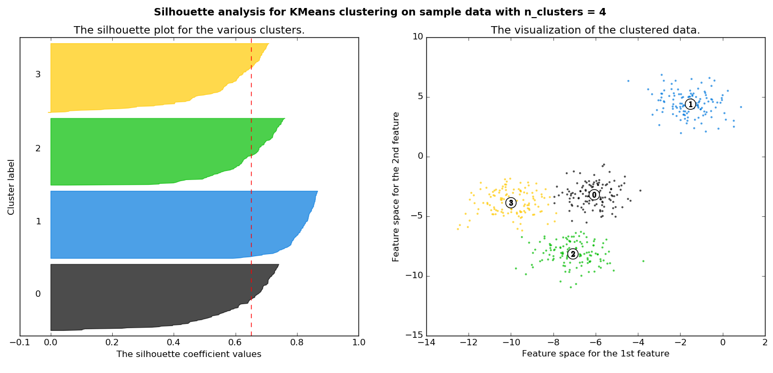
Notes:
Note width is quality of cluster, height is size of cluster
Could also use this to visualize quickly and maybe equal size clusters are important, etc.
Note for top cluster 0, the bottom points might be better included in cluster 2, thus there negative s scores. Cluster 0 not too happy
Whereas all clusters pretty good for k=4 and better overall score
Data would be impossible to see in greater dimensions, but silhouette still easy to visualize

Slide 24
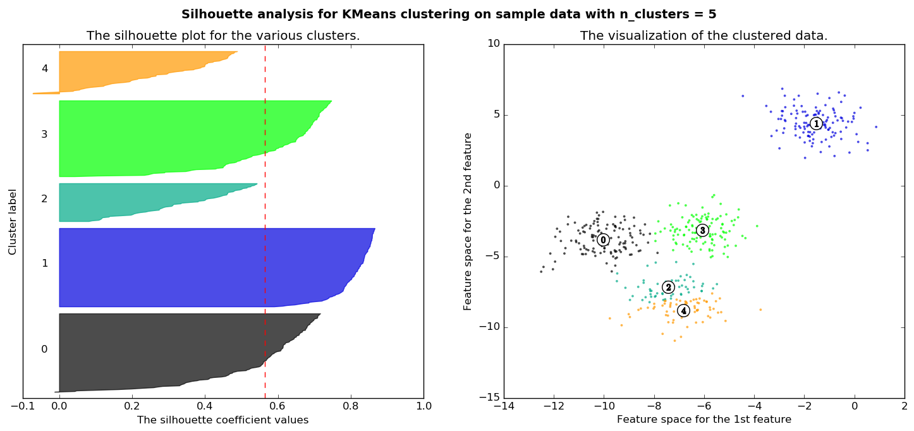
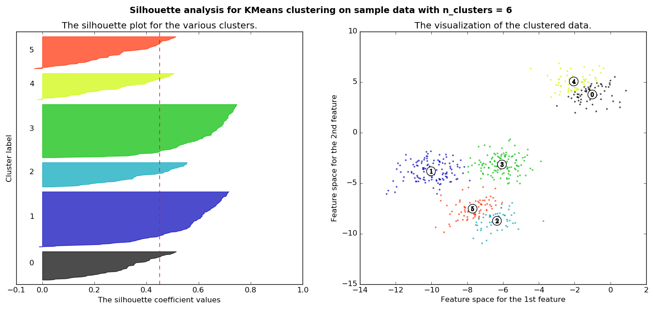
Notes:
Go back and argue which are best: k=2 and k=4. Choose two if just want best score, choose 4 if want fairly equal cluster size. Others are all worse,
Top clusters 4 and 2 are now losers

Slide 25
Silhouette
Best case graph for silhouette?
Notes:
Best case silhouette close to 1 (wide) but also having cluster sizes and number close to what you want. Not many small silhouette instances.
If two clusters are equidistant from i, then the one with the highest scatter (the worst case) will maximize ri. It will have typically higher scatter because of the larger squared distances from the centroid.
What might a plot of DB vs k look like?

Slide 26
Silhouette
Best case graph for silhouette?
Clusters are wide – Scores close to 1
Not many small silhouette instances
Depending on your goals:
Clusters are similar in size
Cluster size and/or number are close to what you want
Notes:
Best case silhouette close to 1 (wide) but also having cluster sizes and number close to what you want. Not many small silhouette instances.
If two clusters are equidistant from i, then the one with the highest scatter (the worst case) will maximize ri. It will have typically higher scatter because of the larger squared distances from the centroid.
What might a plot of DB vs k look like?

Slide 27
Silhouette
Could just use total silhouette average to decide best clustering but best to do silhouette analysis with a visualization tool and use score along with other aspects of the clustering
Cluster sizes
Number of clusters
Shape of clusters
Etc.
Note when task dimensions are > 3 (typical and no longer visualizable for us), silhouette graph still easy to visualize
O(n²) complexity due to b(i) computation
There are other cluster metrics out there
These metrics are rough guidelines and should be "taken with a grain of salt"
Notes:
Best case silhouette close to 1 (wide) but also having cluster sizes and number close to what you want. Not many small silhouette instances.
If two clusters are equidistant from i, then the one with the highest scatter (the worst case) will maximize ri. It will have typically higher scatter because of the larger squared distances from the centroid.
What might a plot of DB vs k look like?

Slide 28
Silhouette Homework
Assume a clustering with {a,b} in cluster 1 and {c,d,e} in cluster 2. What would the Silhouette score be for a) each instance, b) each cluster, and c) the entire clustering. d) Sketch the Silhouette visualization for this clustering. Use Manhattan distance for your distance calculations.
Pattern | x | y
a | .8 | .7
b | .9 | .8
c | .6 | .6
d | 0 | .2
e | .2 | .1

Slide 29
K-means
Perhaps the most well-known clustering algorithm
Partitioning algorithm
Must choose a k beforehand
Thus, typically try a spread of different k's (e.g. 2-10) and then compare results to see which made the best clustering
Could use cluster validity metrics (e.g. Silhouette) to help in the decision
Randomly choose k instances from the data set to be the initial k centroids
Repeat until no (or negligible) more changes occur
Group each instance with its closest centroid
Recalculate the centroid based on its new cluster
Time complexity is O(mkn) where m is # of iterations and space is O(n), both much better than HAC time and space (n³ and n²)
Notes:
Do an example on board with just 5 or 6 points, and k = 2 (with initial centroids at one end and close to each other), and then example on next slide
Centroid Based Clustering type

Slide 30
K-means Example

Slide 31
K-means Continued
Type of EM (Expectation-Maximization) algorithm, Gradient descent
Can struggle with local minima, unlucky random initial centroids, and outliers
K-medoids finds medoid (median) centers rather than average centers and is thus less effected by outliers
Local minima, empty clusters: Can just re-run with different initial centroids
Could compare different solutions for a specific k value by seeing which clusterings minimize the overall SSE to the cluster centers (i.e. compactness), or use silhouette, etc.
And test solutions with different k values using Silhouette or other metric
Can do further refinement of HAC results using any k centroids from HAC as starting centroids for k-means
Notes:
Incremental update of centroids can be better
Bisecting K-means as a divisive hierarchical variation
PAM – Partitioning around Medoids – Most common K-medoid algorithm – Pick K medoids, cluster, try all swaps for improved closeness, recluster and repeat until convergence
Clara (Clustering LARge Applications) – Sample q times, do PAM (or other?) on sample, take clustering with best similarity, Speed/quality tradeoff in sample size, slows with more clusters k (PAM swaps are k*n)
Clarans – Randomized serial search. Local search. Each node is set of possible optimal medoids (size k), Each neighbor in graph differs by one object, only move if improve k(n-k) neighbors, since local minima, try multiple times and take best
GA approaches – Genome made up of possible medoids
Distribution based clustering – Mixture of Gaussians, must choose distribution, local minima, susceptible to overfit
Density Based clustering – High density regions separated by low density regions (outliers), DBSCAN – connection based but only for points in density – enhancements – OPTICS (global vigilance, hierarchy), De-Li-Clu, can struggle with continues density gradients
BIRCH – Tree rep with each node a cluster needing simple info (e.g. centroid), to compare/merge with other clusters, all in memory. but must supply a cluster distance threshold T, too low leads to rebuilds and automatically bigger T values, (better than too high, can just start at 0 – is global vigilance) until fits in memory, thus T decided by memory size rather than cluster needs, which is odd (along with global vigilance problem), but some of the ideas are reasonable.

Slide 32
** K-means Challenge Question **
For the data below, show the centroid values and which instances are closest to each centroid after centroid calculation for two iterations of K-means using Manhattan distance
By 2 iterations I mean 2 centroid changes after the initial centroids
Assume k = 2 and that the first two instances are the initial centroids
Pattern | x | y
a | 3 | 1
b | 4 | 0
c | 0 | 0
d | 0 | 1
Iteration | Centroid 1 and instances | Centroid 2 and instances
0
1
2
Repeat until no more changes occur
Group each instance with its closest centroid
Recalculate the centroid based on its new cluster

Slide 33
** K-means Challenge Question **
For the data below, show the centroid values and which instances are closest to each centroid after centroid calculation for two iterations of K-means using Manhattan distance
By 2 iterations I mean 2 centroid changes after the initial centroids
Assume k = 2 and that the first two instances are the initial centroids
Pattern | x | y
a | 3 | 1
b | 4 | 0
c | 0 | 0
d | 0 | 1
Iteration | Centroid 1 and instances | Centroid 2 and instances
0 | 3, 1 {a, c, d} | 4, 0 {b}
1 | 1, 2/3 {c, d} | 4, 0 {a, b}
2 | 0, .5 {c, d} | 3.5, .5 {a, b}
3 | 0, .5 {c, d} | 3.5, .5 {a, b}

Slide 34
K-means Homework
For the data below, show the centroid values and which instances are closest to each centroid after centroid calculation for two iterations of K-means using Manhattan distance
By 2 iterations I mean 2 centroid changes after the initial centroids
Assume k = 2 and that the first two instances are the initial centroids
Pattern | x | y
a | .9 | .8
b | .2 | .2
c | .7 | .6
d | -.1 | -.6
e | .5 | .5

Slide 35
Other Unsupervised Models
Vector Quantization – Discretize into codebooks
K-medoids
Conceptual Clustering (Symbolic AI) – Cobweb, Classit, etc.
Incremental vs Batch
Density based clustering, DBSCAN, OPTICS
Outlier detection models
Special models for large data bases – n² space?, disk I/O
Sampling – Bring in enough data to fill memory and then cluster
Once initial prototypes found, can iteratively bring in more data to adjust/fine-tune current prototypes as desired
Linear algorithms
Notes:
RCE nets?
Incremental update of centroids can be better
Bisecting K-means as a divisive hierarchical variation
PAM – Partitioning around Medoids – Most common K-medoid algorithm – Pick K medoids, cluster, try all swaps for improved closeness, recluster and repeat until convergence
Clara (Clustering LARge Applications) – Sample q times, do PAM (or other?) on sample, take clustering with best similarity, Speed/quality tradeoff in sample size, slows with more clusters k (PAM swaps are k*n)
Clarans – Randomized serial search. Local search. Each node is set of possible optimal medoids (size k), Each neighbor in graph differs by one object, only move if improve k(n-k) neighbors, since local minima, try multiple times and take best
GA approaches – Genome made up of possible medoids
Distribution based clustering – Mixture of Gaussians, must choose distribution, local minima, susceptible to overfit
Density Based clustering – High density regions separated by low density regions (outliers), DBSCAN – connection based but only for points in density – enhancements – OPTICS (global vigilance, hierarchy), De-Li-Clu, can struggle with continues density gradients
BIRCH – Tree rep with each node a cluster needing simple info (e.g. centroid), to compare/merge with other clusters, all in memory. but must supply a cluster distance threshold T, too low leads to rebuilds and automatically bigger T values, (better than too high, can just start at 0 – is global vigilance) until fits in memory, thus T decided by memory size rather than cluster needs, which is odd (along with global vigilance problem), but some of the ideas are reasonable.

Slide 36
Semi-Supervised Learning Examples
Combine labeled and unlabeled data with assumptions about typical
data to find better solutions than just using the labeled data
Notes:
Already mentioned. Brief. Lots of ways to gain advantage

Slide 37
Summary
Standard clustering highly used
Can also use clustering as a discretization technique on continuous data for many other models which favor nominal or discretized data
Including supervised learning models (Decision trees, Naïve Bayes, etc.)
With so much (unlabeled) data out there, opportunities to do unsupervised learning are growing
Semi-Supervised learning is becoming very important
Use unlabeled data to augment the more limited labeled data to improve accuracy of a supervised learner
Deep Learning – Unsupervised training of early layers is an important approach in some deep learning models
Notes:
How Semi Supervised on board, couple + and – points with boundary, then add bunch of unlabeled points and show new boundary – Two ameobas
For deep mention MNIST example – reg single layer BP around 96%
FPGA deep BP 99.7%
Also big acc improvement when using unsupervised deep layers with image type problems (big picture with input, deep unsupervised feature discovery, supervised at top)
Self taught learning in deep learning (semi-supervised example)

Slide 38
Clustering Project
Last individual project

Slide 39
Neural Network Clustering
×
1
2
1
y
×
2
x
y
x
Single layer network
Bit like a chopped off RBF, where prototypes become adaptive output nodes
Arbitrary number of output nodes (cluster prototypes) – User defined
Locations of output nodes (prototypes) can be initialized randomly
Could set them at locations of random instances, etc.
Each node computes distance to the current instance
Competitive Learning style – winner takes all – closest node decides the cluster during execution
Closest node is also the node which usually adjusts during learning
Node adjusts slightly (learning rate) towards the current example
Notes:
At end of slide, walk through this situation

Slide 40
Neural Network Clustering
×
1
2
1
y
×
2
x
y
x
What would happen in this situation?
Could start with more nodes than probably needed and drop those that end up representing none or few instances
Could start them all in one spot – However…
Could dynamically add/delete nodes
Local vigilance threshold
Global vs local vigilance
Outliers

Slide 41
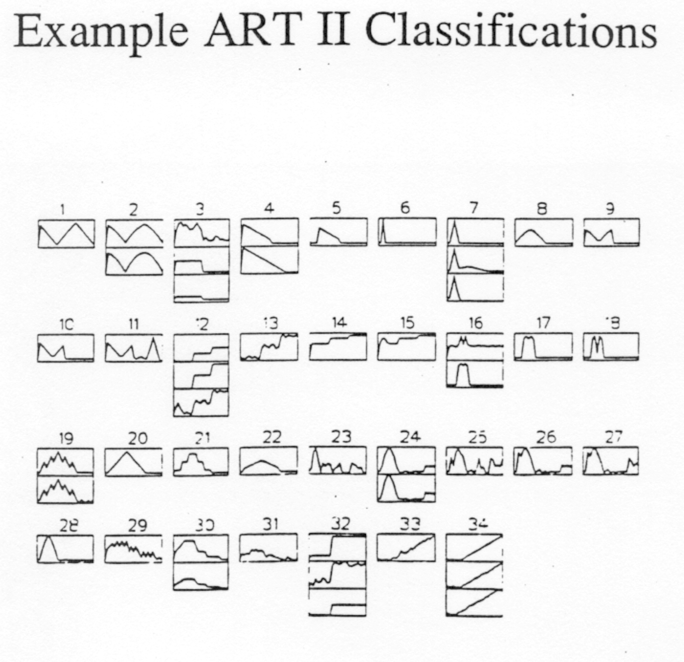
Example Clusterings with Vigilance
Notes:
Skip?

Slide 42
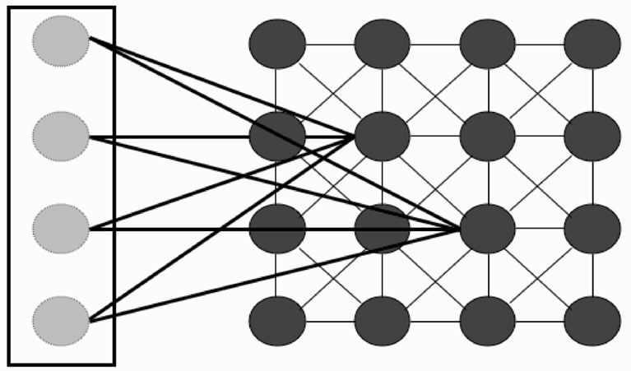
Self-Organizing Maps
Output nodes which are close to each other represent similar classes – Biological plausibility
Neighbors of winning node also update in the same direction (scaled by a learning rate), as the winner
Self organizes to a topological class map (e.g. vowel sounds)
Can interpolate, k value less critical, different 2 or 3-dimensional topologies

Slide 43
Association Analysis – Link Analysis
Used to discover relationships/rules in large databases
Relationships represented as association rules
Unsupervised learning, can give significant business advantages, and also good for many other large data areas: astronomy, etc.
One example is market basket analysis which seeks to understand more about what items are bought together
This can then lead to improved approaches for advertising, product placement, etc.
Example Association Rule: {Cereal} ⇒ {Milk}
Transaction ID and Info | Items Bought
1 and (who, when, etc.) | {Ice cream, milk, eggs, cereal}
2 | {Ice cream}
3 | {milk, cereal, sugar}
4 | {eggs, yogurt, sugar}
5 | {Ice cream, milk, cereal}
Notes:
Less obvious rules in very large DB can be great finds
Also have this in Data Mining. Decide where.

