Slide 1
P, NP, and NP-Complete
P – Polynomial class – Problems that can be solved in polynomial time
NP – Nondeterministic Polynomial – Problems for which we currently do not have a polynomial time solution
Except for the subset P of problems in NP
Might we find polynomial solutions for the all the problems in NP? If so P = NP.
We currently think that we won’t, but it has not yet been proven.
Notes:
What do P and NP stand for?
simple is n*2^n
Test: linear in number of literals
Could represent as binary tree. Search tree only better if we can prune, etc.
What is left after the w=0 test? (will see full tree next slide)
What is left after x=0 and x=1?
Where else might we be smart on search. Which variables higher in the tree

Slide 2
P, NP, and NP-Complete
Many problems have an exponential number of possibilities and we can test each option against some objective to see if it is a solution
This "testing" must be fast (polynomial) for the problem to be in NP
If not, then the problem is not in NP, and is in an even more complex class
SAT – Satisfiability: Does there exist a setting of Boolean variables which satisfies a particular CNF Boolean expression
Just test each of the 2^{n} possible settings of the Boolean variables – no known polynomial solution
However, testing if a particular setting of the variables satisfies the expression is fast (polynomial time). Thus, SAT is in NP.
The class NP are the set of problems where solutions can be verified in polynomial time – (which includes P)
Notes:
What do P and NP stand for?
simple is n*2^n
Test: linear in number of literals
Could represent as binary tree. Search tree only better if we can prune, etc.
What is left after the w=0 test? (will see full tree next slide)
What is left after x=0 and x=1?
Where else might we be smart on search. Which variables higher in the tree

Slide 3
P, NP, and NP-Complete
If we can always find a solution with a deterministic algorithm which only tests a polynomial number of the potentially exponential cases, then the problem is in P
If not, the problem is in NP and likely not in P, as P is a subset of NP
In many cases (Edit distance, longest increasing subsequence, etc.) we have been able to use smart algorithms (Greedy, DP, LP) to search a polynomial subset of the exponential possibilities to always get optimal solutions in polynomial time (class P)
For other tasks (TSP, ILP) there are no known polynomial solutions (in class NP, but not in P)
Notes:
P is a subset of NP, but we cheat a little here and use NP to refer to those in NP AND not in P
Review HW 9.3 at beginning or end of this lecture?
Not in NP, undecidable problems, eg Hatling Problem, also problems whose output is exponential
Or last problem we show of arbitrary polynomial seeking integer solution. For a solution that exists, we can return a yes fast. For an example that does not exist, we would not get a response, would not halt

Slide 4
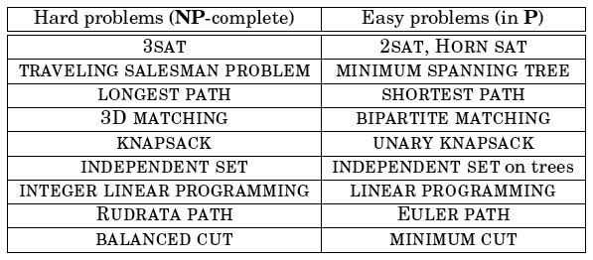
Examples of Problems in NP vs P
For problems in P we were able to find diverse algorithmic approaches to solve them efficiently with different complexities, but all within P
There is a consistency amongst the problems in NP (not not in P) which makes them all equally hard to solve
Notes:
Euler Path – Path with all edges exactly once, Rudrata all vertices
Balanced cut, at least 1/3 in each side
3D matching, match into groups of 3 (e.g. Boy, Girl, Pet)

Slide 5
Tasks as Search Problems
We can consider all these NP tasks as search problems
Given an instance I of the problem, can we find a solution S to I, or state that no solutions exists
I could be a CNF equation for SAT and S would be a particular variable setting
For NP search problems there must exist an efficient mechanism, C(I,S) which verifies if a particular variable setting S is a solution to I
Like we can do with SAT
However, for TSP (optimization problem) can we take a particular path and quickly state whether it is optimal or not?
Notes:
For optimizing TSP, can I ask "is S optimal?" - Not directly
Binary search on bounds which is just a polynomial increase
The algorithm does a binary search over all possible lengths of the optimal tour, going from 0 to the sum of all distances(or better LB is sum of smallest outgoing path from each city, and UB is sum of largest outgoing paths)
Note that binary search is necessary here and we can’t just increment the value of b by 1 each time since the sum of all distances is exponential in the size of n, the number of cities. Thus if D is max (sum of all edges in graph), then first test D/2, etc.

Slide 6
TSP as a Search Problem
For TSP I would be a city distribution, S a path, and b an arbitrary distance
A common way that TSP is presented is: For an instance I does there exist an S ≤ b (and if yes it returns S)
This makes it a yes/no search problem and is an NP problem as there is an easy test to see if any potential solution path S is ≤ b (just add up the path and see)
We can verify quickly if a path length is ≤ b but not if it is the optimal path
But for natural optimization problems like TSP we would rather just ask it to return the optimal path
We can show by a reduction that if a search version of an NP problem can be solved in polynomial time, then the optimization version can also. How?
Notes:
For optimizing TSP, can I ask "is S optimal?" - Not directly
Binary search on bounds which is just a polynomial increase
The algorithm does a binary search over all possible lengths of the optimal tour, going from 0 to the sum of all distances(or better LB is sum of smallest outgoing path from each city, and UB is sum of largest outgoing paths)
Note that binary search is necessary here and we can’t just increment the value of b by 1 each time since the sum of all distances is exponential in the size of n, the number of cities. Thus if D is max (sum of all edges in graph), then first test D/2, etc.

Slide 7
Tasks as Search Problems
Search version STSP: For an instance I does there exist S ≤ b
Optimization version OTSP: For an instance I return the optimal S
If somehow we knew the length L of the optimal path we could call STSP(I, L) and it would return yes and return the optimal path S, while STSP(I, L-1) would return no
OTSP can do a binary search using STSP to find the optimal path value with min and max of LB and UB for I
LB could be 0 or sum of smallest edges out of each node
UB could be sum of max edges out of each node
Start binary search with STSP(I, (UB-LB)/2)
In a logarithmic number of steps we will find the optimal path value and return the path
OTSP is O(STSP*log(UB-LB)) which is within polynomial of STSP
Notes:
For optimizing TSP, can I ask "is S optimal?" - Not directly
Binary search on bounds which is just a polynomial increase
The algorithm does a binary search over all possible lengths of the optimal tour, going from 0 to the sum of all distances(or better LB is sum of smallest outgoing path from each city, and UB is sum of largest outgoing paths)
Note that binary search is necessary here and we can’t just increment the value of b by 1 each time since the sum of all distances is exponential in the size of n, the number of cities. Thus if D is max (sum of all edges in graph), then first test D/2, etc.

Slide 8
P –Polynomial Time
Now we have the basis of a consistent search algorithm
Test each of the exponential cases to see if it is a solution
It is in NP if the test is polynomial time
If we have a deterministic algorithm which can make the decision by only testing a polynomial number of possibilities, then the task is in P (polynomial time)
P = Those problems which can be decided in polynomial time
Problems in P are efficient

Slide 9
NP – Non-Deterministic Polynomial Time
If we must test an exponential number of cases, then the task is in NP (Non-Deterministic Polynomial Time), but not P
Class NP are those problems that can be solved in polynomial time on a non-deterministic turing machine
A non-deterministic machine basically tries all alternatives in parallel, with the time complexity being equal to the longest path (always polynomial depth) in the potentially exponentially wide search tree
The class NP are those problems that can be tested/verified in polynomial time
Current deterministic implementations of non-deterministic machines require checking all possible solutions leading to exponential time complexity

Slide 10
P
P = problems that can be solved in
polynomial time on a deterministic
Turing Machine.

Slide 11
P, NP
P ⊆ NP, because every problem in P has a solution in NP
P = problems that can be solved in
polynomial time on a deterministic
Turing Machine.
NP = problems that can be solved in
polynomial time on a non-deterministic
Turing machine

Slide 12
Reductions Again
We only consider reductions that are polynomial time
If f and h are polynomial time operations (and have complexity ≤ B) then algorithm A will have the same complexity as algorithm B
We say A reduces to B
A problem is NP-Complete if all other problems in NP reduce to it
Notes:
Careful – not the other way around!

Slide 13
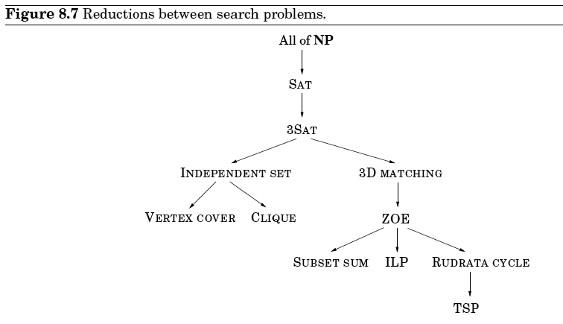
NP-Completeness
Thus if we can find a polynomial time solution to any of the NP-complete problems, then we can solve all of NP in polynomial time, and then P = NP!
Can SAT necessarily reduce to all other NP problems? No!
Notes:
Cook's Theorem - SAT
Not all problems in NP have been shown to be NP-complete – Most believe Factoring (though in NP) is not NP-complete
So even if I have no solution to SAT, if I can find a Polynomial solution to TSP, then all NP = P, show going though graph
If a problem can reduce to SAT does that make it NP-complete? No. All can reduce to SAT. but can SAT reduce to it? (Not always symmetric) Only those that all NP can reduce TO are in NP-complete.
All problems in NP can reduce to SAT. If had a P solution to the problem but SAT could not reduce to it, then still can’t use it to solve SAT.
ZOE – Zero One Equations, like ILP but binary
We've published some early ML proofs (best DT is NP-complete, etc.)
NP-Hard are all problems at least as hard as hardest problems in NP. Includes all NP-complete problems, but also problems harder than NP-Complete. A problem H is NP-hard when every problem L in NP can be reduced in polynomial time to H. Notice this is the same definition as NP-complete, except for NP-complete, problem must also be in NP. Thus NP-hard could include problems that cannot be tested in polynomial time. (e.g. Halting Problem)

Slide 14
Proving a Problem is NP-Complete
1. First prove that the problem is in NP
Show that any potential solution is verifiable in polynomial time
e.g. Does a certain setting of variables satisfy a SAT problem
This is why we showed that all NP optimization problems can be cast as search problems, in order to be verifiable
e.g. Is there a path less than b for some TSP problem
When we test a particular solution, we just add up the path and test if it is less than b. O(n) to verify!
2. Next, prove that all problems in NP can reduce to it
As in Cook's theorem for SAT
Usually easiest to show that a particular problem already in NP-complete reduces to it

Slide 15
Unsolvable Problems
There are problems in higher complexity classes than NP
Guaranteed exponential, super-exponential, etc.
List all possible paths in a TSP problem
List the power-set of all possible paths in a TSP problem, etc.
There is an even larger infinite class of unsolvable problems regardless of time available
For an arbitrary polynomial equation in many variables
x²yz³ + 3y²z – 4xy⁵z² = 7
Are there integer values of the variables which solve it? (x, y, and z in this case) A possible solution is easy to verify, but in general, how would we know when to stop looking for possible solutions?
Notes:
For polynomial, what is simple algorithm? Just try all combinations and stop when find one. But, infinite number of combinations, thus can't in general know when to stop searching.
Do group project review next. This is not decidable,. Will return an answer in finite time if solution exists, but if not will never halt. Thus not in NP.
Problems as Functions
Regularity vs Random
Also many regular problems that are not solvable: halting, etc.

