Slide 2
Personal Digital Preservation: Issues and Approaches
Randy Wilson
wilsonr@familysearch.org
RootsTech 2012

Slide 3
The Problem
How to preserve precious photos long-term?
Outline:
Issues
Standards
Arrangements
Face-tagging
Preservation
Open discussion

Slide 4
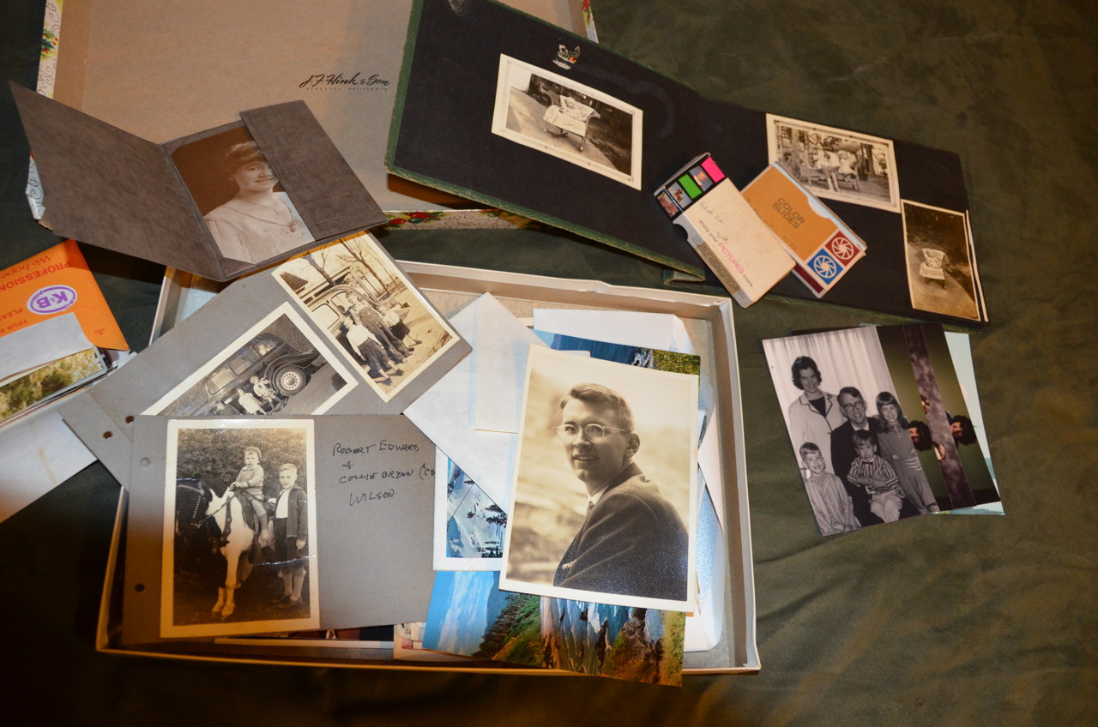
The Situation
We have photos
Shoe box
Slides
Negatives
Albums
Documents
We can scan them
Flatbed scanner
Slide scanner

Slide 5
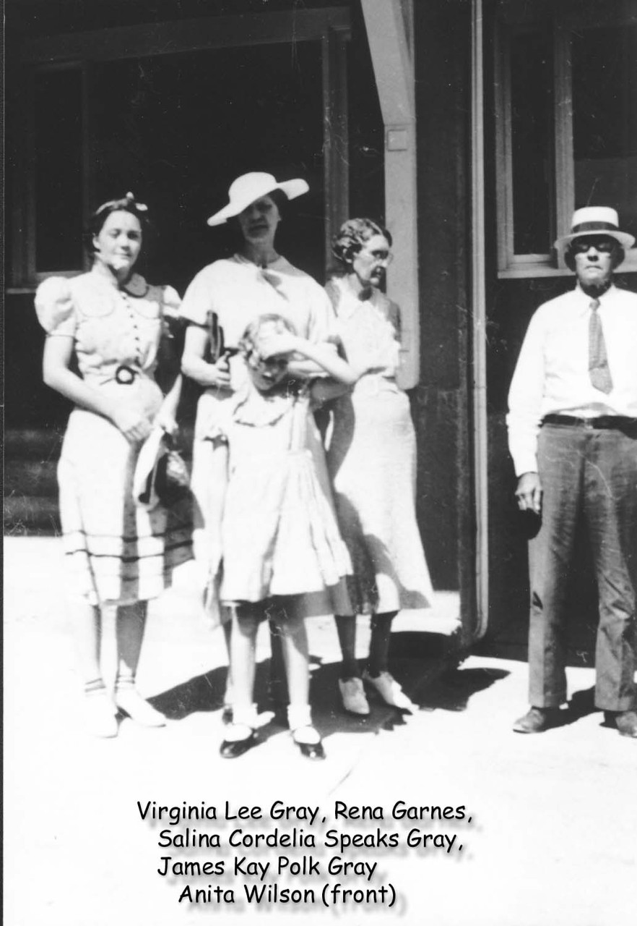
The Situation
We can identify faces
…but not all of them
…and face tags are still proprietary.

Slide 6
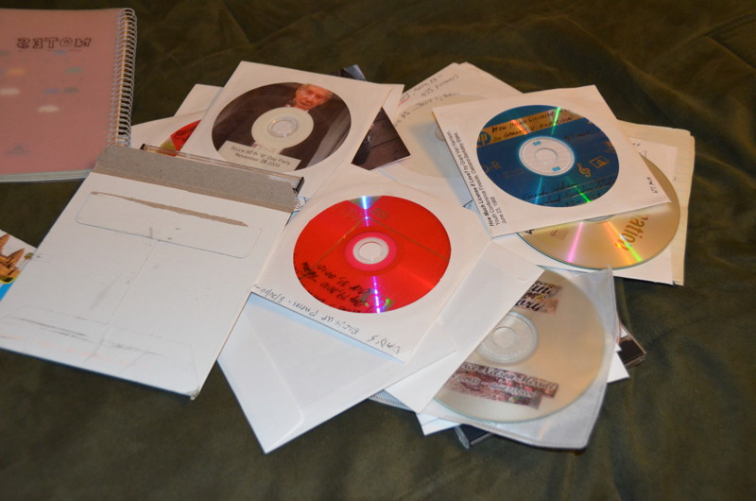
The Situation
We can share photos
DVD-ROM
Online
Facebook
Flickr
Picasa
Etc…
…but it is ad-hoc
…and short-lived.

Slide 7
The Situation
Organizing & arranging images is hard
We can remember how we found them;
OR we can rearrange them more nicely;
…but it is hard to do both, especially long-term.
Robert’s Slides
Wooden box
Slide 0001.tif
Slide 0002.tif
…
Small boxes
Box 1966A
Slide 0001.tif
Slide 0002.tif
Box 1966B
…

Slide 8
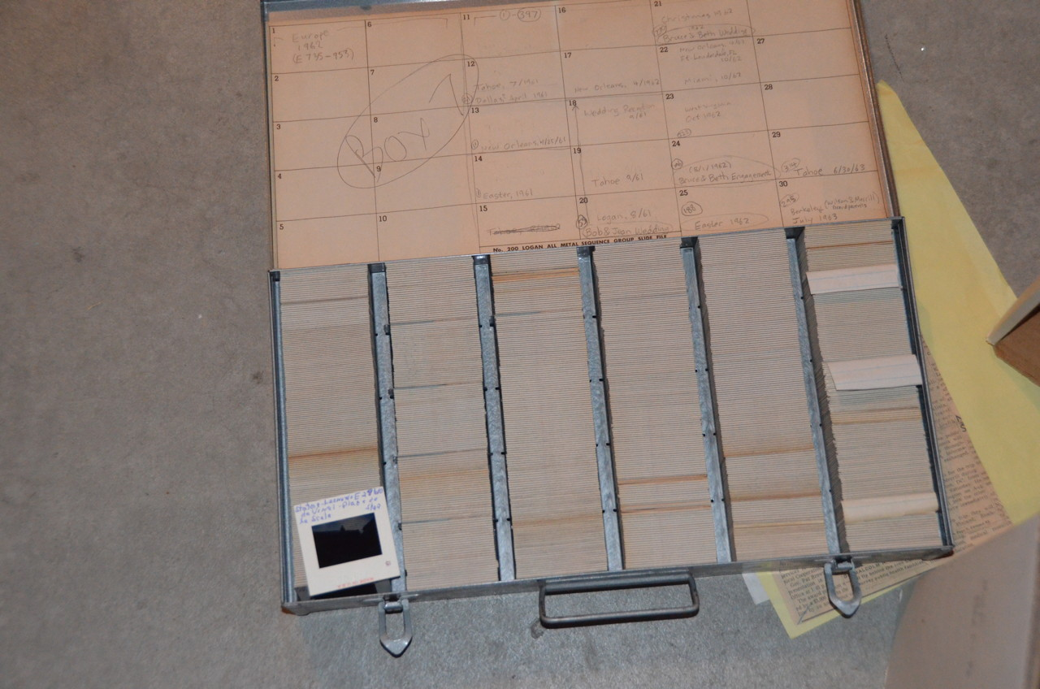

Slide 9
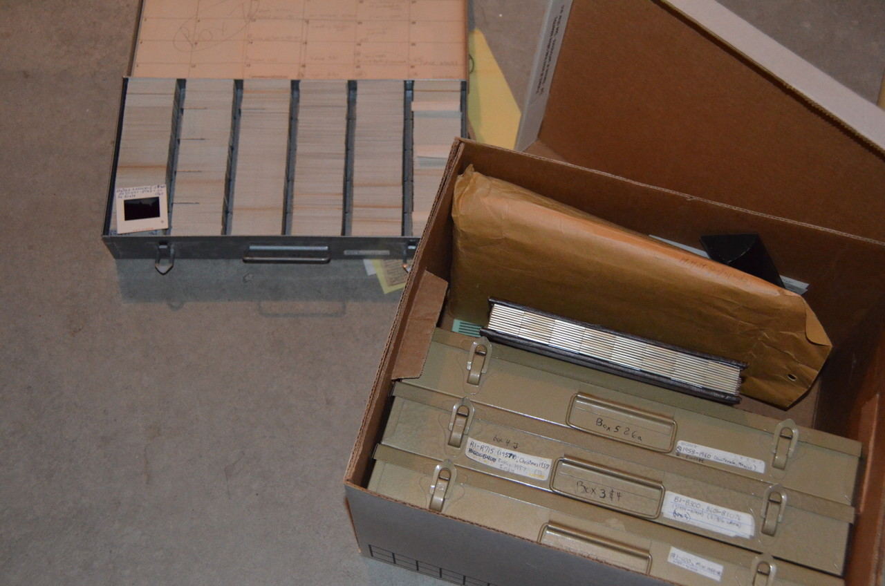

Slide 10
Images and “Artifacts”
Physical Artifacts
Photograph
Document
Journal
Cassette tape
Movie Reel
Digital Artifacts
Image
TIFF, JPEG, PDF…
Audio
MP3, WAV…
Video
MOV, AVI, DV…

Slide 11
Archival Principles
http://en.wikipedia.org/wiki/Archival_processing
Respect de Fonds (Collections/grouping)
Respect for Original Order
Remember the grouping and ordering.
Context preserves meaning and thus the value.
Groups have similar people, time, place.
Order preserves time, logical groups.

Slide 12
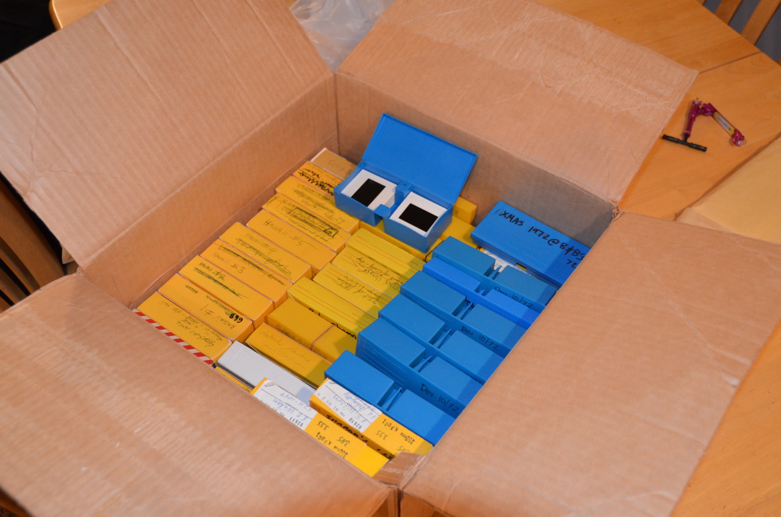

Slide 13
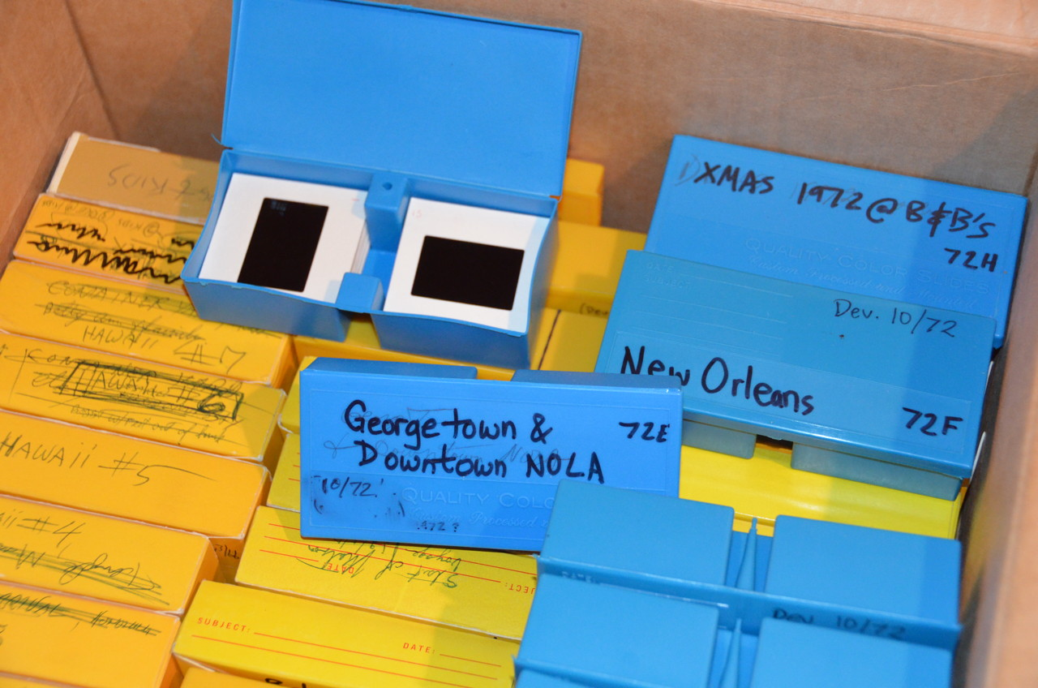

Slide 14
Physical and Logical Arrangements
Physical Arrangement
Logical Arrangement
Box 00037
1959.08a - Family gathering
Box 00038
1959.08b - Trip to Hawaii
Box 00039
Notes:
Physical arrangement: Remembers context about how images were originally created (e.g., sequentially on a single camera).
Logical arrangement: More useful. Can introduce context based on your knowledge that will be useful to others later.
Sometimes physical arrangement has been lost (e.g., jumble of photos in shoe box). You don’t have to preserve arbitrary physical arrangements that are clearly not helpful.

Slide 15
Embedded Arrangement Tags
Embed physical “path” in image metadata, for use when needed.
As single directory path.
path=“myattic.org/wilsonr/03-MHM/02-Slide_Boxes/Box_07/A0327.tif”
As nested XML, with “sortKey”
<collection title=“Randy’s Photos” uri=“https://myattic.org/ark:12345/047”>
<collection title=“Malcolm’s Slides” uri = “https://myattic.org/ark:12345/A7634D8-87” sortKey=“03-MHM”>
<arrangement uri=“https://myattic.org/ark:12345/B76FR28” sortKey=“02-Slide_Boxes”>
<collection uri=“https://myattic.org/ark:12345/F76R56E-34” sortKey=“Box_07”>
<collection uri=“https://myattic.org/ark:12345/H32R56E-34” sortKey=“A0327”>
Can reconstruct arrangement from subset of images.
Need a standard for portability and longevity of arrangements.

Slide 16
Importance of Standards
Standards needed for
Interoperability
Do work using one tool
Migrate to another when needed
Work is not lost
Longevity
A proprietary solution only lasts as long as that system.
Notes:
Critical mass: when many tools use a standard, it is more valuable for many users, which makes it more attractive to write tools that use it, and so on.

Slide 17
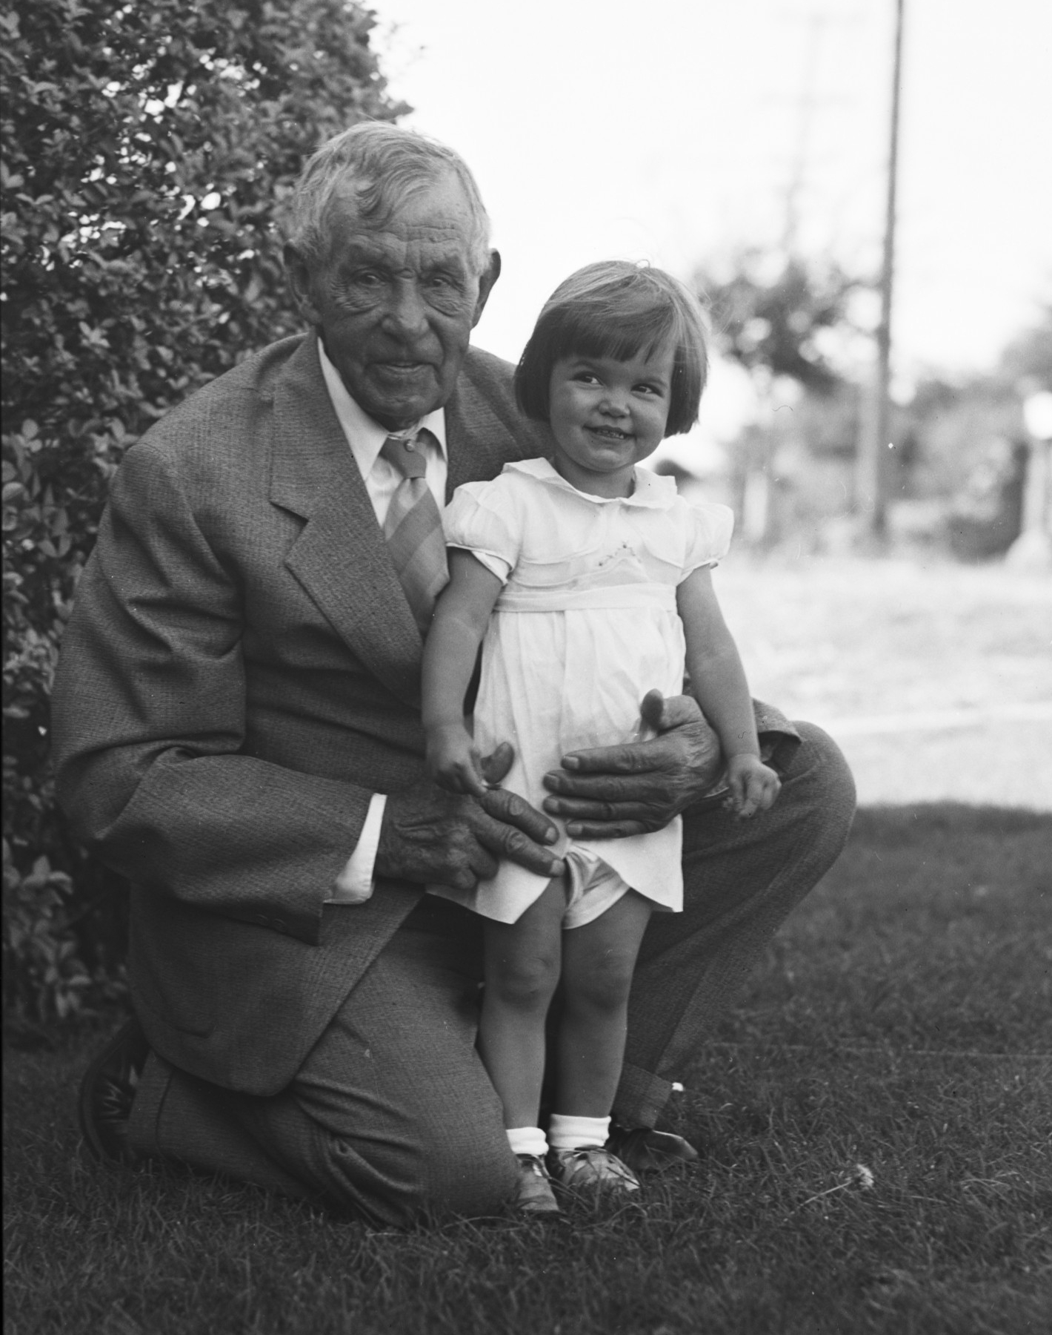
Face Tagging
Old photos can be:
Priceless treasures
or
Worthless rubbish
Depending on if you know who it is.

Slide 18
Face Tagging
Names are nice:
Thomas Teancum Holdaway,
Thelma Jean Merrill
But ambiguous in a group photo

Slide 19
Face Tagging
Face tags are better
You know which name goes with which person.
Thomas
Teancum
Holdaway
Thelma
Jean
Merrill

Slide 20
Face Tagging
Face tagging systems
Facebook
Picasa
iPhoto
Photoshop
Flickr
Photoloom
Mundia
1000memories.com
Myheritage
Heritagecollector
etc…
Thomas
Teancum
Holdaway
Thelma
Jean
Merrill

Slide 21
Face Tagging
Face tagging systems
Facebook
Picasa
iPhoto
Photoshop
Flickr
Photoloom
Mundia
1000memories.com
Myheritage
Heritagecollector
etc…
Face recognition
Face clusters
Name vs. Entity
Facebook user
Ancestor in tree
External IDs

Slide 22
Face Tagging Standard
Metadata Working Group (MWG)
Extension to Adobe XMP
V2.0: November 2010, includes:
Image regions (i.e., face tags)
Hierarchical keywords
Image collections
Notes:
I don’t know know which, if any, of the face-tagging solutions support this standard

Slide 23
MWG Face Tag Standard
Define region as one of:
Rectangle (center, w, h)
Circle (center, radius)
Point
using relative coordinates (0..1).
Store original width and height
Notes:
Radius of circle specified in relative (0..1) coordinates using minimum direction of width and height of the image.

Slide 24
MWG Face Tag: Handling Edits
Scaling
=>Use normalized (0..1) coordinates
Rotation
=> Compliant “changers” rotate regions
Cropping
Shift regions
Shrink and shift regions that are partially cropped.
Drop regions whose center is cropped
Notes:
Radius of circle specified in relative (0..1) coordinates using minimum direction of width and height of the image.

Slide 25
Adopting face-tagging standard
Metadata Working Group Image Regions
No known adopters yet
A few adopters would allow users to begin, with hope of future portability.
Notes:
A few adopters => critical mass.

Slide 26
External Identifiers
Need extension to handle external identifiers.
Type: rdf-style URI
Facebook User
FamilySearch Ancestor
Photoloom Person
Identifier: URI, usually URL
Notes:
Radius of circle specified in relative (0..1) coordinates using minimum direction of width and height of the image.

Slide 27
External Identifiers
Facebook
Jean Wilson
new.familysearch.org
Thelma Jean Merrill
Thomas
Teancum
Holdaway
Thelma
Jean
Merrill
Thomas Teancum Holdaway
Thelma Myrl Holdaway
Mary Eliza White
photoloom.com
Thelma Jean Merrill
Thomas T. Holdaway
Thelma M. Holdaway
Notes:
Radius of circle specified in relative (0..1) coordinates using minimum direction of width and height of the image.

Slide 28
Preservation Challenges
Hard drive crash, fire, theft => backups
Media degrades (CD-ROM)=>M-DISC
Obsolete media (5.25” floppies, Zip drive)
Obsolete data formats (EBCDIC) => migrate
Companies go out of business
Proprietary formats hard to migrate
Dead men don’t pay subscription fees
Ignorance.
Apathy.
Notes:
Your kids might wipe your hard drive before donating your computer to a charity. Journals thrown out. I rescued grandfather’s 20,000 slides.
M-DISC provides permanent DVDs. LG Blu-ray/M-DISC burner at newegg.com for $87. M-Discs are $3 each online.

Slide 29
Preservation Approaches
Benevolent Organization
Non-profit (e.g., FamilySearch, Internet Archive)
Free (e.g., 1000memories), but long-term.
Prepaid service
May need to be backed by “benevolent org.”
Lots of distributed copies
Share with relatives, several online services
Unique IDs (URIs) allow sharing of metadata and avoid duplication.
Embedded metadata preserves collection info.
(LOCKSS—Lots of Copies Keeps Stuff Safe)
Notes:
Your kids might wipe your hard drive before donating your computer to a charity. Journals thrown out. I rescued grandfather’s 20,000 slides.

Slide 30
Long-lived Links
Links Break
Change path
https://blah.org/v1/books/herman/Grumpy_Dog
https://blah.org/v2/titles/124583
=> Design paths carefully,
=> Use opaque identifiers
Change domain
https://blah.org/ark:/12345/PV7342_34
https://next.com/swiped/ark:/12345/PV7342_34
=> Can use “resolver” with long-lived part.
Notes:
Your kids might wipe your hard drive before donating your computer to a charity. Journals thrown out. I rescued grandfather’s 20,000 slides.

Slide 31
Sharing
Ad-hoc sharing
DVD-ROM, E-mail, Web sites
Subset of images, often low resolution
No face tags, arrangement info
Embedded metadata
Face tags with external identifiers
Help you discover photos of people you care about, and related photos from there.
Physical and logical arrangement info/context

Slide 32
Summary
Organizing, arranging, tagging, preserving, and sharing photos is important to many people.
Wide adoption of XMP/MWG face tagging
Define standards for
External IDs on face tags
Physical and logical arrangements
Unique identifiers embedded in images
Long-term free or prepaid service; or distributed storage of many copies
Notes:
Your kids might wipe your hard drive before donating your computer to a charity. Journals thrown out. I rescued grandfather’s 20,000 slides.

Slide 33
Randy Wilson
wilsonr@familysearch.org

