Slide 2
Date Range Propagation in Genealogical Databases
Randy Wilson
wilsonr@familysearch.org
Family History Technology Workshop
(FHTW 2012)

Slide 3
Different snapshots
Robert Jones, b. 1820
Bob Jones, m. 1860 to Mary Lee
Rob Jones, d. 1810
Notes:
In genealogy, we attempt to discover what was really true about a real person. But we have to do this using “snapshots” of information about the person from various sources. We don’t even always know when the sources are talking about the same person. And each source sometimes contains a different set of information about the person. But often we can use what is there to infer reasonable ranges for what is not.

Slide 4
Inferring Missing Data
Robert Jones, b. 1820
=> m. 1835..1890; d. 1820-1917
Bob Jones, m. 1860 to Mary Lee
=> b. 1790..1845; d. 1860-1930
Rob Jones, d. 1810
=> b. 1720..1810; m. 1740..1810

Slide 5
Uses for date propagation
Matching
Are these the same real person?
Searching
Which results are reasonable?
Living calculation
Could this person still be alive?

Slide 6
Problem definition
G = Relationship graph
n = Number of persons, p₁..p_{n}.
Person p_{i} has:
Gender={male, female, unknown}
Relatives:
Father
Person
Child
Spouse
Mother

Slide 7
Deriving Deltas
5-D array of cases from 15M people
Target event: birth, marriage, death (single), death (married)
Relative type: individual, father, mother, spouse, child.
Source event: birth, christening, marriage, death/burial, other.
Gender: male, female, either/unknown
Exactness: specific (3 Jan 1820), year-only.
Notes:
“other”=any event indicating the person was alive.
“year-only” includes “about”
burial ignored when there is a death event.

Slide 8
delta(birth, ind, marriage, {m,f}, exact)

Slide 9
Delta(birth, spouse, birth, male, exact)

Slide 10
Delta(death, ind, birth, male, exact)

Slide 11
Drop outliers
Drop top and bottom 1% => 98%
delta(birth, individual, marriage, male, specific)=17..63
delta(birth, individual, marriage, female, specific)=14..52
Notes:
I don’t know know which, if any, of the face-tagging solutions support this standard

Slide 12
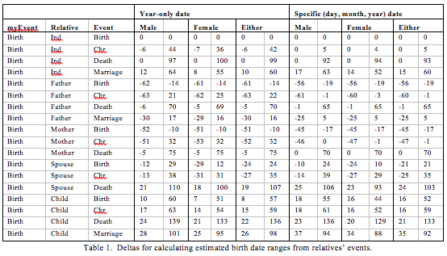
Delta tables
Notes:
I don’t know know which, if any, of the face-tagging solutions support this standard

Slide 13
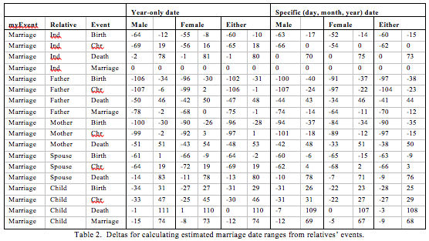
Delta tables
Notes:
I don’t know know which, if any, of the face-tagging solutions support this standard

Slide 14
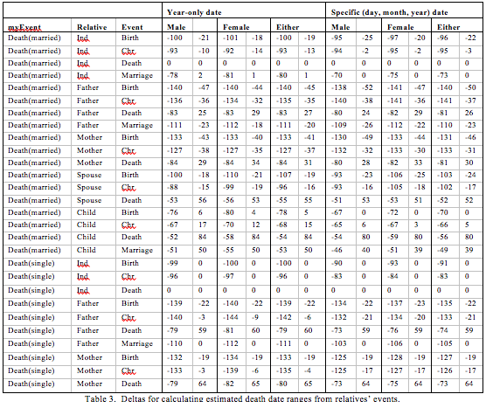
Notes:
I don’t know know which, if any, of the face-tagging solutions support this standard

Slide 15
Calculating ranges
From year and delta:
range.min = eventYear - delta.max
range.max = eventYear - delta.min
Father death= 1800
Delta = -1..65
=> Birth = 1800-65..1800-(-1)
= 1735..1801
Notes:
Radius of circle specified in relative (0..1) coordinates using minimum direction of width and height of the image.

Slide 16
Calculating ranges
From range and delta:
range.min = eventRange.min - delta.max
range.max = eventRange.max - delta.min
Father death= 1800..1820
Delta = -1..65
=> Birth = 1800-65..1820-(-1)
= 1735..1821
Notes:
Radius of circle specified in relative (0..1) coordinates using minimum direction of width and height of the image.

Slide 17
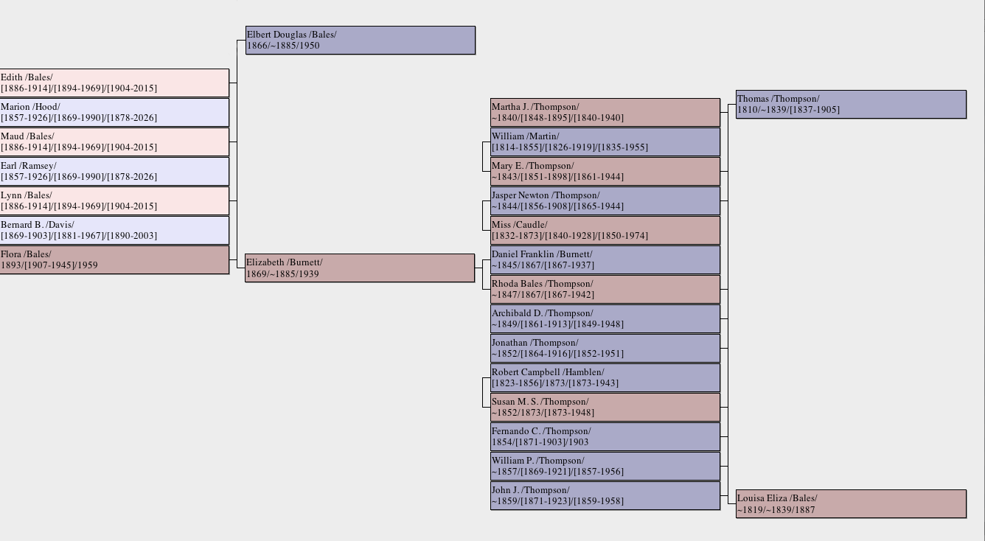
Iterating over generations
Notes:
Radius of circle specified in relative (0..1) coordinates using minimum direction of width and height of the image.

Slide 18
Combining evidence: Intersecting Ranges
From range and delta:
range.min = max(range_{i}.min)
range.max = min(range_{i}.max)
1760
1830
1790
1850
1770
1860
1795
1830
Notes:
Radius of circle specified in relative (0..1) coordinates using minimum direction of width and height of the image.

Slide 19
Ignoring Conflicting Data: Voting
1960
1835
1855
1745
1760
1830
1850
1790
1770
1860
1795
1830
1855..1860

Slide 20
Uses of date propagation
Person matching
“Reasonable” search results
Living calculation
Propagate ranges to everyone.
Latest death year from own death year or (latest birth year + 110)
(Latest death year) < now => dead.
Notes:
Radius of circle specified in relative (0..1) coordinates using minimum direction of width and height of the image.

Slide 21
Evaluating Living Calculation
Prune graph at 1900
Remove events after 1900
Remember death events
Remove people, spouses, descendants born after 1900
Do date propagation
Compare “estimated living” vs. known death dates

Slide 22
Evaluating Living Calculation
Estimated and actual death year both before 1900 => "correct dead"
Estimated and actual death year both after 1900 => "correct living"
Estimated death year < 1900, actual > 1900 => "false dead" / "leaked living data"
Estimated death year > 1900, actual < 1900 => "false living" / "(unnecessarily) hidden data"

Slide 23
Empirical Results
 | Year Propagation |  | Range Propagation
 | count | percent | count | percent
Correct dead | 1492 | 26.69% | 1517 | 27.14%
Correct living | 3458 | 61.86% | 3194 | 57.14%
False dead (“Leaked living”) | 36 | 0.64% | 11 | 0.20%
False living (“Hidden dead”) | 604 | 10.81% | 868 | 15.53%
Notes:
Radius of circle specified in relative (0..1) coordinates using minimum direction of width and height of the image.

Slide 24
Future Research
Larger sample size.
Propagate probability distributions
±100-year counts per range.
Use convolution
Renormalize after each iteration
Trim ranges at the end.
Notes:
Radius of circle specified in relative (0..1) coordinates using minimum direction of width and height of the image.

Slide 26
Randy Wilson
wilsonr@familysearch.org

