Slide 1
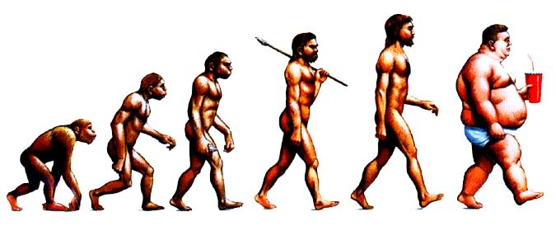
Genetic Programming
Robert Stromberg
CS778

Slide 2
Outline
Genetics, biology, and evolution
Genetic algorithms
Overview of GP
Details
Example
Applications
Advanced GP
Future work

Slide 3
Evolutionary computation (EC) technique that automatically solves problems without requiring the user to know or specify the form or structure of the solution in advance.
Systematic, domain-independent method for getting computers to solve problems automatically starting from a high-level statement of what needs to be done.

Slide 4
DNA
Notes:
Somatic cells – everything but gametes (sex cells)
Where is DNA located?
Central dogma of microbiology

Slide 5
DNA
Genetic code
3 x 10⁹ base pairs
2m DNA/cell
~1 billion miles per human
~23,000 genes
only 1.5% of genome sequence codes for protein
Notes:
Where is DNA located?
Central dogma of molecular biology

Slide 6
Chromosomes

Slide 7
Chromosomes
Notes:
Somatic cells – everything but gametes (sex cells)
Chromatin

Slide 8
Mitosis
Separation of sister chromatids into daughter cells
Fig. 2.6 ©Scion Publishing Ltd
Notes:
A chromatid is one copy of a newly copied chromosome which is still joined to the other copy by a single centromere

Slide 9
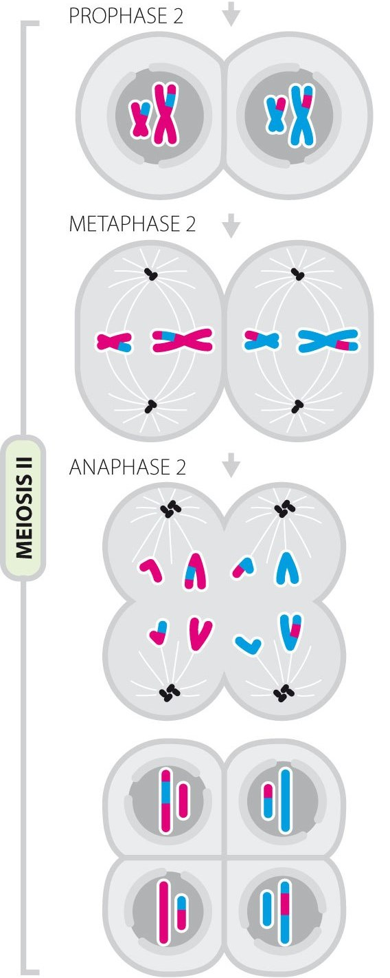
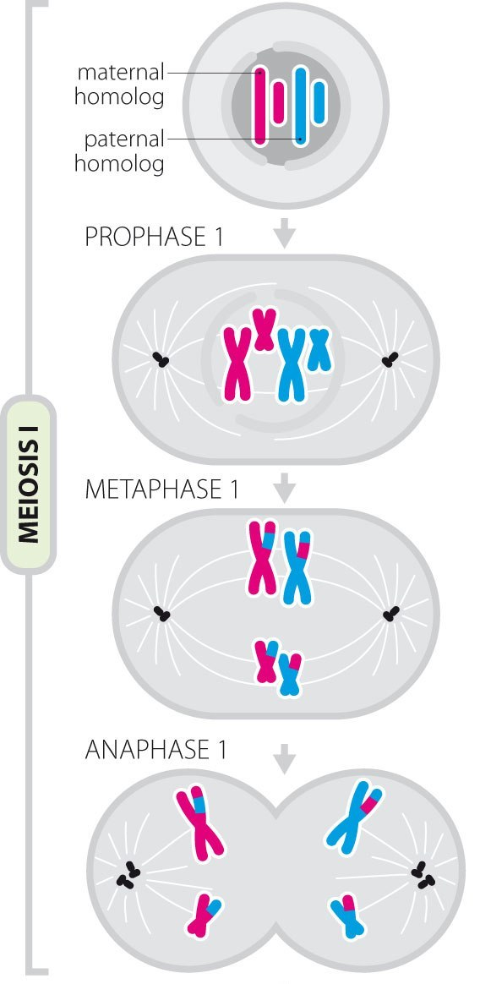
Meiosis
Pairing of homologous chromosomes
Recombination - at least one event for each pair
Separation of homologous chromosomes (1) and chromatids (2)
Results in HAPLOID gametes
Fig. 2.7 ©Scion Publishing Ltd

Slide 10
Crossing Over
Notes:
Prophase I of meiosis
Increases genetic diversity
Sister chromatids
Centromere

Slide 11
Mutation
DNA synthesis - 1 error per 1,000,000,000 nucleotides added

Slide 12
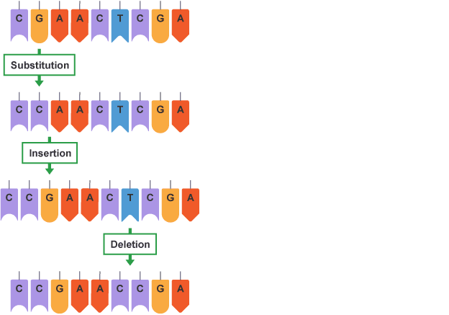
Point Mutation
Notes:
Frameshift error
Sickle-cell disease – single point mutation

Slide 13
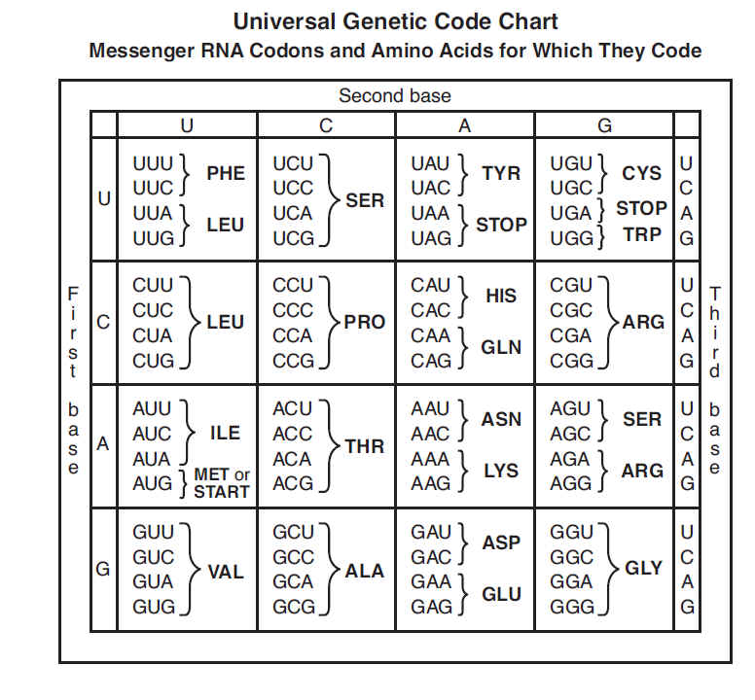
Translation
Notes:
Adenine, cytosine, guanine, thymine, uracil
Amino acids

Slide 14
Mutation

Slide 15
History
Nils Barricelli – 1964 – artificial life
1960s, 1970s – genetic algorithms
Nichael Cramer – 1985 – first statement of “tree-based” GP
John R. Koza – 1992 – “Genetic Programming: On the Programming of Computers by Means of Natural Selection”
1990s – simple problems – computationally intensive
2000s – exponential growth in CPU power
Notes:
Koza is considered the father of GP

Slide 16
Evolutionary Algorithms

Slide 17
Evolutionary Computation/Algorithms Genetic Algorithms
Simulate “natural” evolution of structures via selection and reproduction, based on performance (fitness)
Type of heuristic search to optimize any set of parameters- Discovery, not inductive learning in isolation
Create "genomes" which represent a current potential solution with a fitness (quality) score
Values in genome represent parameters to optimize
MLP weights, TSP path, knapsack, potential clusterings, etc.
Discover new genomes (solutions) using genetic operators
Recombination (crossover) and mutation are most common

Slide 18
Evolutionary Computation/Algorithms Genetic Algorithms
Populate our search space with initial random solutions
Use genetic operators to search the space
Do local search near the possible solutions with mutation
Do exploratory search with recombination (crossover)
1 1 0 2 3 1 0 2 2 1 (Fitness = 60)
2 2 0 1 1 3 1 1 0 0 (Fitness = 72)
1 1 0 2 1 3 1 1 0 0 (Fitness = 55)
2 2 0 1 3 1 0 2 2 1 (Fitness = 88)
Notes:
Use knapsack with repetition as an example, Book does w/o repetition.
If over, real low fitness, or at least lower fitness if want some close ones for diversity.

Slide 19
Evolutionary Algorithms
Start with initialized population P(t) - random, domain- knowledge, etc.
Typically have fixed population size (type of beam search), large enough to maintain diversity
Selection
Parent_Selection P(t) - Promising Parents more likely to be chosen based on fitness to create new children using genetic operators
Survive P(t) - Pruning of less promising candidates, Evaluate P(t) - Calculate fitness of population members. Could be simple metrics to complex simulations.
Survival of the fittest - Find and keep best while also maintaining diversity

Slide 20
Evolutionary Algorithm
Procedure EA
t = 0;
Initialize Population P(t);
Evaluate P(t);
Until Done{ /*Sufficiently “good” individuals discovered or many iterations passed with no improvement, etc.*/
t = t + 1;
Parent_Selection P(t);
Recombine P(t);
Mutate P(t);
Evaluate P(t);
Survive P(t);}
Notes:
Do Knapsack as an example rather than engines for 478 if doing this for 312. Just put 6 items.

Slide 21
Data Representation (Genome)
Individuals are represented so that they can be manipulated by genetic operators
Simplest representation is a bit string, where each bit or group of bits could represent a feature/parameter
Assume the following represents a set of parameters
Could do crossovers anywhere or just at parameter breaks
Can use more complex representations including real numbers, symbolic representations (e.g. programs for genetic programming), etc.
Notes:
Train a NN’s weights

Slide 22
Genetic Operators
Crossover variations - multi-point, uniform, averaging, etc.
Mutation - Random changes in features, adaptive, different for each feature, etc.
Others - many schemes mimicking natural genetics: dominance, selective mating, inversion, reordering, speciation, knowledge-based, etc.
Notes:
Go to next slide for crossover and then come back

Slide 23
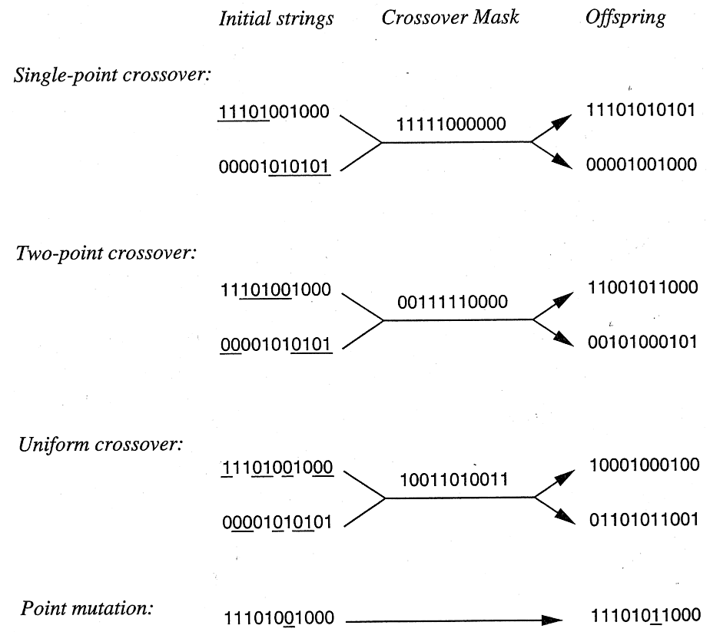

Slide 24
Fitness Function Evaluation
Each individual in the population should have a fitness based on the fitness function
Fitness function will depend on the application
Learning system will usually use accuracy on a validation set for fitness (note that no training set needed, just validation and test)
Solution finding (path, plan, etc.) - Length or cost of solution
Program - Does it work and how efficient is it
Cost of evaluating function can be an issue. When expensive can approximate or use rankings, etc. which could be easier.
Stopping Criteria - A common one is when best candidates in population are no longer improving over time

Slide 25
Parent Selection
In general want the fittest parents to be involved in creating the next generation
However, also need to maintain diversity and avoid crowding so that the entire space gets explored (local minima vs global minima)
Most common approach is Fitness Proportionate Selection (aka roulette wheel selection)
Everyone has a chance but the fittest are more likely

Slide 26
Parent Selection
There are other methods which lead to more diversity
Rank selection
Rank order all candidates
Do random selection weighted towards highest rank
Keeps actual fitness value from dominating
Tournament selection
Randomly select two candidates
The one with highest fitness is chosen with probability p, else the lesser is chosen
p is a user defined parameter, .5 < p < 1
Even more diversity
Fitness scaling - Scale down fitness values during early generations. Scale back up with time. Equivalently could scale selection probability function over time.

Slide 27
Survival - New Generation
Population size - Larger gives more diversity but with diminishing gain, small sizes of ~100 are common
How many new offspring will be created at each generation (what % of current generation will not survive)
Keep selecting parents without replacement until quota filled
New candidates replace old candidates to maintain the population constant
Many variations
Randomly keep best candidates weighted by fitness
No old candidates kept
Always keep a fixed percentage of old vs new candidates
Could keep highest candidate seen so far in separate memory since it may be deleted during normal evolution

Slide 28
Genetic Algorithms
Representation based typically on a list of discrete tokens, often bits (Genome) - can be extended to graphs, lists, real-valued vectors, etc.
Select m parents probabilistically based on fitness
Create m (or 2m) new children using genetic operators (emphasis on crossover) and assign them a fitness - single-point, multi-point, and uniform crossover
Replace m weakest candidates in the population with the new children (or can always delete parents)
Notes:
Skip these slide up until GP

Slide 30
Genetic Programming
A method of solving problems using computers through an analogue of natural selection
© 2009 Kevin Dolan.

Slide 31
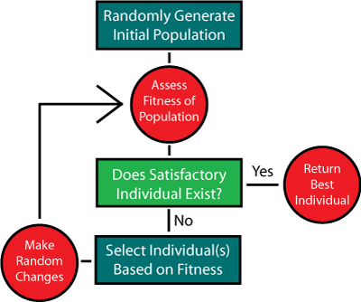
Genetic Programming
Inside the “Genetic Programming” box:
© 2009 Kevin Dolan.

Slide 32
Genetic Programming
“Make Random Changes”:
Crossover
The creation of a child program by combining randomly chosen parts from two selected parent programs
Mutation
The creation of a new child program by randomly altering a randomly chosen part of a selected parent program

Slide 33
Algorithm

Slide 34
Genetic Programming
How is it different from Genetic Algorithms?

Slide 35
Genetic Programming
How is it different from Genetic Algorithms?
Generates programs
Notes:
What are programs?

Slide 36
Genetic Programming
How is it different from Genetic Algorithms?
Generates programs
Functional programming language
Mathematical expressions
Syntax trees
Notes:
Can’t put them in a Turing machine and execute them.
Common Lisp, Scheme, Clojure, Mathematica, Racket, Erlang, OCaml, Haskell, and F#
Iterative languages – C, Java, etc.

Slide 37
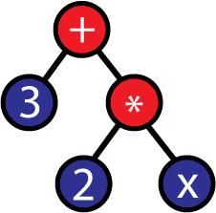
Representation
Syntax Trees
Made of several nodes
All nodes (except the first, or root node) have one parent and any number of children
The number of children a node has is called its “arity”
Nodes with one or more children are called functions and nodes with no children are called terminals
Tree structures are traversed recursively
Node depth - # of edges from the root to a node
Tree depth – depth of deepest leaf

Slide 38
Multi-Component Program
Notes:
Components are subroutines

Slide 39
Initialization
Full
Grow
Ramped half-and-half

Slide 40
Full

Slide 41
Grow

Slide 42
Recursive Program Generation

Slide 43
Ramped Half-and-Half
Neither the grow or full method provide a very wide array of sizes or shapes
Half constructed using full
Half constructed using grow
Range of depth limits
Results in a variety of sizes and shapes

Slide 44
Selection
Individuals probabilistically selected based on fitness
Better individuals more likely to have more child programs than inferior individuals

Slide 45
Selection
Individuals probabilistically selected based on fitness
Better individuals more likely to have more child programs than inferior individuals
Selection Methods
Tournament
Fitness-proportionate
Roulette Wheel Selection
Stochastic Universal Sampling

Slide 46
Tournament Selection
Individuals chosen at random from population
Better (more fit) is chosen as parent
Don’t need to know how much better
Rescales fitness so that selection pressure on population remains constant
Single extraordinarily good program can’t swamp next generation
Would lead to a rapid loss of diversity
Amplifies small differences in fitness to prefer the better program
Inherent noise
Ensures that even average-quality programs have some chance of having children
Notes:
A key property of any selection mechanism is selection pressure. A system with a strong selection pressure very highly favors the more fit individuals, while a system with a weak selection pressure isn’t so discriminating.

Slide 47
Fitness-Proportionate Selection
All individuals have a chance of being selected at any given point
Probability that individual will be selected = normalized fitness
Sum of all normalized fitnesses in the population = 1
More-fit individuals have higher normalized fitness
Higher chance of being selected and their genetic material has a higher chance of being preserved
All individuals have some chance of being selected
Less loss of genetic diversity

Slide 48
Fitness-Proportionate Selection
Roulette Wheel Selection
Each member allocated a section of an imaginary roulette wheel
Size proportional to individual's fitness
Multiple spins of the roulette wheel
Individual may be selected multiple times
Stochastic Universal Sampling
Single spin of the roulette wheel -> starting position and first individual
Advance all the way around the wheel in equal sized steps
Step size determined by the number of individuals to be selected
ex: 30 individuals = 1/30 x 360 degrees for each selection
Does not mean that every individual will be selected

Slide 49
Recombination and Mutation
Subtree crossover
Notes:
Given two parents, subtree crossover randomly (and independently) selects a crossover point (a node) in each parent tree.
Then, it creates the offspring by replacing the subtree rooted at the crossover point in a copy of the first parent with a copy of the subtree rooted at the crossover point in the second parent.
Copies are used to avoid disrupting the original individuals.

Slide 50
Recombination and Mutation
Subtree mutation
Notes:
Randomly selects a mutation point in a tree and substitutes the subtree rooted there with a randomly generated subtree.

Slide 51
Recombination and Mutation
Point mutation
Similar to bit-flip mutation used in genetic algorithms
Process
Random node is selected
Primitive replaced with different random primitive of same arity
Applied on a per-node basis
Each node mutated with certain probability
Multiple nodes mutated independently

Slide 52
Reproduction
Operator rates
Crossover rate
>=90%
Mutation rate
~1%
p = CR + MR
If p < 1, reproduce at rate of 1 – p
Select individual based on fitness and insert copy in the next generation

Slide 53
Preparatory Steps for a GP Run
Objective
Terminal set
Function set
Fitness function
Selection
Parameters
Termination

Slide 54
1. Objective
What’s the problem you’re trying to solve?

Slide 55
2. Terminal Set
Program’s external inputs
Named variables (e.g., x, y)
Functions with no arguments (0-arity)
rand(), go_left(), dist_to_wall()
Constants
Pre-specified
Randomly generated
Created by mutation
Ephemeral random constant -
Notes:
Every time this terminal is chosen in the construction of an initial tree (or a new subtree to use in an operation like mutation), a different random value is generated which is then used for that particular terminal, and which will remain fixed for the rest of the run.

Slide 56
3. Function Set
Typically driven by the nature of the problem domain
Arithmetic (+, -, *, /)
Mathematical (sin, cos, exp)
Boolean (AND, OR, NOT)
Conditional (IF-THEN-ELSE)
Looping (FOR, REPEAT)

Slide 57
Closure
Type consistency
All functions return values of the same type
Each of the arguments have this type
Alternatives:
Automatic conversion between types
Crossover and mutation only produce valid trees
Evaluation safety
Functions can fail at runtime
Divide by 0, MOVE_FORWARD when facing a wall
Solutions:
Protected versions of functions
Return default value (e.g., x % 0 = 1)
Trap runtime exceptions and reduce fitness
Can lead to too many individuals having poor fitness
Notes:
The decision to return the value 1 provides the GP system with a simple way to generate the constant 1, via an expression of the form (% x x). This combined with a similar mechanism for generating 0 via (- x x) ensures that GP can easily construct these two important constants.

Slide 58
Sufficiency
Possible to express a solution to the problem at hand using the elements of the primitive set
Sufficient:
{AND, OR, NOT, x1, x2,..., xN}
Can produce all Boolean functions of the variables x1 , x2 , ..., xN
Insufficient:
{+, -, *, /, x, 0, 1, 2 }
Unable to represent transcendental functions (e.g., exp(x))
Insufficient - can only develop solutions that approximate the desired one
May be good enough
Notes:
More formally, the primitive set is sufficient if the set of all the possible recursive compositions of primitives includes at least one solution.

Slide 59
4. Fitness Function
Measurements:
Error between output and desired output
Amount of time (fuel, money, etc.) required to bring the system to a desired target state
Accuracy of the program in recognizing patterns or classifying objects
Payoff that a game-playing program produces
Compliance of a structure with user-specified design criteria

Slide 60
Evaluation
Executing all programs in population, multiple times

Slide 61
Interpreter for GP

Slide 62
5. Selection
Tournament
Roulette Wheel
Stochastic Universal Sampling

Slide 63
6. Parameters
Population size
Ramped half-and-half
Depth 2-6
>=500
Probabilities of performing genetic operations
90% subtree crossover
Maximum program size
Robust
Not much tuning required

Slide 64
Runtime Estimation
RE = R * G * P * S * F
R = # of runs
G = # generations (10 – 30)
P = size of population
S = average size of programs
F = # of fitness cases

Slide 65
7. Termination
Termination criterion
Maximum # of generation
Success predicate
Method of designating the result
Single best-so-far individual
Additional individuals and data as necessary

Slide 66
Example
Objective
Evolve a program that approximates x² + x + 1 in the range [-1, 1]

Slide 67
Example
Objective
Evolve a program that approximates x² + x + 1 in the range [-1, 1]
Terminal set

Slide 68
Example
Objective
Evolve a program that approximates x² + x + 1 in the range [-1, 1]
Terminal set
T = {x, } (where -5.0 < < +5.0)
Notes:
Ephemeral

Slide 69
Example
Objective
Evolve a program that approximates x² + x + 1 in the range [-1, 1]
Terminal set
T = {x, } (where -5.0 < < +5.0)
Function set

Slide 70
Example
Objective
Evolve a program that approximates x² + x + 1 in the range [-1, 1]
Terminal set
T = {x, } (where -5.0 < < +5.0)
Function set
F = {+, -, *, %} (where % = protected divide)

Slide 71
Example
Objective
Evolve a program that approximates x² + x + 1 in the range [-1, 1]
Terminal set
T = {x, } (where -5.0 < < +5.0)
Function set
F = {+, -, *, %} (where % = protected divide)
Fitness function

Slide 72
Example
Objective
Evolve a program that approximates x² + x + 1 in the range [-1, 1]
Terminal set
T = {x, } (where -5.0 < < +5.0)
Function set
F = {+, -, *, %} (where % = protected divide)
Fitness function
Sum of absolute errors at x ϵ {-1.0, -0.5, 0, 0.5, 1.0}

Slide 73
Example
Objective
Evolve a program that approximates x² + x + 1 in the range [-1, 1]
Terminal set
T = {x, } (where -5.0 < < +5.0)
Function set
F = {+, -, *, %} (where % = protected divide)
Fitness function
Sum of absolute errors at x ϵ {-1.0, -0.5, 0, 0.5, 1.0}
Selection
Fitness proportionate (roulette wheel) non elitist

Slide 74
Example
Parameters
Population size 4
50% subtree crossover
25% subtree mutation
25% reproduction
No tree size limits

Slide 75
Example
Parameters
Population size 4
50% subtree crossover
25% subtree mutation
25% reproduction
No tree size limits
Termination

Slide 76
Example
Parameters
Population size 4
50% subtree crossover
25% subtree mutation
25% reproduction
No tree size limits
Termination
Individual with fitness better than 0.1 found

Slide 77
Example
Notes:
In fitness proportional selection, all individuals have a chance of being selected at any given point. Furthermore, the probability that a given individual will be selected is equal to its normalized fitness. The sum of all normalized fitnesses in the population is 1.
Elitism involves copying a small propotion of the fittest candidates, unchanged, into the next generation.

Slide 78
Initial Population

Slide 79
Algorithm

Slide 80
Initial Fitness
2.5
3.0
4.5
7.5

Slide 81
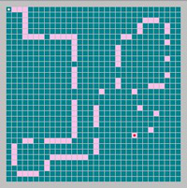
Santa Fe Ant Trail
Notes:
The goal is to eat as much food as possible in a given amount of time

Slide 82
Santa Fe Ant Trail
Function set:
If Food Ahead: arity-2. If there is food directly in front of the ant, the first child is evaluated, otherwise the second child is processed
Progn-2: arity-2. The first child is evaluated and then the second child is evaluated, in that order
Progn-3: arity-3. The three child nodes are evaluated in order
Terminal set:
Move: Move the ant one space forward
Turn Left: Rotate the ant 90 degrees left
Turn Right: Rotate the ant 90 degrees right

Slide 83
Santa Fe Ant Trail
Fitness:

Slide 84
Santa Fe Ant Trail
Fitness:
Limited number of time steps (move or turn)
1 – (food eaten / # time steps)

Slide 85
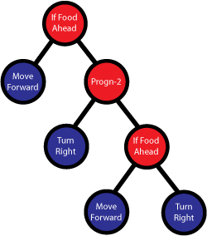
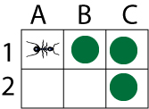
Santa Fe Ant Trail

Slide 86
Santa Fe Ant Trail
https://www.youtube.com/watch?v=BKF7pGw8qbY

Slide 88
Classification
Iris data set
4 attributes
113 training instances
37 test instances
Parameters
MAX_LEN = 10,000
POPSIZE = 50,000
DEPTH = 5
GENERATIONS = 100
TSIZE = 2
PMUT_PER_NODE = 0.05
CROSSOVER_PROB = 0.9
3 x one-vs-all

Slide 89
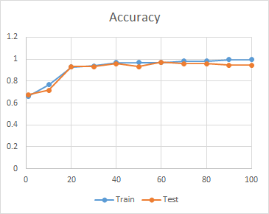
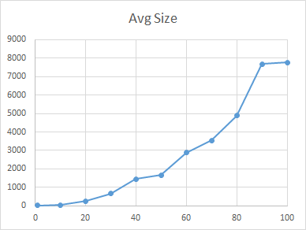
Results

Slide 90
Generation 1
(((((-4.58523843883781 - 3.85705124999259) / (-0.505322956249734 - -2.65578741098558)) / -2.40924280947505) + (-0.433142266903604 + ((-3.33015128426727 * -3.2909496213733) / (-1.66411878385773 * X3 )))) / -3.9092112653466)
Notes:
Iris-setosa Generation 1

Slide 91
Generation 100
(-3.52092471370517 / (-1.9525351873378 * ((X3 + 0.432601610865724) / ((((((((-3.96193704519511 + X4 ) / ((-2.40924280947505 + X3 ) * (-0.505322956249734 + 1.61471222369685))) * ((1.00774620473746 / (3.93568627486736 + -1.76359098253939)) / -2.65578741098558)) * (((0.0855016592356854 / (-3.52092471370517 * ((X3 - 0.432601610865724) / ((-0.433142266903604 - (-4.96397767679951 - (0.563997139951214 / (3.85298486279928 / (((-1.92231173483763 / ((X3 / (((1.61471222369685 + (-3.5386778547143 / 1.85629282000302)) * ((X3 * ((-3.2318673554025 + -0.466814979662567) * (-1.99779882887276 - 0.504882985495442))) / (-1.76359098253939 / 2.91584678362862))) + (-3.45912097415846 / 1.18803173126096))) + 3.85298486279928)) + (((((3.85298486279928 * 2.18958964906148) - ((3.85298486279928 + ((4.27181281115478 / (0.432601610865724 / (((-3.33015128426727 * (-2.40924280947505 * X4 )) * -1.34376732927922) - -4.19711711779103))) / -1.21908996078143)) * ((2.19384038224529 * X1 ) + 0.0855016592356854))) - ((2.77285620000812 / ((-1.92231173483763 / (-3.96193704519511 + 3.85298486279928)) * ((((((2.07921167699583 + (-1.37781071307967 * 2.91584678362862)) + -2.69671479132805) + (2.77285620000812 / ((((((((-3.96193704519511 + X4 ) / ((-2.40924280947505 + X3 ) * (((1.00774620473746 / (3.93568627486736 / -1.76359098253939)) / -2.65578741098558) + 1.61471222369685))) * ((1.00774620473746 / (3.93568627486736 + -1.76359098253939)) / -2.65578741098558)) * ((((((((-1.92231173483763 / (((-0.466814979662567 / (-4.55327364595294 + (((((-1.76359098253939 + -1.99779882887276) / ((4.87779872486265 + -1.66411878385773) - ((((-1.92231173483763 / (-1.92231173483763 / -4.6415582530394)) + -3.33015128426727) / 2.91584678362862) / (3.85298486279928 / (-1.92231173483763 - ((((-3.96193704519511 + X4 ) / ((-2.40924280947505 + X3 ) * 0.267929735252601)) / (((((0.68821694501127 / (X3 - ((-3.9092112653466 / (-1.21908996078143 / -3.27912953136448)) / -0.505322956249734))) + ((3.83469562923289 + ((X3 + (-2.69671479132805 * X2 )) + -1.09940100279609)) / 2.19384038224529)) + 3.85705124999259) / -1.34376732927922) - (-4.6415582530394 - X3 ))) / -0.345537669651926)))))) / -4.55327364595294) / -4.96397767679951) / (-1.9525351873378 * -0.413281193661168)))) / (4.3766578796211 + ((0.0585424178552536 * (1.30013424730866 + 0.432601610865724)) + (-0.354660169852274 / (-2.69671479132805 + (0.123718006128314 * ((-0.0461787986784143 / (1.30013424730866 - 4.24092730006246)) / 2.24267141765108))))))) + 3.85298486279928)) + 2.94541736037723) / 2.91584678362862) - (((((((-1.34376732927922 + -3.33015128426727) * -0.354660169852274) / -3.33015128426727) - ((((((((-0.497251365099685 + -1.21908996078143) / (((-0.433142266903604 * -1.37781071307967) * -3.2909496213733) - -0.433142266903604)) / 1.79840222317651) + (2.77285620000812 + -1.66411878385773)) * (0.659981414517379 + 0.123718006128314)) * -3.53918890400752) - -4.6415582530394) + (X1 * ((-0.0461787986784143 / -2.65578741098558) + 2.24267141765108)))) + ((-1.76359098253939 + (-0.101541171363341 / -4.38816138049036)) - (1.85629282000302 / -3.52092471370517))) / (1.18803173126096 + X3 )) - X4 )) / (3.85298486279928 - ((X3 / (0.00825755065691514 / ((((((-3.27912953136448 * 3.83469562923289) * -0.345537669651926) * (0.659981414517379 + 0.123718006128314)) * X3 ) - -3.9092112653466) + (3.93568627486736 * ((0.291079918523822 / (2.91584678362862 - 4.24092730006246)) / 2.24267141765108))))) / -3.96193704519511))) / 2.18958964906148) - (0.504882985495442 - -0.466814979662567)) - 4.87779872486265)) + -0.0461787986784143) + -1.99779882887276) - (-4.96397767679951 - (4.24092730006246 / ((-4.6415582530394 - X3 ) / ((((((-1.92231173483763 / (((((-0.497251365099685 + -1.21908996078143) / (((-0.433142266903604 * -1.37781071307967) * -3.2909496213733) - -0.433142266903604)) / 1.79840222317651) + (2.77285620000812 + -1.66411878385773)) + 3.85298486279928)) + (-4.2370192330503 + -3.96193704519511)) / 2.91584678362862) / (3.85298486279928 / ((((0.0855016592356854 * -3.33015128426727) / ((-3.9092112653466 / (2.24267141765108 / X4 )) + 4.0888342815865)) / (-1.76359098253939 - (X2 - (X4 / X3 )))) / (-1.99779882887276 + -4.45549897824205)))) + ((((1.80522941369807 / ((X3 + (((4.2423588825587 + -3.2909496213733) * 1.00774620473746) * (3.85705124999259 + -1.97673107822273))) + ((X3 * 3.85298486279928) + (-3.96193704519511 / ((((-1.21908996078143 - (-4.58523843883781 - -0.466814979662567)) / ((-2.27302174888226 + ((-4.72381271409048 / 3.93568627486736) + ((((-0.413281193661168 * 1.04498088641324) - -3.5386778547143) - (((-4.45549897824205 / -3.2909496213733) * (((0.0585424178552536 / -3.52092471370517) + ((-4.96397767679951 - (((2.91584678362862 - -0.433142266903604) / 4.0888342815865) - 0.267929735252601)) / X4 )) / (((-2.79655566802088 / (4.87779872486265 + -4.55327364595294)) / ((-0.354660169852274 + (-2.79655566802088 / (-1.34376732927922 * -3.2318673554025))) / 1.61471222369685)) - 0.563997139951214))) + -4.55327364595294)) / -1.66411878385773))) - (-3.2318673554025 - ((-2.65578741098558 / -4.96397767679951) + (3.93568627486736 * (-4.55327364595294 - ((-3.52092471370517 * ((X3 - 0.432601610865724) / ((((((((-3.96193704519511 + ((0.291079918523822 - -0.404620545639014) / (-1.37781071307967 - 0.425050964311255))) / ((-2.40924280947505 + X3 ) * ((((((-1.76359098253939 / -1.99779882887276) / (-2.27302174888226 - 0.00825755065691514)) / -4.55327364595294) + -1.66411878385773) - (-4.96397767679951 - (0.563997139951214 / (3.85298486279928 / ((((((-1.92231173483763 / (((((-1.92231173483763 / X2 ) + (-4.2370192330503 + -3.96193704519511)) / ((1.04498088641324 * (0.00825755065691514 * -1.19569812724166)) + 0.123718006128314)) / ((1.18803173126096 / X3 ) - ((0.0855016592356854 / ((((-0.413281193661168 * 1.04498088641324) - -3.5386778547143) - ((((-4.96397767679951 - -0.413281193661168) - (((X3 * -1.99779882887276) * (1.61471222369685 * ((((((-3.96193704519511 + X4 ) / ((-2.40924280947505 + X3 ) * (-0.505322956249734 + 1.61471222369685))) * ((1.00774620473746 / (3.93568627486736 + -1.76359098253939)) / -2.65578741098558)) * ((-1.92231173483763 / -0.413281193661168) - 4.87779872486265)) + -0.0461787986784143) * 0.267929735252601))) / (-1.15188268299768 * (-4.38816138049036 / -4.19711711779103)))) * ((-4.45549897824205 + (1.79840222317651 / X4 )) / 2.94541736037723)) + -4.55327364595294)) / -1.66411878385773)) * (3.83469562923289 / -1.21908996078143)))) + 3.85298486279928)) + 2.94541736037723) / 2.91584678362862) / -3.27912953136448) + 1.00774620473746) / (1.80522941369807 * ((-1.92231173483763 / (0.123718006128314 + 1.80522941369807)) / (-4.72381271409048 - (X2 - (-0.0461787986784143 / -2.65578741098558)))))))))) * 0.123718006128314))) * (((4.27181281115478 / (0.432601610865724 / (((-2.40924280947505 / (-3.52092471370517 * -0.505322956249734)) / -4.02971963352976) - -4.19711711779103))) / (3.93568627486736 / -1.76359098253939)) / -2.65578741098558)) * (((0.0855016592356854 / 2.18958964906148) - ((2.77285620000812 / (4.24092730006246 * (((4.2940706756404 / (X1 / ((-4.58523843883781 / (X3 + -3.27912953136448)) * 0.0855016592356854))) / (4.2940706756404 / (((((-3.96193704519511 + X4 ) / -2.65578741098558) * ((1.00774620473746 / (3.93568627486736 + -1.76359098253939)) / -2.65578741098558)) * (((((-3.52092471370517 - (((-4.58523843883781 / X3 ) / (1.18803173126096 + X3 )) - X4 )) / ((X3 * -3.27912953136448) - ((-4.02971963352976 / (-1.92231173483763 - ((((-3.96193704519511 + X4 ) / ((4.24092730006246 + X3 ) * (-0.505322956249734 + 1.61471222369685))) / (((((0.68821694501127 / (X3 - ((-3.9092112653466 / ((((-3.96193704519511 + X4 ) / ((-2.40924280947505 + X3 ) * (-0.505322956249734 + 1.61471222369685))) * ((1.00774620473746 / (3.93568627486736 + -1.76359098253939)) / (X1 - (-3.96193704519511 + 0.68821694501127)))) * ((((-1.66411878385773 * X3 ) - (-1.99779882887276 - (4.2940706756404 - 4.27181281115478))) * -1.99779882887276) - 4.87779872486265))) / -0.505322956249734))) + ((3.83469562923289 + ((X3 + (-2.79655566802088 * X2 )) + -1.09940100279609)) / -3.52092471370517)) + -1.76359098253939) / -1.34376732927922) - (-4.6415582530394 - X3 ))) / -0.345537669651926))) / -3.96193704519511))) / 2.18958964906148) - (0.504882985495442 - -0.466814979662567)) - 4.87779872486265)) + -0.0461787986784143))) * X3 ))) - -0.466814979662567)) - 4.87779872486265)) + 0.68821694501127) + 0.123718006128314) - (-4.96397767679951 - (0.563997139951214 / (3.85298486279928 / ((((((-1.92231173483763 / X2 ) + (-4.2370192330503 + -3.96193704519511)) / -0.466814979662567) / (3.85298486279928 / (-3.52092471370517 / (1.61471222369685 + -4.45549897824205)))) + (((((3.85298486279928 * 2.18958964906148) - ((3.85298486279928 + ((4.27181281115478 / (0.432601610865724 / (((-3.33015128426727 * (((-1.66411878385773 * X3 ) - (-1.99779882887276 - (4.2940706756404 - 4.27181281115478))) * X4 )) * -1.34376732927922) - -4.19711711779103))) / -1.21908996078143)) * ((2.19384038224529 * X1 ) + 0.0855016592356854))) - ((2.77285620000812 / ((-1.92231173483763 / (((0.00825755065691514 / (-4.55327364595294 + ((((-1.92231173483763 / ((((1.04498088641324 * (0.00825755065691514 * -1.19569812724166)) * 3.66218258564462) / X1 ) / (-1.37781071307967 + 0.123718006128314))) / -4.55327364595294) / -3.96193704519511) / 4.08134269019651))) / ((X3 + 0.123718006128314) + -4.96397767679951)) + 3.85298486279928)) * (((4.2940706756404 + 0.0855016592356854) / -4.2370192330503) * 0.432601610865724))) - (0.123718006128314 / (-1.37781071307967 - 0.425050964311255)))) / -3.9092112653466) / X3 )) * ((2.91584678362862 * -2.79655566802088) * (-1.76359098253939 * (-3.33015128426727 * (X1 / 3.85298486279928))))))))) * 0.123718006128314))) / -1.99779882887276))))))) + 3.85298486279928) + ((1.80522941369807 * (-1.76359098253939 * (0.291079918523822 / (1.30013424730866 - 4.24092730006246)))) * ((0.291079918523822 / (1.30013424730866 - 4.24092730006246)) / (-1.21908996078143 - (-4.58523843883781 - (((4.2423588825587 + 3.85298486279928) / (X4 + ((X3 / -3.52092471370517) / (-3.33015128426727 + -3.33015128426727)))) + (X3 * 4.87779872486265))))))))))) + 3.85298486279928) / -2.40924280947505) / X3 )) / (-0.433142266903604 + (-1.76359098253939 * (-1.99779882887276 * 2.94541736037723)))))))) * 0.123718006128314))) * (0.659981414517379 + 0.123718006128314)) / -4.2370192330503) * 0.432601610865724))) - ((0.291079918523822 - -0.404620545639014) / (-1.37781071307967 - 3.85298486279928)))) / -3.9092112653466) / X3 )) * ((2.91584678362862 * -2.79655566802088) * (-1.76359098253939 * (1.00774620473746 / ((1.80522941369807 - -1.21908996078143) + -1.99779882887276))))))))) * 0.123718006128314)))) - (0.504882985495442 * 3.66218258564462)) - 4.87779872486265)) + ((0.291079918523822 / ((-1.92231173483763 / (((-0.466814979662567 / ((((((-0.497251365099685 + -1.21908996078143) / (((-0.433142266903604 * -1.37781071307967) * -3.2909496213733) - -0.433142266903604)) / 1.79840222317651) + (2.77285620000812 + -1.66411878385773)) * (0.659981414517379 + 0.123718006128314)) + (((((-1.76359098253939 + -1.99779882887276) / 1.61471222369685) / 4.2940706756404) / (0.432601610865724 - 4.24092730006246)) / ((-1.37781071307967 - (-1.76359098253939 * (-1.99779882887276 * (-3.52092471370517 / -3.2318673554025)))) * -0.413281193661168)))) / ((X3 + ((2.19384038224529 * -0.433142266903604) / (3.85705124999259 + -1.97673107822273))) + ((0.0585424178552536 * (X3 - ((-3.9092112653466 / (-1.21908996078143 / -3.27912953136448)) / -0.505322956249734))) + (0.00825755065691514 / (((-3.52092471370517 * X3 ) - 1.30013424730866) + (-3.33015128426727 * (0.432601610865724 / 2.24267141765108))))))) + 3.85298486279928)) - 4.24092730006246)) / 2.24267141765108)) + -1.66411878385773) - (-4.96397767679951 - (0.563997139951214 / (3.85298486279928 / ((((((-1.92231173483763 / 3.85298486279928) + 2.94541736037723) / 2.91584678362862) / (((((((-1.92231173483763 / 3.85298486279928) + 2.94541736037723) / 2.91584678362862) / (3.85298486279928 / ((((0.0855016592356854 * -3.33015128426727) / (0.123718006128314 + 1.80522941369807)) / (-4.72381271409048 - (X2 - (-0.0461787986784143 / -2.65578741098558)))) / (1.61471222369685 + -4.45549897824205)))) + ((-4.96397767679951 / ((((0.68821694501127 / (X3 - ((-3.9092112653466 / (-1.21908996078143 / -3.27912953136448)) / ((((((-0.497251365099685 + -1.21908996078143) / (0.0855016592356854 - -0.433142266903604)) / 1.79840222317651) + (2.77285620000812 / -1.66411878385773)) * (0.659981414517379 + 0.123718006128314)) * X3 )))) + (((3.85298486279928 / ((((((-1.92231173483763 / ((X1 / (4.3766578796211 + ((0.0585424178552536 * (1.30013424730866 + 0.432601610865724)) + (-0.354660169852274 / (-2.69671479132805 + 0.123718006128314))))) + 3.85298486279928)) + 2.94541736037723) / 2.91584678362862) / (3.85298486279928 / ((((((-4.96397767679951 / ((((0.68821694501127 / (X3 - ((-3.9092112653466 / (-1.21908996078143 / -3.27912953136448)) / ((((((-0.497251365099685 + -1.21908996078143) / (0.0855016592356854 - -0.433142266903604)) / 1.79840222317651) + (2.77285620000812 / -1.66411878385773)) * (0.659981414517379 + 0.123718006128314)) * X3 )))) + (X3 / -3.52092471370517)) + 3.85705124999259) / ((((-3.96193704519511 + X4 ) / ((-2.40924280947505 + X3 ) * (-0.505322956249734 + 1.61471222369685))) / ((((-1.92231173483763 / (((-0.466814979662567 / (-4.55327364595294 + (((((-1.76359098253939 + -1.99779882887276) / (-2.27302174888226 - 0.00825755065691514)) / -3.9092112653466) / -2.69671479132805) / ((-3.18988597867539 / -1.15188268299768) * -0.413281193661168)))) / ((X3 + ((2.19384038224529 * 1.00774620473746) + (3.85705124999259 + -1.97673107822273))) + (((1.18803173126096 / (1.61471222369685 + -4.45549897824205)) * (1.30013424730866 + 0.432601610865724)) + (0.00825755065691514 / ((((((((-0.497251365099685 + -1.21908996078143) / (2.91584678362862 - -0.433142266903604)) / 1.79840222317651) + (2.77285620000812 / -1.66411878385773)) * (0.659981414517379 + 0.123718006128314)) * -3.53918890400752) - -4.6415582530394) + (3.93568627486736 * ((0.291079918523822 / (1.30013424730866 - 4.24092730006246)) / -3.27912953136448))))))) + 3.85298486279928)) + ((1.18803173126096 + -0.413281193661168) + -1.34376732927922)) / 2.91584678362862) - (-3.33015128426727 / (((((4.2940706756404 + 0.0855016592356854) / -4.2370192330503) * 0.432601610865724) + 1.80522941369807) - -3.18988597867539)))) * (2.18958964906148 + -0.101541171363341)))) / X3 ) * (((1.61471222369685 + (-3.5386778547143 / 1.85629282000302)) * (((0.267929735252601 / 2.19384038224529) * ((-3.2318673554025 + -0.466814979662567) * (-1.99779882887276 - 0.504882985495442))) / (-1.76359098253939 / 2.91584678362862))) + (-3.45912097415846 / 1.18803173126096))) / (0.123718006128314 + -4.55327364595294)) / ((0.432601610865724 / (((-2.40924280947505 / (-3.52092471370517 * -0.505322956249734)) / -4.02971963352976) - -4.19711711779103)) - (X2 - ((-4.55327364595294 + (((-3.53918890400752 / -4.55327364595294) / -1.66411878385773) / ((-3.18988597867539 * -3.9092112653466) * -0.413281193661168))) / -2.65578741098558)))) / (-0.404620545639014 + -4.45549897824205)))) + ((-4.96397767679951 / -3.9092112653466) / X3 )) / (1.80522941369807 * (-1.76359098253939 * (-4.96397767679951 * (X1 / (3.85298486279928 / (-3.52092471370517 / 0.0585424178552536)))))))) + ((X3 + (-2.69671479132805 * X2 )) + -1.09940100279609)) / -3.52092471370517)) + 3.85705124999259) / -1.34376732927922)) / X3 )) / (4.3766578796211 * ((X3 + ((-0.466814979662567 / -2.79655566802088) * 4.87779872486265)) * (0.563997139951214 * (-3.53918890400752 / (-3.52092471370517 * ((X3 - 0.432601610865724) / (((((((((((-0.466814979662567 / (-4.58523843883781 + ((-0.977199727658741 * (1.30013424730866 / (-4.45549897824205 - (((((((-1.92231173483763 / ((-1.76359098253939 / (((((-4.58523843883781 + X3 ) * (-0.505322956249734 + 1.61471222369685)) / X3 ) + -2.40924280947505) + ((0.0585424178552536 * (1.30013424730866 + 0.432601610865724)) + (0.00825755065691514 / ((((((((-0.497251365099685 + -1.21908996078143) / (0.0855016592356854 - (3.93568627486736 * (-4.55327364595294 - ((-3.52092471370517 * ((X3 - 0.432601610865724) / ((((-4.96397767679951 + 0.68821694501127) + -1.66411878385773) - (-4.96397767679951 - (0.563997139951214 / (3.85298486279928 / (((-1.92231173483763 / ((X3 / (((1.61471222369685 + (-3.5386778547143 / 1.85629282000302)) * (((0.267929735252601 / 2.19384038224529) * ((-3.2318673554025 + -0.466814979662567) * (-1.99779882887276 - 0.504882985495442))) / (-1.76359098253939 / 2.91584678362862))) + (-3.45912097415846 / 1.18803173126096))) + 3.85298486279928)) + (((((3.85298486279928 * 2.18958964906148) - ((3.85298486279928 + ((4.27181281115478 / (0.432601610865724 / (((-3.33015128426727 * (((-1.66411878385773 * X3 ) - (-1.99779882887276 - (4.2940706756404 - 4.27181281115478))) * X4 )) * -1.34376732927922) - -4.19711711779103))) / (-3.53918890400752 / (-3.52092471370517 * ((X3 - 0.432601610865724) / (((((((((((-0.466814979662567 / (-4.58523843883781 + ((-0.977199727658741 * (1.30013424730866 / (-4.45549897824205 - (((((((-1.92231173483763 / (((-0.466814979662567 / (-4.55327364595294 + (((((-1.76359098253939 + -1.99779882887276) / 1.61471222369685) / 4.2940706756404) / (0.432601610865724 - 4.24092730006246)) / ((-1.37781071307967 - (-3.96193704519511 + X4 )) * -0.413281193661168)))) / (((((-4.58523843883781 + (-1.92231173483763 / (((-0.466814979662567 / (-4.55327364595294 + (((((-1.76359098253939 + -1.99779882887276) / 1.61471222369685) / 4.2940706756404) / (0.432601610865724 - 4.24092730006246)) / ((-1.37781071307967 - (-1.76359098253939 * (-1.99779882887276 * (X1 / -3.2318673554025)))) * -0.413281193661168)))) / ((X3 + ((2.19384038224529 * -0.433142266903604) / (3.85705124999259 + -1.97673107822273))) + ((0.0585424178552536 * (X3 - ((-3.9092112653466 / (-1.21908996078143 / -3.27912953136448)) / -0.505322956249734))) + (0.00825755065691514 / ((((((((-0.497251365099685 + -1.21908996078143) / (0.0855016592356854 - -0.433142266903604)) / 1.79840222317651) + (2.77285620000812 / -1.66411878385773)) * (0.659981414517379

Slide 92
Regression
Housing data set
13 attributes
455 training instances
51 test instances
Parameters
MAX_LEN = 10,000
POPSIZE = 50,000
DEPTH = 5
GENERATIONS = 100
TSIZE = 2
PMUT_PER_NODE = 0.05
CROSSOVER_PROB = 0.9

Slide 93
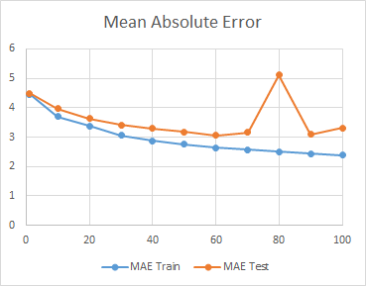
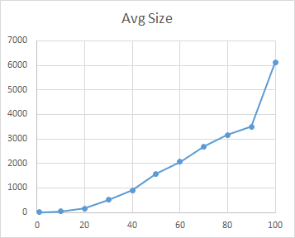
Results

Slide 94
210 Generations
Average size = 18,843 nodes
MAE Test = 3.0588
Most fit = 194,699 characters

Slide 96
Alternative Initializations
PTC1
Guarantees trees will be generated around an expected tree size
Does not provide control over variance in size
PTC2
User-provided probability distribution by tree size
Approximates generating trees from this distribution
Ramped uniform
Specify a range of initial tree sizes
Generates equal numbers of random trees
Notes:
Probabilistic Tree-Creation

Slide 97
Alternative Initializations
Seeding
A good starting point
Descendants may take over population
Loss of diversity
Single seed individual may be removed from population
Fill population with identical or mutated copies of seed

Slide 98
Mutations
Subtree mutation
Replaces randomly selected subtree with another randomly created subtree
Size-fair subtree mutation
Random subtree is, on average, same size as code it replaces
Node replacement mutation (point mutation)
Node in the tree is randomly selected and randomly changed
Same arity
Hoist mutation
creates new offspring individual which is copy of randomly chosen subtree of the parent

Slide 99
Mutations
Shrink mutation
Replaces randomly chosen subtree with randomly created terminal
Permutation mutation
selects random function node in tree and then randomly permutates its arguments (subtrees)
Mutating constants at random
Mutates constants by adding random noise from Gaussian distribution
Mutating constants systematically
Find “best” value for constants

Slide 100
Homologous Crossover
One-point
Notes:
Select common crossover point in the parent programs and then swap corresponding subtrees.
Crossover point is selected only from the parts of the two trees in the common region.
Nodes in the common region need not be identical but they must have the same arity.

Slide 101
Homologous Crossover
Uniform
Visit nodes in common region
Flip a coin at each locus
Choose offspring from first or second parent
Context-preserving
Crossover points are constrained to have same coordinates
Not limited to common region
Size-fair
First crossover point selected randomly
Second crossover point constrained by size of subtree to be removed

Slide 102
Linear Genetic Programming
Linear sequences of instructions
Most computer architectures represent programs linearly
Computers don’t run tree-shaped programs
Interpreters or compilers
Speed

Slide 103
Linear Genetic Programming
Representation
Machine code GP
Interpreted linear GP

Slide 104
Crossover
Normal
Homologous
Notes:
Crossover points occur only at the boundaries between words

Slide 105
Mutation
Respect word boundaries
Generate legal machine code

Slide 106
Graph-Based Genetic Programming
Parallel Distributed GP
Edges represent both control flow and data flow

Slide 107
Multi-objective Genetic Programming
Multi-objective optimization (MOO)
Multiple goals or fitness functions
Find simultaneous optimal solutions
Aggregate scalar fitness function
Notes:
Combine program fitness and program size

Slide 108
Multi-objective Genetic Programming
Separate objectives
Pareto dominance
A solution is said to Pareto dominate another if the first is not inferior to the second in all objectives, and, additionally, there is at least one objective where it is better
Partial order
No longer a strict linear ordering of solutions
Notes:
Combine program fitness and program size

Slide 109
Bloat
Program growth without (significant) return in terms of fitness
Large programs are problematic
computationally expensive to evolve and later use
hard to interpret
may exhibit poor generalization
No single, universally-accepted unifying theory

Slide 110
Bloat
Replication accuracy theory
Success of a GP individual depends on its ability to have offspring that are functionally similar to the parent
Removal bias theory
Inactive code in a GP tree tends to be low in the tree
Crossover events excising inactive subtrees produce offspring with the same fitness as their parents
On average the inserted subtree is bigger than the excised one
Nature of program search spaces theory
Above a certain size, the distribution of fitness does not vary with size
Over time, GP samples longer and longer programs simply because there are more of them

Slide 111
Bloat Control
Hard limits on the size or depth of offspring
If offspring exceeds the limit, one of the parents is returned
Population will tend to be filled up with programs that nearly infringe the constraint
Fixed by not returning parent
Anti-bloat genetic operators
Size fair crossover
Size fair mutation
Anti-bloat selection
Set fitness of randomly chosen longer-than-average programs to 0

Slide 112
Future Work
Evolution of Assembly Code
Automatically Defined Functions and Macros
Cellular Encoding
Automatic Programming of Multi-Agent Systems
Autoparallelization of Algorithms
Co-Evolution
Complex Adaptive Systems
Evolvable Hardware
Notes:
J. R. Koza. Future Work and Practical Applications of Genetic Programming.

Slide 113
Where has GP Done Well?
The interrelationships among the relevant variables is unknown or poorly understood
Finding the size and shape of the ultimate solution is a major part of the problem
Significant amounts of test data are available in computer-readable form
There are good simulators to test the performance of tentative solutions to a problem, but poor methods to directly obtain good solutions

Slide 114
Where has GP Done Well?
Conventional mathematical analysis does not, or cannot, provide analytic solutions
An approximate solution is acceptable (or is the only result that is ever likely to be obtained)
Small improvements in performance are routinely measured (or easily measurable) and highly prized

Slide 115
Where has GP Done Well?
Curve Fitting, Data Modelling and Symbolic Regression
Image and Signal Processing
Financial Trading, Time Series Prediction and Economic Modelling
Industrial Process Control
Medicine, Biology and Bioinformatics
Entertainment and Computer Games
The Arts
Compression

Slide 116
Bibliography
R. Poli, W. B. Langdon, and N. F. McPhee. A field guide to genetic programming. Published via http://lulu.com and freely available at http://www.gp-field-guide.org.uk, 2008. (With contributions by J. R. Koza)
K. Dolan. Genetic Programming Source, http://geneticprogramming.us/Home_Page.html
Langdon, et al. GP Bibliography. 1995 - 2016, http://www.cs.bham.ac.uk/~wbl/biblio/
J. R. Koza. Future Work and Practical Applications of Genetic Programming. http://citeseerx.ist.psu.edu/viewdoc/summary?doi=10.1.1.49.8874

