Slide 1
Speech Recognition and HMM Learning
Overview of speech recognition approaches
Standard Bayesian Model
Features
Acoustic Model Approaches
Language Model
Decoder
Issues
Hidden Markov Models
HMM Basics
HMM in Speech
Forward, Backward, and Viterbi Algorithms, Models
Baum-Welch Learning Algorithm

Slide 2
Speech Recognition Challenges
Large Vocabulary Continuous Speaker Independent
Approaching infinite number of possible outputs
vs. specialty niches
Background Noise
Different Speakers
Pitch, Accent, Speed, etc.
Spontaneous Speech
vs. Written
Hmm, ah…, cough, false starts, non grammatical, etc.
OOV (When is a word Out of Vocabulary)
Pronunciation variance
Co-Articulation
Humans demand very high accuracy before using ASR
Notes:
Infinte vs classify as one of a thousand…
Pronunciation variance and vs n
Co-articulation on “and” You n (un) me, me n (en) you

Slide 3
Standard Approach
Number of possible approaches, but most have converged to a standard overall model
Lots of minor variations
Right approach or local minimum?
An utterance W consists of a sequence of words w₁, w₂,…
Different W's are broken by "silence" – thus different lengths
Seek most probable Ŵ out of all possible W's, based on
Sound input – Acoustic Model
Reasonable linguistics – Language Model
Notes:
CTC - Connectionist Temporal Classification

Slide 4
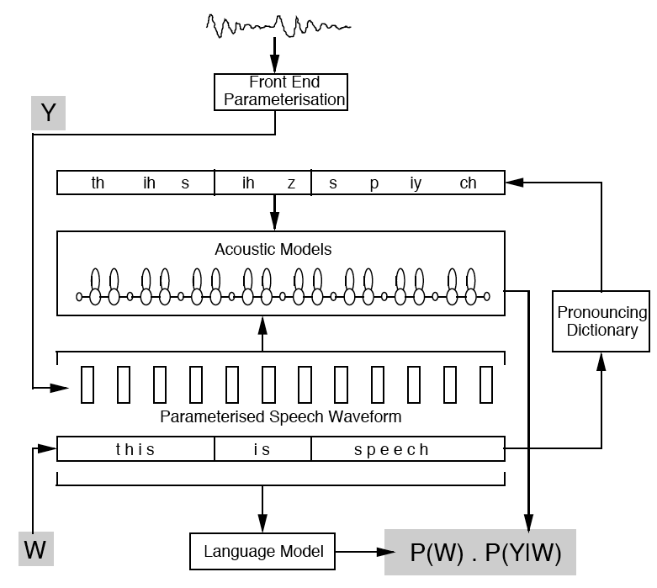
Standard Bayesian Model
Can drop P(Y)
Try all possible W? – Decoder will do an efficient search over the most likely candidates (beam search variation)
Notes:
Review picture carefully
Show example values for "The dog" and "Thy frog" lang model first .8*.4 vs .3*.6

Slide 5
Features
We assume speech is stationary over some number of milliseconds
Break speech input Y into a sequence of feature vectors y₁, y₂,…, y_{T} sampled about every 10ms
A five second utterance has 500 feature vectors
Usually overlapped with a tapered hamming window (e.g. feature represents about 25ms of time)
Many possibilities – Typically use Fourier transform to get into frequency spectrum
How much energy is in each frequency bin
Somewhat patterned after cochlea in the ear
We hear from about 20Hz up to about 20Khz
Use Mel Scale bins (ear inspired) which get wider as frequency increases

Slide 7
Notes:
From Adam Coates slides

Slide 8
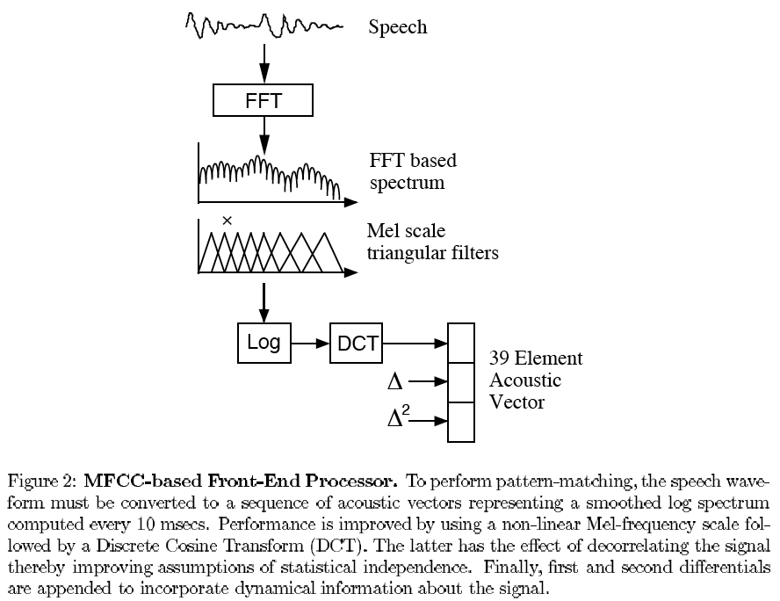
MFCC – Mel Frequency Cepstral Coefficients

Slide 9
Features
Most common industry standard is the first 12 cepstral coefficients for a sample, plus the signal energy making 13 basic features.
Note: CEPStral are the decorrelated SPECtral coefficients
Also include the first and second derivatives of these features to get input regarding signal dynamics (39 total)
Are MFCCs a local minimum?
Tone, mood, prosody, etc.
Notes:
NN details later

Slide 10
Acoustic Model
Acoustic model is P(Y|W)
Recently HMMs being replaced by LSTM with CTC training (Connectionist Temporal Classification) to handle time warping
New models coming fast including possible end-to-end neural solutions
RNN-Transducers, Seq2Seq Attention models, etc. – drop CTC's label independence assumption and thus do some language model learning
Why not calculate P(Y|W) directly?
Too many possible W's and Y's
Instead work with smaller atomic versions of Y and W
P(sample frame|an atomic sound unit) = P(y_{i}|phoneme)
Can get enough data to train accurately
Gives us a more traditional classification problem at that level
Put them together with decoder to recognize full utterances
Which Basic sound units?
Syllables
Automatic Clustering
Most common are Phonemes (Phones)
Notes:
RNN-Transducers, (Seq2Seq) Attention models also do language model learning as they drop the word independence assumption of CTC. They still are benefited by some post language-model processing but are steps closer to end-to-end.

Slide 11
Context Dependent Phonemes
Typically context dependent phones (bi, tri, quin, etc)
tri-phone "beat it" = sil sil-b+iy b-iy+t iy-t+ih ih-t+sil sil
Co-articulation
Not all decoders include cross-word context, best if you do
About 40-45 phonemes in English
Thus 45³ tri-phones and 45⁵ quin-phones
With one HMM for each quin-phone, and with each HMM having about 800 parameters, we would have more than 1.5·10¹² trainable parameters
Not enough data to avoid overfit issues
Use state-tying (e.g. hard_consonant – phone + nasal_consonant)

Slide 12
A Neural Network Acoustic Model
Acoustic model using MLP and BP
Outputs a score/confidence for each phone
26 features (13 MFCC and 1st derivative) in a sample
5 different time samples (-6, -3, 0, +3, +6)
HMMs do not require context snapshot, but they do assume Markovian independence
120 total inputs into a Neural Network
411 outputs (just uses bi-phones and a few tied tri-phones)
230 hidden nodes
120×411×230 = 1,134,600 weights
Requires a large training set
The most common current acoustic models are based on HMMs which we will discuss shortly
Recent attempts using deep neural networks

Slide 13
Notes:
Note- Bidirectional accurate, but has latency issues. Must wait until full speech done, but not liked by humans who want immediate feedback.. Could do limited future frames context do find a compromise.

Slide 18
Speech Training Data
Lots of speech data out there
Can create word labels and also to do dictionary based phone labeling
True phone labeling extremely difficult
Boundaries?
What sound was actually made by the speaker?
One early basic labeled data set: TIMIT, experts continue to argue about how correct the labelings are
There is some human hand labeling, but still relatively small data sets (compared to data needed) due to complexity of phone labeling
Common approach is to iteratively "Bootstrap" to larger training sets
Not completely reassuring
Often use read data (more labeled data available) and then add noise or distort, etc.
Notes:
Bootstrapping usually most confident examples added as labeled data

Slide 19
Language Model
Many possible complex grammar models
In practice, typically use N-grams
2-gram (bigram) p(w_{i}|w_{i-1})
3-gram (trigram) p(w_{i}|w_{i-1}, w_{i-2})
Best with languages which have local dependencies and more consistent word order
Does not handle long-term dependencies
Easy to compute by just using frequencies and lots of data
However, Spontaneous vs. Written/Text Data
Though N-grams are obviously non-optimal, to date, more complex approaches have shown only minor improvements and N-grams are the common standard
Mid-grams

Slide 20
N-Gram Discount/Back-Off
Trigram calculation
Note that many (most) trigrams (and even bigrams) rarely occur while some higher grams could be common
"zebra cheese swim"
"And it came to pass"
With a 50,000 word vocabulary there are 1.25×10¹⁴ unique trigrams
It would take a tremendous amount of training data to even see most of them once, and to be statistically interesting they need to be seen many times
Discounting – Redistribute some of the probability mass from the more frequent N-grams to the less frequent
Backing-Off – For rare N-grams replace with properly scaled/normalized (N-k gram) (e.g. replace trigram with bigram)
Both of these require some ad-hoc parameterization
When to back-off, how much mass to redistribute, etc.

Slide 21
Language Model Example
It is difficult to put together spoken language only with acoustics (So many different phrases sound the same). Need strong balance with the language model.
It’s not easy to recognize speech
It’s not easy to wreck a nice beach
It’s not easy to wreck an ice beach
Speech recognition of Christmas Carols
Youtube closed caption interpretation of sung Christmas carols
Then sing again, but with the recognized words
Too much focus on acoustic model and not enough balance on the language model
Direct link
Notes:
http://www.youtube.com/watch?feature=player_embedded&v=wY0F31G-i9Y
Use following to show importance of language model balance
http://www.wired.com/underwire/2011/12/rhett-link-carol-fails/

Slide 22
Decoder
How do we search through the most probable W, since exhaustive search is intractable
This is the job of the Decoder
Depth first: A*-decoder
Breadth first: Viterbi decoder – most common
Start a parallel breadth first search beginning with all possible words and keep those paths (tokens) which are most promising
Beam search
Notes:
sketch the utterance tree – No. Just wait until next slide.
sketch multiple tokens (what happens when merge)

Slide 23
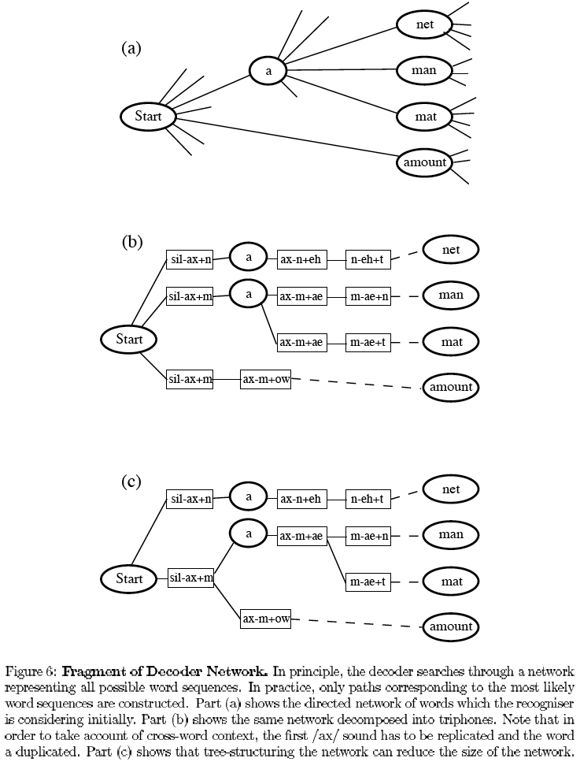
Acoustic model gives scores for the different tri-phones
Can support multiple pronunciations (e.g. either, "and" vs "n", etc.)
Language model adds scores at cross word boundaries
Begin with token at start node
Forks into multiple tokens
As acoustic info obtained, each token accumulates a transition score and keeps a backpointer
If tokens merge, just keep best scoring path (optimal)
Drop worst tokens when new ones are created (beam)
At end, pick the highest token to get best utterance (or set of utterances)
"Optimal" if not for beam
Notes:
Optimal search of the given tree and parameters. Tree parameters (language/acoustic models still approximations)

Slide 24
3 Abstract Decoder Token Paths
R | r | r
I |  |  | i | i | i | i
B |  |  |  |  |  |  | b | b
R | r | r | r
I |  |  |  | i | i
B |  |  |  |  |  | b | b | b
R | r | r
O |  |  | o | o | o | o | o
B |  |  |  |  |  |  |  | b
Scores at each state come from the acoustic model
Notes:
Have to sum across each frame

Slide 25
3 Abstract Decoder Token Paths
R | r | r
I |  |  | i | i | i | i
B |  |  |  |  |  |  | b | b
R | r | r | r
I |  |  |  | i | i
B |  |  |  |  |  | b | b | b
R | r | r
O |  |  | o | o | o | o | o
B |  |  |  |  |  |  |  | b
Scores at each frame come from the acoustic model
Merged token states are highlighted
At last frame just one token with backpointers along best path

Slide 26
Other Items
In decoder etc., use log probabilities (else underflow)
And give at least small probability to any transition (else one 0 transition sets the accumulated total to 0)
Multi Pass Decoding
Speaker adaptation
Combine general model parameters trained with lots of data with the parameters of a model trained with the smaller amount of data available for a specific speaker (or subset of speakers)
λ = ελ_{general} + (1-ε) λ_{speaker}
Trends with more powerful computers
Quin-phones
More HMM mixtures
Longer N-grams
End-to-end Deep Learning
Important problem which still needs much improvement
Notes:
Note lack of creativity on more powerful computer uses – Local minima?

Slide 27
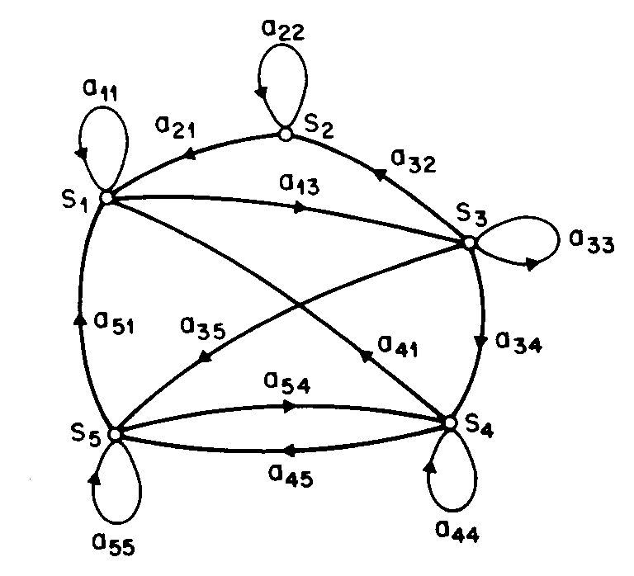
Markov Models
Markov Assumption – Next state only dependent on current state – no other memory
In speech this means that consecutive input signals are assumed to be independent (which is not so, but still works pretty good)
Markov models handle time varying signals efficiently/well
Creates a statistical model of the time varying system
Discrete Markov Process (N, A, π)
Discrete refers to discrete time steps
N states S_{i} represent observable events
a_{ij} represent transition probabilities
π_{i} represent initial state probabilities
Buffet example (Chicken and Ribs)

Slide 28
Discrete Markov Processes
Generative model
Can be used to generate possible sequences based on its stochastic parameters
Can also be used to calculate probabilities of observed sequences
Three common questions with Markov Models
What is the probability of a particular sequence?
This is the critical capability for classification in general, and the acoustic model in speech
If we have one Markov model for each class (e.g. phoneme, etc.), just pick the one with the maximum probability given the input sequence
What is the most probable sequence of length T through the model
This can be interesting for certain applications
How can we learn the model parameters based on a training set of observed sequences (Given N, tunable parameters are A and π)
Look at these three questions with our DMP example
Notes:
MLP not generative rather a discriminative model
Note it is the probability of a sequence of length T

Slide 29
Discrete Markov Processes
Three common questions with Markov Models
What is the probability of a particular sequence of length T?

Slide 30
Discrete Markov Processes
Three common questions with Markov Models
What is the probability of a particular sequence of length T?
Just multiply the probabilities of the sequence
It is the exact probability (given the model assumptions and parameters)
What is the most probable sequence of length T through the model?

Slide 31
Discrete Markov Processes
Three common questions with Markov Models
What is the probability of a particular sequence of length T?
Just multiply the probabilities of the sequence
It is the exact probability (given the model assumptions and parameters)
What is the most probable sequence of length T through the model?
For each sequence of length T just choose the maximum probability transition at each step.
How can we learn the model parameters based on a training set of observed sequences?

Slide 32
Discrete Markov Processes
Three common questions with Markov Models
What is the probability of a particular sequence of length T?
Just multiply the probabilities of the sequence
It is the exact probability (given the model assumptions and parameters)
What is the most probable sequence of length T through the model?
For each sequence of length T just choose the maximum probability transition at each step.
How can we learn the model parameters based on a training set of observed sequences?
Just calculate probabilities based on training sequence frequencies
From state i what is the frequency of transition to each other states
How often do we start in state i
Not so simple with HMMs

Slide 33
Hidden Markov Models
Discrete Markov Processes are simple but are limited in what they can represent
HMM extends model to include observations which are a probabilistic function of the state
The actual state sequence is hidden; we just see emitted observations
Doubly embedded stochastic process
Unobservable stochastic state transition process
Can view the sequence of observations, which are a stochastic function of the hidden states
HMMs are much more expressive than DMPs and can represent many real world tasks fairly well

Slide 34
Hidden Markov Models
HMM is a 5-tuple (N, M, π, A, B)
M is the observation alphabet
We will discuss later how to handle continuous observations
B is the observation probability matrix (|N|×|M|)
For each state, the probability that the state outputs M_{i}
Given N and M, tunable parameters λ = (A, B, π)
A classic example is picking balls with replacement from N urns, each with its own distribution of colored balls
Often, choosing the number of states can be based on an obvious underlying aspect of the system being modeled (e.g. number of urns, number of coins being tossed, etc.)
Not always the case
More states lead to more tunable parameters
Increased potential expressiveness
Need more data
Possible overfit, etc.
Notes:
For DMP state itself was also the observation, now states are hidden

Slide 35
HMM Example
In ergodic models there is a non-zero transition probability between all states
not always the case (e.g. speech, "done" state for buffet before dessert, etc.)
Create our own example
Three friends (F1, F2, F3) regularly play cutthroat Racquetball
State represents whose home court they play at (C1, C2, C3)
Observations are who wins each time
Note that state transitions are independent of observations and transitions/observations depend only on current state
Leads to significant efficiencies
Not realistic assumptions for many applications (including speech), but still works pretty well
Notes:
Do our own version here, then next slide introduce one for the rest

Slide 36
One Possible Racquetball HMM
N = {C1, C2, C3}
M = {F1, F2, F3}
π = vector of length |N| which sums to 1 = {.3, .3, .4}
A = |N|×|N| Matrix (from, to) which sums to 1 along rows
.2 .5 .3
.4 .4 .2
.1 .4 .5
B = |N|×|M| Matrix (state, observation) sums to 1 along rows
.5 .2 .3
.2 .3 .5
.1 .1 .8
Notes:
Come up with our own first
Picture already on board

Slide 37
The Three Questions with HMMs
What is the probability of a particular observation sequence?
What is the most probable state sequence of length T through the model, given the observation?
How can we learn the model parameters based on a training set of observed sequences?
Notes:
Try first one with RB example. All states seq * P(state seq| obs sequence). Efficient version in a minute. N^T state sequences each take time T to calculate.

Slide 38
The Three Questions with HMMs
What is the probability of a particular observation sequence?
Have to sum the probabilities of the state sequence given the observation sequence for every possible state transition sequence – Forward Algorithm is efficient version
It is still an exact probability (given the model assumptions and parameters)
What is the most probable state sequence of length T through the model, given the observation?
How can we learn the model parameters based on a training set of observed sequences?

Slide 39
The Three Questions with HMMs
What is the probability of a particular observation sequence?
Have to sum the probabilities of the state sequence given the observation sequence for every possible state transition sequence – Forward Algorithm is efficient version
It is still an exact probability (given the model assumptions and parameters)
What is the most probable state sequence of length T through the model, given the observation?
Have to find the single most probable state transition sequence given the observation sequence – Viterbi Algorithm
How can we learn the model parameters based on a training set of observed sequences?
Baum-Welch Algorithm

Slide 40
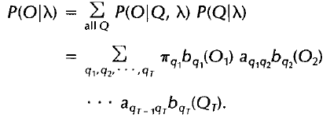
Forward Algorithm
For a sequence of length T, there are N^{T} possible state sequences q₁ … q_{T} (subscript is time/# of observations)
We need to multiply the observation probability for each possible state in the sequence
Thus the overall complexity would be 2T·N^{T}
The forward algorithm give us the exact same solution in time T·N²
Dynamic Programming approach
Do each sub-calculation just once and re-use the results
Notes:
Where N is number of HMM states
Walk through F3, F1, calculate C1, C2 case, then show other cases with the racquetball example given an observation sequence, (most) every state sequence can lead to the observation sequence, each with a different probability

Slide 41
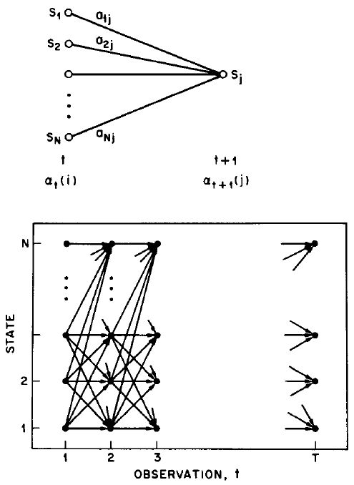
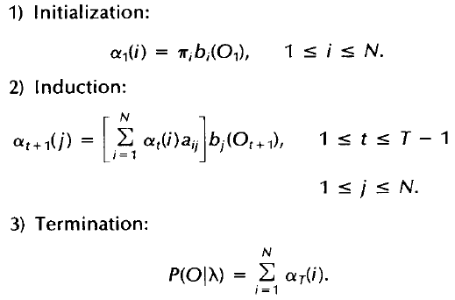
Forward Algorithm
Forward variable α_{t}(i) = probability of sub-observation O₁…O_{t} and being in S_{i} at step t
Fill in the table for our racquetball example

Slide 42
Forward Algorithm Example
π = {.3, .3, .4} A = .2 .5 .3 B = .5 .2 .3
.4 .4 .2 .2 .3 .5
.1 .4 .5 .1 .1 .8
What is P("F1 F3 F3"|λ)?
 | t =1, O_{t} = F1 | t =2, O_{t} = F3 | t =3, O_{t} = F3
C₁ | .3 · .5 = .15
C₂
C₃

Slide 43
Forward Algorithm Example
π = {.3, .3, .4} A = .2 .5 .3 B = .5 .2 .3
.4 .4 .2 .2 .3 .5
.1 .4 .5 .1 .1 .8
What is P("F1 F3 F3"|λ)?
 | t =1, O_{t} = F1 | t =2, O_{t} = F3 | t =3, O_{t} = F3
C₁ | .3 · .5 = .15
C₂ | .3 · .2 = .06
C₃ | .4 · .1 = .04
Notes:
Why don't probabilities sum to 1? This is just one of M^M = 27 possible observations

Slide 44
Forward Algorithm Example
π = {.3, .3, .4} A = .2 .5 .3 B = .5 .2 .3
.4 .4 .2 .2 .3 .5
.1 .4 .5 .1 .1 .8
What is P("F1 F3 F3"|λ)?
 | t =1, O_{t} = F1 | t =2, O_{t} = F3 | t =3, O_{t} = F3
C₁ | .3 · .5 = .15 | (.15·.2 + .06·.4 + .04·.1)·.3 = .017
C₂ | .3 · .2 = .06
C₃ | .4 · .1 = .04
Notes:
Why don't probabilities sum to 1? This is just one of M^M = 27 possible observations

Slide 45
Forward Algorithm Example
π = {.3, .3, .4} A = .2 .5 .3 B = .5 .2 .3
.4 .4 .2 .2 .3 .5
.1 .4 .5 .1 .1 .8
What is P("F1 F3 F3"|λ)?
P("F1 F3 F3"|λ) =
.010 + .028 + .038 = .076
 | t =1, O_{t} = F1 | t =2, O_{t} = F3 | t =3, O_{t} = F3
C₁ | .3 · .5 = .15 | (.15·.2 + .06·.4 + .04·.1)·.3 = .017 | (.017·.2 + .058·.4 + .062·.1)·.3 = .010
C₂ | .3 · .2 = .06 | (.15·.5 + .06·.4 + .04·.4)·.5 = .058 | (.017·.5 + .058·.4 + .062·.4)·.5 = .028
C₃ | .4 · .1 = .04 | (.15·.3 + .06·.2 + .04·.5)·.8 = .062 | (.017·.3 + .058·.2 + .062·.5)·.8 = .038
Notes:
Why don't probabilities sum to 1? This is just one of M^M = 27 possible observations

Slide 46
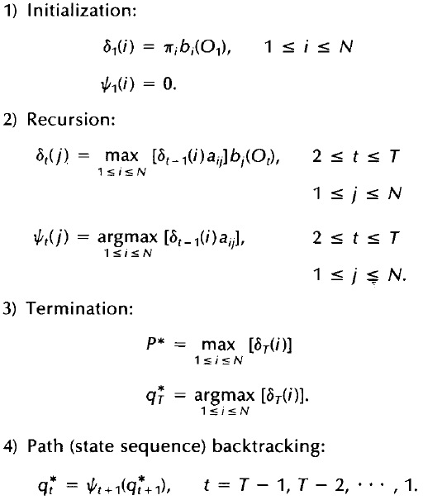
Viterbi Algorithm
Sometimes we want the single most probable (or other optimality criteria) state sequence and its probability rather than the full probability
The Viterbi algorithm does this. It is the exact same as the forward algorithm except that we take the max at each time step rather than the sum.
We must also keep a backpointer Ψ_{t}(j) from each max so that we can recover the actual best sequence after termination.
Do it for the example
Notes:
Backpointer Greek symbol is Psi (sigh)
Why – model understanding, often used in some decoders, though not optimal??, can avoid the cumulative effect of lots of small contributing sequences (which can be less accurate if we have to give non-zero probability guesses, etc.)

Slide 47
Viterbi Algorithm Example
π = {.3, .3, .4} A = .2 .5 .3 B = .5 .2 .3
.4 .4 .2 .2 .3 .5
.1 .4 .5 .1 .1 .8
What is most probable state sequence given "F1 F3 F3" and λ?
 | t =1, O_{t} = F1 | t =2, O_{t} = F3 | t =3, O_{t} = F3
C₁ | .3 · .5 = .15
C₂ | .3 · .2 = .06
C₃ | .4 · .1 = .04
Notes:
If output were just “F1” what would viterbi give (C1 and .15), and what would forward give (.25)? Will first C1 necessarily be part of the final Viterbi sequence? No

Slide 48
Viterbi Algorithm Example
π = {.3, .3, .4} A = .2 .5 .3 B = .5 .2 .3
.4 .4 .2 .2 .3 .5
.1 .4 .5 .1 .1 .8
What is most probable state sequence given "F1 F3 F3" and λ?
 | t =1, O_{t} = F1 | t =2, O_{t} = F3 | t =3, O_{t} = F3
C₁ | .3 · .5 = .15 | max(.15·.2, .06·.4, .04·.1)·.3 = .009
C₂ | .3 · .2 = .06
C₃ | .4 · .1 = .04
Notes:
Why don't probabilities sum to 1? This is just one of M^M = 27 possible observations

Slide 49
Viterbi Algorithm Example
π = {.3, .3, .4} A = .2 .5 .3 B = .5 .2 .3
.4 .4 .2 .2 .3 .5
.1 .4 .5 .1 .1 .8
What is most probable state sequence given "F1 F3 F3" and λ?
C1, C3, C3 – Home court advantage in this case
 | t =1, O_{t} = F1 | t =2, O_{t} = F3 | t =3, O_{t} = F3
C₁ | .3 · .5 = .15 | max(.15·.2, .06·.4, .04·.1)·.3 = .009 | max(.009·.2, .038·.4, .036·.1)·.3 = .0046
C₂ | .3 · .2 = .06 | max(.15·.5, .06·.4, .04·.4)·.5 = .038 | max(.009·.5, .038·.4, .036·.4)·.5 = .0076
C₃ | .4 · .1 = .04 | max(.15·.3, .06·.2, .04·.5)·.8 = .036 | max(.009·.3, .038·.2, .036·.5)·.8 = .014
Notes:
Why don't probabilities sum to 1? This is just one of M^M = 27 possible observations

Slide 50
Baum-Welch HMM Learning Algorithm
Given a training set of observations, how do we learn the parameters λ = (A, B, π)
Baum-Welch is an EM (Expectation-Maximization) algorithm
Gradient ascent (can have local maxima)
Unsupervised – Data does not have specific labels, we just want to maximize the likelihood of the unlabeled training data sequences given the HMM parameters
How about N and M? – Often obvious based on the type of systems being modeled
Otherwise could test out different values (CV) – similar to finding the right number of hidden nodes in an MLP

Slide 51
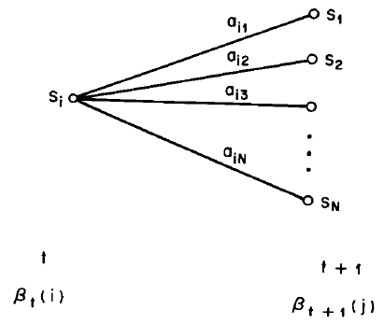
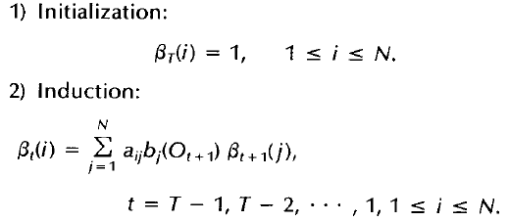
Baum-Welch HMM Learning Algorithm
Need to define three more variables: β_{t}(i), γ_{t}(i), ξ_{t}(i,j)
Backward variable is the counterpart to forward variable α_{t}(i)
β_{t}(i) = probability of sub-observation O_{t+1}…O_{T} when starting from S_{i} at step t
Notes:
Beta, Gamma, Xi (Ksi)
Fill in backward table since we'll need to for Baum Welch

Slide 52
Backward Algorithm Example
π = {.3, .3, .4} A = .2 .5 .3 B = .5 .2 .3
.4 .4 .2 .2 .3 .5
.1 .4 .5 .1 .1 .8
What is P("F1 F3 F3"|λ)?
 | t =1, O_{t+1} = F3 | t =2, O_{t+1} = F3 | T=3
C₁
C₂
C₃
Notes:
Compare to Forward alg (same with a round-off error)

Slide 53
Backward Algorithm Example
π = {.3, .3, .4} A = .2 .5 .3 B = .5 .2 .3
.4 .4 .2 .2 .3 .5
.1 .4 .5 .1 .1 .8
What is P("F1 F3 F3"|λ)?
 | t =1, O_{t+1} = F3 | t =2, O_{t+1} = F3 | T=3
C₁ |  |  | 1
C₂ |  |  | 1
C₃ |  |  | 1
Notes:
Compare to Forward alg (same with a round-off error)

Slide 54
Backward Algorithm Example
π = {.3, .3, .4} A = .2 .5 .3 B = .5 .2 .3
.4 .4 .2 .2 .3 .5
.1 .4 .5 .1 .1 .8
What is P("F1 F3 F3"|λ)?
 | t =1, O_{t+1} = F3 | t =2, O_{t+1} = F3 | T=3
C₁ |  | .2·.3·1 + .5·.5·1 + .3·.8·1 = .57 | 1
C₂ |  |  | 1
C₃ |  |  | 1
Notes:
Compare to Forward alg (same with a round-off error)

Slide 55
Backward Algorithm Example
π = {.3, .3, .4} A = .2 .5 .3 B = .5 .2 .3
.4 .4 .2 .2 .3 .5
.1 .4 .5 .1 .1 .8
What is P("F1 F3 F3"|λ)?
P("F1 F3 F3"|λ) = Σπ_{i}b_{i}(O₁) β_{t}(i) =
.3·.30·.5 + .3·.26·.2 + .4·.36·.1 =
.045 + .016 + .014 = .076
 | t =1, O_{t+1} = F3 | t =2, O_{t+1} = F3 | T=3
C₁ | .2·.3·.55 + .5·.5·.48 + .3·.8·.63 = .30 | .2·.3·1 + .5·.5·1 + .3·.8·1 = .55 | 1
C₂ | .4·.3·.55 + .4·.5·.48 + .2·.8·.63 = .26 | .4·.3·1 + .4·.5·1 + .2·.8·1 = .48 | 1
C₃ | .1·.3·.55 + .4·.5·.48 + .5·.8·.63 = .36 | .1·.3·1 + .4·.5·1 + .5·.8·1 = .63 | 1
Notes:
Compare to Forward alg (same) – above adds to .075, I put same .076 as forward, difference is just rounding values.

Slide 56
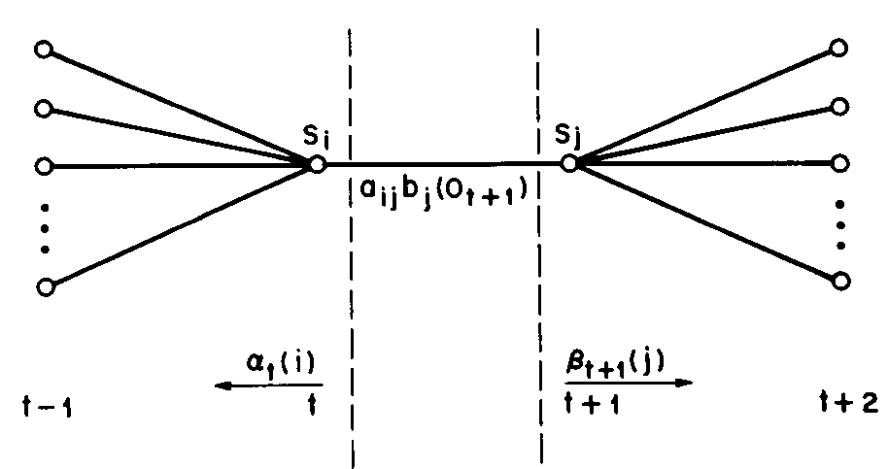
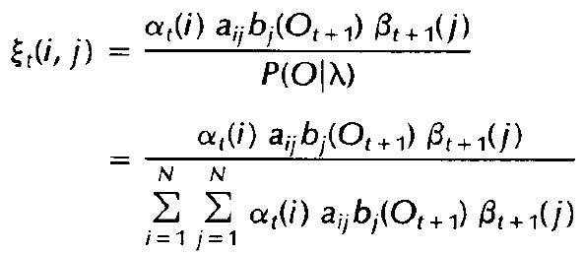
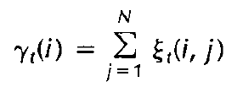
γ_{t}(i) = probability of being in S_{i} at step t given the sequence
α_{t}(i)β_{t}(i) = P(O|λ and constrained to go through state i at time t)
ξ_{t}(i,j) = probability of being in S_{i} at step t and S_{j} at step t+1
α_{t}(i)a_{ij}b_{j}(O_{t+1})β_{t+1}(j) = P(O|λ and constrained to go through state i at time t and state j at time t+1)
Denominators normalize values to obtain correct probabilities Also note that by this time we may have already calculated P(O|λ) using the forward algorithm so we may not need to recalculate it.
Notes:
Gamma and Xi (ksi)
What would happen if we set pi = alpha rather than gamma, short sighted version which we point out in the coming example. Also, good chance to show why gamma is different than beta
Psi (and gamma) sums to T-1 because it looks forward an extra 1. Thus skips the end of sequence values just like in CR (Chicken/Rib).

Slide 57
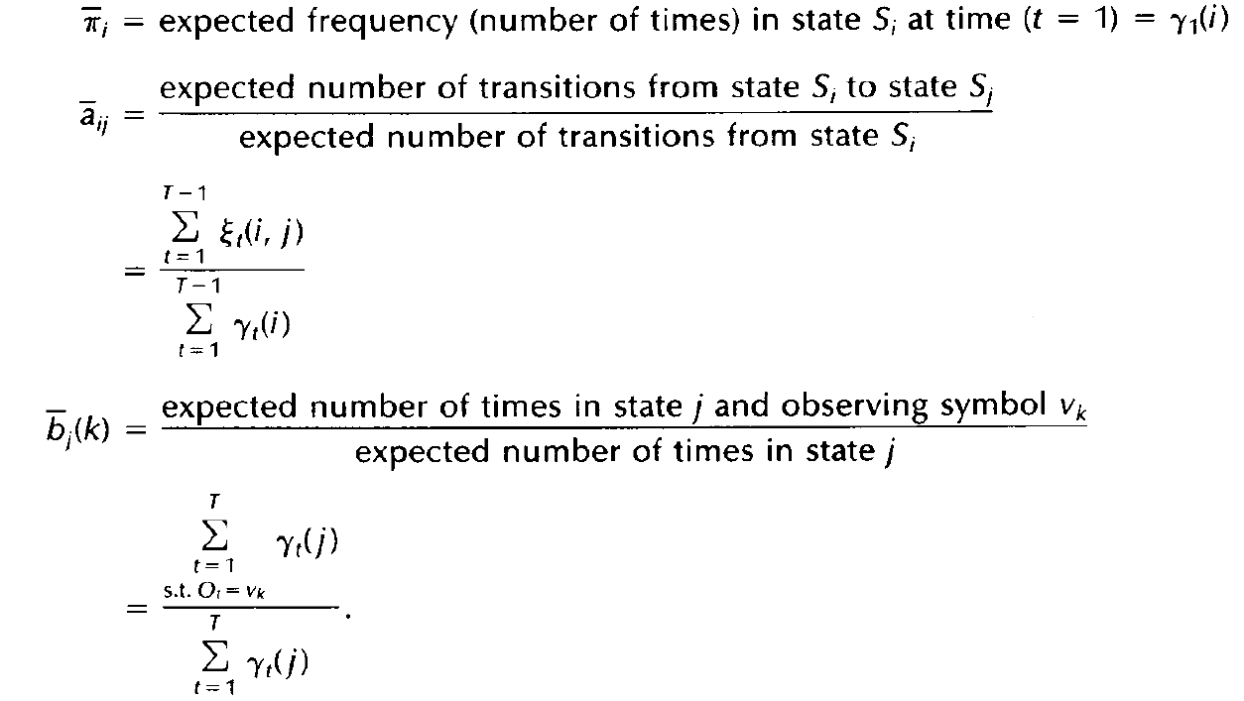
Mixed usage of frequency/counts and probability is fine when doing ratios
Notes:
Given these let’s figure out how to adjust parameters for pi and A referring back to Rib Chicken DPM example – This worked real good. Why can’t we count like in CR? because with HMM we only see observations, not states
Observations are summed from 1 to T because want every observation occurrence (including the last one, since not a state transition issue).
The above values are all conditioned on the observation sequence, which is what causes them to adjust
Start with prose explanations in bottom picture before reviewing equations – note they are similar to discrete Markov process prose (the T-1,. etc from the rib chicken example)
Example: Next slide, assume all have same initial state probability, one has higher prob of outputting F1, and in the data F1 tends to win more often than others. What will happen to pi vector
First pi re-estimation is a probability, not a frequency count

Slide 58
Baum Welch Re-estimation
Initialize parameters λ to arbitrary values
Reasonable estimates can help since gradient ascent
Re-estimate (given the observations) to new parameters λ' such that
Maximizes observation likelihood
EM – Expectation Maximization approach
Keep iterating until P(O|λ') = P(O|λ), then local maxima has been reached and the algorithm terminates
Can also terminate when the overall parameter change is below some epsilon

Slide 59
EM Intuition
The expected probabilities based on the current parameters will differ given specific observations
Assume in our example:
All initial states are initially equi-probable
C1 has higher probability than the other states of outputting F1
F1 is the most common first observation in the training data
What could happen to initial probability of C1: π(C1) in order to increase the likelihood of the observation?

Slide 60
EM Intuition
The expected probabilities based on the current parameters will differ given specific observations
Assume in our example:
All initial states are initially equi-probable
C1 has higher probability than the other states of outputting F1
F1 is the most common first observation in the training data
What could happen to initial probability of C1: π(C1)?
When we calculate γ₁(C1) (given the observation) it will probably be larger than the original π(C1), thus increasing P(O|λ')
The other initial probabilities must then decrease
But more than just the initial observation, Baum-Welch considers the entire observation

Slide 61
EM Intuition
γ_{t}(i) = probability of being in S_{i} at step t (given O and λ)
New value for π(C1) = γ₁(C1) is based on α₁(C1) and β₁(C1) which considers the probability of the entire sequence given α₁(C1) (i.e. that it started at C1 with observation F1) and all possible state sequences
So could π(C1) decrease in this case?
Notes:
So could π(C1) actually decrease in this example? Yes if mostly just transitions to states which are low prob for the rest of the observation sequence.

Slide 62
Baum-Welch Example – Model
λ={π, A, B}
π = {.3, .3, .4}
A = .2 .5 .3 B = .5 .2 .3
.4 .4 .2 .2 .3 .5
.1 .4 .5 .1 .1 .8
O = F1,F3,F3 (The Training Set – will be much longer)
Note the unfortunate luck that there happens to be 3 states, and an alphabet of size 3, and 3 observations in our sample sequence. Those are usually not the same. Table will be the same size for any O, though the O can change length.
 | α₁(i) | α₂(i) | α₃(i)
 | F₁ | F₂ | F₃
C₁ | .15 | .017 | .010
C₂ | .06 | .058 | .028
C₃ | .04 | .062 | .038
 | β₁(i) | β₂(i) | β₃(i)
 | F₁ | F₂ | F₃
C₁ | .30 | .55 | 1
C₂ | .26 | .48 | 1
C₃ | .36 | .63 | 1
Notes:
Size of tables do not change, length of O can change anytime.
Have them do this as a homework, and then review it at the beginning of class!
Just all pi values, couple A values including A12 and a couple of B values including B23

Slide 63
Baum-Welch Example – π Vector
 | α₁(i) | α₂(i) | α₃(i)
C₁ | .15 | .017 | .010
C₂ | .06 | .058 | .028
C₃ | .04 | .062 | .038
 | β₁(i) | β₂(i) | β₃(i)
C₁ | .30 | .55 | 1
C₂ | .26 | .48 | 1
C₃ | .36 | .63 | 1
π = {.3, .3, .4} O = F1,F3,F3
A = .2 .5 .3 B = .5 .2 .3
.4 .4 .2 .2 .3 .5
.1 .4 .5 .1 .1 .8
π_{i}' = probability of starting in S_{i} given O and λ
π_{i}' = γ₁(i) = α₁(i) · β₁(i) / P(O|λ) = α₁(i) · β₁(i) / Σ_{i} α₁(i) · β₁(i)
π₁' =
Notes:
Have them do this as a homework, and then review it at the beginning of class!
Just all pi values, couple A values including A12 and a couple of B values including B23

Slide 64
Baum-Welch Example – π Vector
 | α₁(i) | α₂(i) | α₃(i)
C₁ | .15 | .017 | .010
C₂ | .06 | .058 | .028
C₃ | .04 | .062 | .038
 | β₁(i) | β₂(i) | β₃(i)
C₁ | .30 | .55 | 1
C₂ | .26 | .48 | 1
C₃ | .36 | .63 | 1
π = {.3, .3, .4} O = F1,F3,F3
A = .2 .5 .3 B = .5 .2 .3
.4 .4 .2 .2 .3 .5
.1 .4 .5 .1 .1 .8
π_{i}' = probability of starting in S_{i} given O and λ
π_{i}' = γ₁(i) = α₁(i) · β₁(i) / P(O|λ) = α₁(i) · β₁(i) / Σ_{i} α₁(i) · β₁(i)
π₁' = γ₁(1) = .15·.30/.076 = .60 // .076 comes from previous calc of P(O|λ)
π₁' = γ₁(1) = .15·.30/((.15·.30) + (.06·.26) + (.04·.36))
= .15·.30/.076 = .60

Slide 65
Baum-Welch Example – π Vector
 | α₁(i) | α₂(i) | α₃(i)
C₁ | .15 | .017 | .010
C₂ | .06 | .058 | .028
C₃ | .04 | .062 | .038
 | β₁(i) | β₂(i) | β₃(i)
C₁ | .30 | .55 | 1
C₂ | .26 | .48 | 1
C₃ | .36 | .63 | 1
π = {.3, .3, .4} O = F1,F3,F3
A = .2 .5 .3 B = .5 .2 .3
.4 .4 .2 .2 .3 .5
.1 .4 .5 .1 .1 .8
π_{i}' = probability of starting in S_{i} given O and λ
π_{i}' = γ₁(i) = α₁(i) · β₁(i) / P(O|λ) = α₁(i) · β₁(i) / Σ_{i} α₁(i) · β₁(i)
π₁' = γ₁(1) = .15·.30/.076 = .60 // .076 comes from previous calc of P(O|λ)
π₁' = γ₁(1) = .15·.30/((.15·.30) + (.06·.26) + (.04·.36))
= .15·.30/.076 = .60
π₂' = γ₁(2) = .06·.26/.076 = .21
π₃' = γ₁(3) = .04·.36/.076 = .19
Note that Σ π_{i}' = 1
Note that the new π_{i}' equation does not explicitly include π_{i} but depends on it since the forward and backward numbers are effected by π_{i}

Slide 66
Baum-Welch Example – Transition Matrix
 | α₁(i) | α₂(i) | α₃(i)
C₁ | .15 | .017 | .010
C₂ | .06 | .058 | .028
C₃ | .04 | .062 | .038
 | β₁(i) | β₂(i) | β₃(i)
C₁ | .30 | .55 | 1
C₂ | .26 | .48 | 1
C₃ | .36 | .63 | 1
π = {.3, .3, .4} O = F1, F3, F3
A = .2 .5 .3 B = .5 .2 .3
.4 .4 .2 .2 .3 .5
.1 .4 .5 .1 .1 .8
a_{ij}' = # Transitions from S_{i} to S_{j} / # Transitions from S_{i}
a_{ij}' = Σ_{t} ξ_{t}(i,j) / Σ_{t} γ_{t}(i) = (Σ_{t} α_{t}(i) · a_{ij} · b_{j}(O_{t+1}) · β_{t+1}(j) / P(O|λ)) / (Σ_{t} α_{t}(i) · β_{t}(i) / P(O|λ))
= (Σ_{t} α_{t}(i) · a_{ij} · b_{j}(O_{t+1}) · β_{t+1}(j)) / (Σ_{t} α_{t}(i) · β_{t}(i)) (where sum is from 1 to T-1)
a₁₂' =

Slide 67
Baum-Welch Example – Transition Matrix
 | α₁(i) | α₂(i) | α₃(i)
C₁ | .15 | .017 | .010
C₂ | .06 | .058 | .028
C₃ | .04 | .062 | .038
 | β₁(i) | β₂(i) | β₃(i)
C₁ | .30 | .55 | 1
C₂ | .26 | .48 | 1
C₃ | .36 | .63 | 1
π = {.3, .3, .4} O = F1, F3, F3
A = .2 .5 .3 B = .5 .2 .3
.4 .4 .2 .2 .3 .5
.1 .4 .5 .1 .1 .8
a_{ij}' = # Transitions from S_{i} to S_{j} / # Transitions from S_{i}
a_{ij}' = Σ_{t} ξ_{t}(i,j) / Σ_{t} γ_{t}(i) = (Σ_{t} α_{t}(i) · a_{ij} · b_{j}(O_{t+1}) · β_{t+1}(j) / P(O|λ)) / (Σ_{t} α_{t}(i) · β_{t}(i) / P(O|λ))
= (Σ_{t} α_{t}(i) · a_{ij} · b_{j}(O_{t+1}) · β_{t+1}(j)) / (Σ_{t} α_{t}(i) · β_{t}(i)) (where sum is from 1 to T-1)
a₁₂' = (.15·.5·.5·.48 + .017·.5·.5·1) / (.15·.30 + .017·.55) = .022/.054 = .41
Note that P(O|λ) is dropped because it cancels in the above equation

Slide 68
Baum-Welch Example – Observation Matrix
 | α₁(i) | α₂(i) | α₃(i)
C₁ | .15 | .017 | .010
C₂ | .06 | .058 | .028
C₃ | .04 | .062 | .038
 | β₁(i) | β₂(i) | β₃(i)
C₁ | .30 | .55 | 1
C₂ | .26 | .48 | 1
C₃ | .36 | .63 | 1
π = {.3, .3, .4} O = F1, F3, F3
A = .2 .5 .3 B = .5 .2 .3
.4 .4 .2 .2 .3 .5
.1 .4 .5 .1 .1 .8
b_{jk}' = # times in S_{j} and observing M_{k} / # times in S_{j}
b_{jk}' = Σ_{t} γ_{t}(j) and observing M_{k} / Σ_{t} γ_{t}(j) (where sum is from 1 to T)
= (Σ_{t and Ot=Mk} (α_{t}(j) · β_{t}(j)) / P(O|λ)) / (Σ_{t} α_{t}(j) · β_{t}(j) / P(O|λ))
= (Σ_{t and Ot=Mk} α_{t}(j) · β_{t}(j)) / (Σ_{t} α_{t}(j) · β_{t}(j))
b₂₃' =

Slide 69
Baum-Welch Example – Observation Matrix
 | α₁(i) | α₂(i) | α₃(i)
C₁ | .15 | .017 | .010
C₂ | .06 | .058 | .028
C₃ | .04 | .062 | .038
 | β₁(i) | β₂(i) | β₃(i)
C₁ | .30 | .55 | 1
C₂ | .26 | .48 | 1
C₃ | .36 | .63 | 1
π = {.3, .3, .4} O = F1, F3, F3
A = .2 .5 .3 B = .5 .2 .3
.4 .4 .2 .2 .3 .5
.1 .4 .5 .1 .1 .8
b_{jk}' = # times in S_{j} and observing M_{k} / # times in S_{j}
b_{jk}' = Σ_{t} γ_{t}(j) and observing M_{k} / Σ_{t} γ_{t}(j) (where sum is from 1 to T)
= (Σ_{t and Ot=Mk} (α_{t}(j) · β_{t}(j)) / P(O|λ)) / (Σ_{t} α_{t}(j) · β_{t}(j) / P(O|λ))
= (Σ_{t and Ot=Mk} α_{t}(j) · β_{t}(j)) / (Σ_{t} α_{t}(j) · β_{t}(j))
b₂₃' = (0 + .058·.48 + .028·1) / (.06·.26 + .058·.48 + .028·1) = .056/.071 = .79
Notes:
Discuss denominator first, then numerator is easy

Slide 70
Baum-Welch Notes
Stochastic constraints automatically maintained at each step
Σπ_{i} = 1, π_{i} ≥ 0, etc.
Initial parameter setting?
All parameters must initially be ≥ 0
Must not all be the same else can get stuck
Empirically shown that to avoid poor maxima, it is good to have reasonable initial approximations for B (especially for mixtures), while initial values for A and π are less critical
O is the entire training set for speech, but we train with many individual utterances O_{i}, to keep TN² algs manageable
And average updates before each actual parameter update
Batch vs. on-line issues
Values set to 0 if smaller observations do not include certain events
Better approach could be updating after smaller observation sequences using λ = cλ' + (1-c)λ where c could change with time
Homework

Slide 71
Continuous Observation HMMs
In speech each sample is a vector of real values
Common approach to representing a probability distribution is by using a mixture of Gaussians (GMM) – Gaussian Mixture Models
c_{jm} are the mixture coefficients for j (each ≥ 0 and sum to 1)
μ_{jm} is the mean vector for the mth Gaussian of S_{j}
U_{jm} is the covariance matrix of the mth Gaussian of S_{j}
With sufficient mixtures can represent any arbitrary distribution
We choose an arbitrary M mixtures to represent the observation distribution at each state
Larger M allows for a more accurate distributions, but must train more tunable parameters
Common M typically less than 10

Slide 72
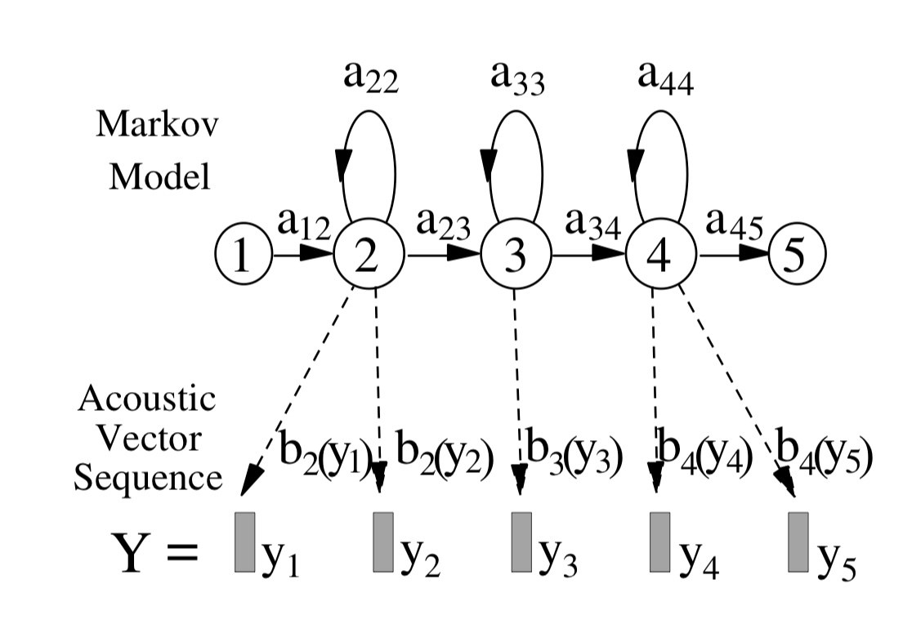
Speech HMM Models
One HMM model for each context dependent phoneme
Typically 3 (tri-phone) or 5 (quin-phone) states
Observations are the input frames (e.g. 30 MFCCs)
Start and end states (1,5 – non-emitting) let us concatenate phones to form a dictionary utterance.
Notes:
Note Start and End States

Slide 73
Continuous Observation Distributions
3 emitting states represent observation probabilities at beginning, middle, and end of the sound

Slide 74
Decode Search
All utterances (beam search) do forward algorithm using the concatenated phone HMM models and language Model which build each possible utterance
Assume person said "Rib" and two competing utterances were "Rib" vs "Rib and Rib" – What would happen?
Language Model at word boundaries
Notes:
The forward algorithm compares all the exponential ways that the HMM stream c
Blank circles are start and end states which let us concatenate HMM models to create the full dictionary utterance. Language Model updates happen at word boundaries.

Slide 75
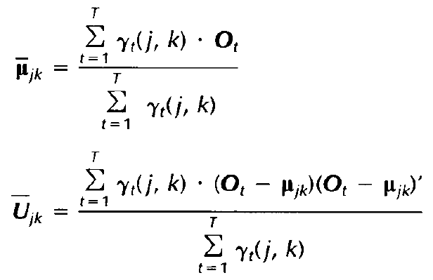
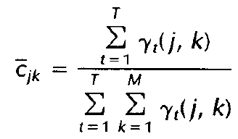
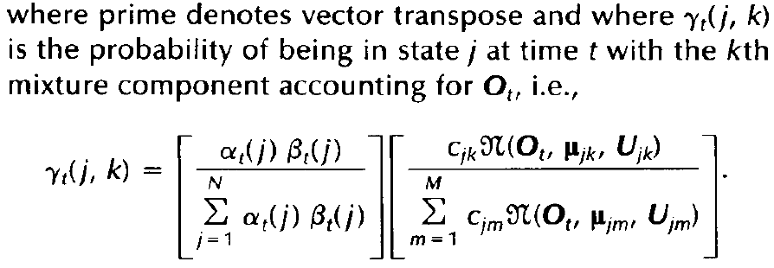
Continuous Observation HMMs
Mixture update with Baum Welch
O_{t} in numerator scales the means based on how often in state j using mixture k and observing O_{t}
How often in state j using mixture k over how often in state j
Notes:
Show bimodal mixture where current observation is mostly attributed to one.

Slide 76
Types of HMMs
Left-Right model (Bakis model) common in speech
As time increases the state index increases or stays the same
Draw model to represent the word "Cat"
Can have higher probability of staying in "a" (long vowel), but no going back
Can try to model state duration more explicitly
Higher Order HMMs
Notes:
Consider other basic tasks with HMMs and how they are actually used. NLP, etc.

Slide 77
Other HMM Application Models
Would if you are building the standard interactive telephone dialogues we have to deal with
A customer calls and is asked to speak a word from a menu such as “Say one of the following”
“Account balance”
“Close account”
“Upgrade services”
“Speak to representative”
How would you set it up?

Slide 78
HMM Application Models – Example
Create one HMM for each phrase
Could also create additional HMMs for each keyword (e.g. “representative”) for those who will speak less than the entire phrase
Alphabet is the real valued speech frames – Continuous HMMs
Each HMM is trained only on examples of its phrase
When a new utterance is given, all HMMs calculate their probability of generating that utterance given the sound
We can use Forward or Viterbi to get probability
We should also multiply the HMM probability by the prior (frequency of customer response from training set or other issues) to get a final probability for each possible utterance
Utterance with max posterior probability wins
Why don’t we do it this way for full speech recognition?
Note we could have used the full speech approach for this problem (how?) though using separate models is more common
Notes:
Other issues – we would rather it go to upgrade vs cancel if they are close
We we need a model for each utterance – too many! – Thus, we just do one big HMM which is trained on general speech, and the use the decoder to test over all possible utterances in an efficient way.
The decoder also allows us to naturally include the language model as the full utterance is considered.

Slide 79
HMM Summary
Model structure (states and transitions) is problem dependent
Even though basic HMM assumptions (signal independence and state independence) are not appropriate for speech and many other applications, still strong empirical performance in many cases
Other speech approaches
MLP
Multcons
Recent work has achieved higher accuracy using deep networks to replace GMMs and HMMs for ASR

