Slide 1
Deep Learning
Basic Philosophy
Why Deep Learning
Deep Backpropagation
CNNs – Convolutional Neural Networks
First “Deep” Nets - Unsupervised Pre-Training Networks
Deep Supervised Networks with managed gradient approaches
  Learning tricks, Dropout, Batch normalization, ResNets, etc.
GANs
Recurrent Networks - LSTM, GRU
Deep Reinforcement Learning
Transformers - GPT
Notes:
Pre-Training

Slide 2
Deep Learning Overview
Train neural networks with many layers (vs. shallow nets with just a couple of layers)
Multiple layers work to build an improved feature space
  First layer learns 1st order features (e.g. edges…)
  2nd layer learns higher order features (combinations of first layer features, combinations of edges, etc.)
  Some models learn in an unsupervised mode and discover general features of the input space – serving multiple tasks related to the unsupervised instances (image recognition, etc.)
  Final layer of transformed features are fed into supervised layer(s)
Notes:
Use playground to show evolving bases, first layer just lines (show circle), do spirals and with 1 hidden layer, then 3 hidden layers with 6 nodes each to show bases. Could do tanh but faster with relu
playground.tensorflow,org

Slide 3
Deep Net Feature Transformation
Supervised
Learning
ML Model
New Feature Space
Supervised
or
unsupervised
Learning
Original Features
Notes:
Can input both new and original spaces
Unsupervised pre-training

Slide 4
Deep Learning Tasks
Images Example: view of a learned vision feature layer (Basis)
Each square in the figure shows the input image that maximally activates one of the 100 units
Notes:
Each square in the figure above shows the (norm bounded) input image that maximally activates one of 100 hidden units. We see that the different hidden units have learned to detect edges at different positions and orientations in the image.
This image if for a simple auto-encoder with 100 hidden units trained on 10x10 images (from UFLDL tutorial)
Use tensorflow playground to show how later layers learn more complex surfaces

Slide 5
Why Deep Learning
Biological Plausibility – e.g. Visual Cortex
Hastad proof - Problems which can be represented with a polynomial number of nodes with k layers, may require an exponential number of nodes with k-1 layers (e.g. parity)
Highly varying functions can be efficiently represented with deep architectures
  Less weights/parameters to update than a less efficient shallow representation
Sub-features created in deep architecture can potentially be shared between multiple tasks
  Type of Transfer/Multi-task learning

Slide 6
Deep Neural Networks Sketch
More than just MLPs, but…
Rumelhart 1986 – great early success
Interest subsides a bit in the late 90’s as other models are introduced – SVMs, Graphical models, etc. – each "wave" ...
Convolutional Neural Nets –LeCun 1989-> Image, speech, etc.
Deep Belief nets (Hinton) and Stacked auto-encoders (Bengio) – 2006 – Unsupervised pre-training followed by supervised. Good feature extractors.
2012 -> Initial successes with supervised approaches which overcome vanishing gradient, etc., and are more generally applicable. Current explosion, but don’t drop the other tools in your kit!
  Stay the course

Slide 7
Early Work
Fukushima (1980) – Neo-Cognitron
LeCun (1989) – Convolutional Neural Networks (CNN)
  Miminal interest at the time before other critical advances
Many layered MLP with backpropagation
  Tried early but without much success
    Very slow
    Vanishing gradient
  More recent work demonstrated significant accuracy improvements by "patiently" training deeper MLPs with BP using fast machines (GPUs)
    More general learning!
    Much improved since 2012 with some important extensions to the original MLP/BP approach

Slide 8
Vanishing/Unstable Gradient
Vanishing Gradient – error attenuates as it propagates to earlier layers – t - z < 1, f '(net), scaled by small initial weights
Leads to very slow training (especially at early layers when top layers saturate and have small f '(net))
Exacerbated since top couple layers can usually learn any task "pretty well" and thus the error to earlier layers drops quickly as the top layers "mostly" solve the task
if lower layers never get the opportunity to use their capacity to improve results, they can just be stuck with their initial random feature mapping
Need a way for early layers to do effective work
Instability of gradient in deep networks: Vanishing or exploding gradient
  Product of many terms, which unless “balanced” just right, is unstable
  Either early or late layers stuck while “opposite” layers are learning
Notes:
If weights were large gradient could explode as go down the net –much less common but still can happen
Note large weights usually lead to saturation and even smaller f’(net)
: Another important reason error is low. Final layer updates weights so that overall accuracy is pretty good just based on the last hidden layer (and the still pretty much initial weights of the earlier layers). Thus T-Z already gets small pretty fast based on just the learning of the last few layers using the initial layers as a random shuffle.
Local minima? Some say, More likely difficult slow curvatures (Martens: Hessian Free Learning), Properly tuned Moment with proper initial conditions can make a big difference.
LSTM are more specialized approach for very long memory cases, but is it best for typical tasks? Hessian free claims to out-perform it and can also do the specialized tasks

Slide 9
Vanishing/Exploding Gradient
Error attenuation, long patient training with GPUs, etc
Recent algorithmic improvements - Rectified Linear Units,
better weight initialization, normalization between layers, residual
deep learning, etc. – 1000’s of layers being effectively trained, will discuss later
….
Notes:
Usually more nodes in internal layers than input layer, layers not same size
Save this until later slide which has it.: Another important reason error is low. Final layer updates weights so that overall accuracy is pretty good just based on the last hidden layer (and the still pretty much initial weights of the earlier layers). Thus T-Z already gets small pretty fast based on just the learning of the last few layers using the initial layers as a random shuffle.
RLEs, constant derivate, thus just can treat as 1 and scale with LR. 0 once saturated, can come back? Review these more before next time
Evidence that tanh and other activations better than sigmoid for avoiding early top layer saturation

Slide 10
Convolutional Neural Networks
"Niche" networks built specifically for problems with low dimensional (e.g. 2-d) grid-like local structure – e.g. Images
  Vision, Character recognition, Speech, Games, Images - where neighboring features have high correlations (pixels, words, etc.), while distant features (pixels, words) are less correlated
    Typically just uses raw features (e.g. pixels) with no preprocessing
  Natural images have the property of being stationary, meaning that the statistics of one part of the image are the same as any other part
  While standard NN nodes take input from all nodes in the previous layer, CNNs enforce that a node receives only a small set of features which are spatially or temporally close to each other called receptive fields from one layer to the next (e.g. 3x3, 5x5), thus enabling ability to handle local 2-D structure.
    Can find edges, corners, endpoints, etc.
    Good for problems with local 2-D structure, but lousy for general learning with abstract features having no prescribed feature ordering or locality
Notes:
Important "Niche"
Exact position of detected feature not important, but the relative positions can be and can be captured by later layers
5x5, 4x4 common
Do 1-d example of MLP layer with sentence input, and trying to learn a feature with 3 inputs (receptive field) (determinant, noun, verb) – Feature map, all same weights – exhaustive search
When training would all weight updates be same? No. Thus save each and take their average to make one update so all weights remain same
now add a second hidden layer behind to find another feature (another feature map) – Just let model learn what features

Slide 11
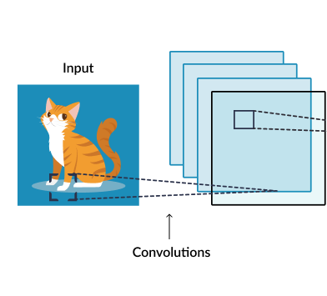
Notes:
With each pixel a feature, close or far pixels most correlated?
Nodes in feature map have same nxn receptive field just slid over/u[ 1 or more (convolution_
Each node in first feature map has same exact weights. When learned do weight averaging. Learns a feature (foot), Each outputs high if a foot in its fields, exhaustive search for feet!
Second feature map learns a different feature, etc.
Each weight matrix called a filter

Slide 12
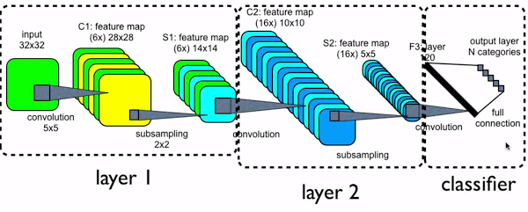
Convolutional Neural Networks
Big Picture: Each feature map learns a different feature. Each node in feature map has same translated receptive field (and weights)
Brute force search to see if and where certain features exist
Pooling/sub-sampling – Does the feature exist in a general area
Final standard supervised layer with improved feature space
Notes:
Big Picture – then we will look at each part in more detail
Start with bottom picture – use top solidify connection to all maps in previous layer for convolution maps
What features help, background?, most discover

Slide 13
Convolutions
Typical MLPs have a connection from every node in the previous layer, and the net value for a node is the scalar dot product of the inputs and weights (e.g. matrix multiply). Convolutional nets are somewhat different:
  Nodes still do a scalar dot product from the previous layer, but with only a small portion (receptive field) of the nodes in the previous layer – Sparse representation
  Every node in a feature map has the exact same weight values from the preceding layer – Shared parameters, tied weights, a LOT less unique weight values. Regularization by having same weights looking at lots of input positions (Convolutional filter – same weights)
  Each node has its shared weight convolution computed on a receptive field slightly shifted, from that of its neighbor, in the previous layer – Translation invariance.
  Each node’s convolution scalar (net value) is then passed through a non-linear activation function (ReLU, tanh, sigmoid, etc.)
Notes:
Called convolution since same weight mask from each node of feature map

Slide 14
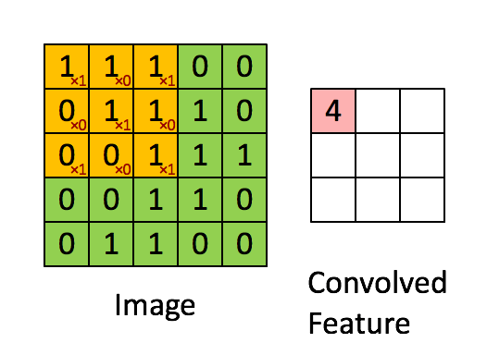
Convolution Example
Notes:
Think of receptive field as a convolution operator, translation is just all the different nodes in the feature map, save for next slide
then pass convolved feature through the non-linearity

Slide 15
CNN
The 2-d planes of nodes (or their outputs) at subsequent layers in a CNN are called feature maps
Thus each feature map searches the full previous layer to see if, where, and how often its feature occurs (precise position less critical)
  The output will be high at each node in the map corresponding to a receptive field where the feature occurs (e.g. edge, curve)
  Convolution layers search across all feature maps of the previous layer
  Later layers can concern themselves with higher order combinations of features and rough relative positions – e.g. eyes next to each other with nose below
Notes:
Exact position of detected feature not important, but the relative positions can be and can be captured by later layers
5x5, 4x4 common
Convolution input, kernel (learned convolution of weights - tensor), and feature map output

Slide 16
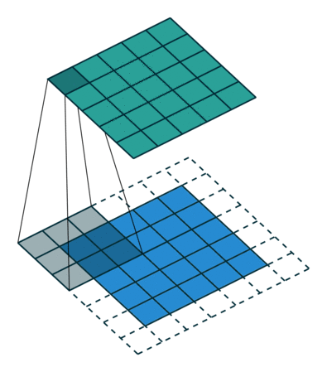
Convolutional Example
0 padding = 1 and stride = 1
Notes:
In theory could be all in parallel, but implemented sequentially as a convolution.
https://towardsdatascience.com/a-comprehensive-guide-to-convolutional-neural-networks-the-eli5-way-3bd2b1164a53
Stride = 1

Slide 17
Sub-Sampling (Pooling)
Convolution and sub-sampling layers can be interleaved
Sub/Down-sampling (Pooling) allows the number of features to be diminished, and to pool information
  Pooling replaces the network output at a certain point with a summary statistic of nearby outputs
  Max-Pooling common (Just as long as the feature is there, take the max, as exact position is not that critical), also averaging, etc.
  Pooling smooths the data and reduces spatial resolution and thus naturally decreases importance of exactly where a feature was found, just keeping the rough location – translation invariance
  2x2 pooling would do 4:1 compression, 3x3 9:1, etc.
  Convolution may increase number of feature maps per layer, pooling keeps same number of reduced maps (one-to-one correspondence of convolution map to pooled map) as the previous layer
  Less pooling layers common in recent architectures to allow more depth
Notes:
L2 pooling – Square root of sum of the activation squares in the field – ~average magnitude
Max pooling – winner take all for receptive field
Small fields most common (2x2), also allows for deeper network
Note depth of network is basically decided by the sub sampling pool size, since once the feature maps are small (e.g. 5x5) there no more room for convoluting and need to just put then in the MLP
Can get some effects of Pooling and save computation by having convolutional layers less tightly overlapped (stride)

Slide 18
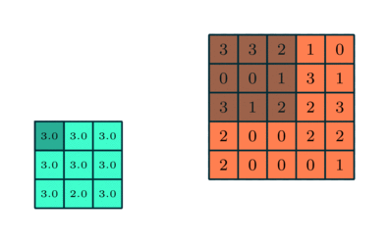
Max Pooling Example
(Sum or Average sometimes used)
Notes:
Skip?, Usually smaller receptive fields, can overlap some

Slide 19
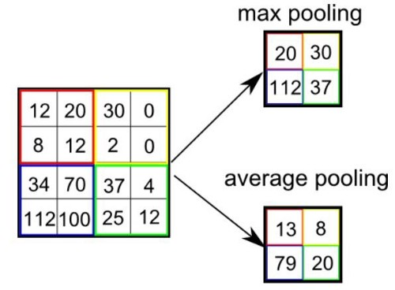
Max and Average Pooling
Non overlapping: Stride = 2
Notes:
Max most common these days and used with small receptive fields (2x2)

Slide 20
Pooling (cont.)
  Common layers are convolution, non-linearity, then pool (repeat)
  Note that pooling/down-sampling decreases map sizes (unless pool stride = 1, highly overlapped), making real deep nets more difficult. Pooling is sometimes used only after multiple convolved layers and sometimes not at all.
  At later layers pooling can make network invariant to more than just translation – learned invariances
Notes:
Skip in 472, Create “Grandmother” cells corresponding do different variants of the concept

Slide 21
CNN Training
Trained with BP, with weight tying in each feature map
  Randomized initial weights throughout entire network, standard training on final fully connected network
Feature Maps
  Each feature map has one weight for each input and one bias
  Thus a feature map with a 5x5 receptive field (filter) would have a total of 26 weights, which are the same coming into each node of the feature map
  If a convolution layer had 10 feature maps with 5x5 receptive fields, then a total of 260 unique weights would be trained in that layer (much less than an arbitrary deep net layer without sharing)
  Calculate weight updates independently into each node but don’t update yet. Average the weight updates over the tied weights and update each the same.
Sub-Sampling (Pooling) Layer
  All elements of receptive field max’d, averaged, summed, etc. No trainable weights necessary
While all weights are trained, the structure of the CNN is currently usually hand crafted with trial and error, including number of total layers, number of receptive fields, size of receptive fields, size of sub-sampling (pooling) fields, etc.
Notes:
Note that pooling (size and function) are hand-crafted by the network designer, though there is a trainable weight and bias to “tune” the pooling
Or BP variant
Can use Local response normalization or variants – effort to have feature maps learn different features, but not essential
But standard BP already deals with that since trying to minimize errors and if all hidden nodes learned the same function, then would get lousy accuracy, with easy problem could duplicate, but then that is all right.
Usually need more maps in layers (100s…)

Slide 22
CNN Hyperparameters
Structure itself, number of layers, size of filters, number of feature maps in convolution layers, connectivity between layers, activation functions, final supervised layers, etc.
Drop-out often used in final fully connected layers for overfit avoidance – less critical in convolution/pooling layers which already regularize due to weight sharing
As is, the feature map would always decrease in volume which is not usually desirable - Zero-padding avoids this and lets us maintain up to the same volume
  Would shrink fast for large kernel/filter sizes and would limit the depth (number of layers) in the network, smaller kernels common (3x3)
  Also allows the different filter sizes to fit arbitrary map widths
Stride – Don’t have to test every location for the feature (i.e. stride = 1), could sample more coarsely
  Another option (besides pooling) for down-sampling
Notes:
Locally unique connections – Same map size but weights trained independently
Tiled convolution – neighbor node uses different kernel, but kernels repeat after some stride
Could have a stride value in each dimension

Slide 23
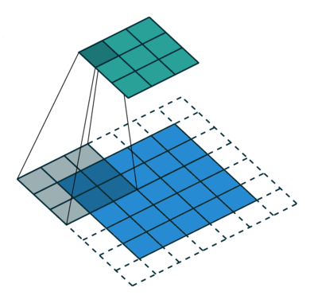
Zero-Pad = 1, Stride = 2
Notes:
https://towardsdatascience.com/a-comprehensive-guide-to-convolutional-neural-networks-the-eli5-way-3bd2b1164a53
Stride = 2
Stride another way of downsampling rather than pooling

Slide 24
Convolutional Example
Zero pad = 1 and stride = 1
Note that the next layer (top) is still 5x5 due to the zero padding. What size would the next layer have been without zero padding?
Notes:
https://towardsdatascience.com/a-comprehensive-guide-to-convolutional-neural-networks-the-eli5-way-3bd2b1164a53
Stride = 1
Without zero padding our next layer would have been 3x3 rather than 5x5

Slide 25
Example – CNN MNIST Classification
Roughly based on LeCun's original model. To help it all sink in:
How many connections and trainable weights at each layer?
  MNIST data input is 28x28 pixels
  Stride = 1 for convolutions, and pooling is non-overlapping
6 maps 16 maps 120 nodes
Notes:
Why 32x32 to start with. Actual characters never bigger than 28x28. Just padding the edges so for example the top corner node of the feature map can have a pad of two up and left for its feature map.
Same drop occurs with 14x14 to 10x10 drop S2 to C3
C1: 156 weights (26*6), 122,304 connections 26*28*28*6 – Parameter sharing - regularization
S1: 0 weights. Connections: 2x2*6*14*14 = 4704
C2: (5*5*6+1) No zero pad this time, weights per node times 16 maps: 2416 weights . Connections: 2416*10*10 = 241,600
S2: 0 weights. Connections: 2x2*16*5*5 = 1600
S2 final number of extracted features: 5*5*16 = 400
N1: 120*(5*5*16+1) = 48,120 weights and connections are the same since it is just a fully connected MLP at this point
N2 Output: (120+1) * 10= 1210

Slide 26
Basic CNN Example
Layer | Trainable Weights per layer | Total Connections
C1 | (25+1)*6 = 156 | 156*28*28 = 122,304
S1 | 0 (LeCun had (1+1)*6 = 12) | 4 (2x2 links) *6*14*14 = 4704
C2 | (5*5*6+1)*16 = 2416 | 2416*10*10 = 241,600
S2 | 0 | 4 (2x2 links) *16*5*5 = 1600
N1 | (5*5*16+1)*120 = 48,120 | Same since fully connected MLP at this point
Output | (120+1)*10 = 1210 | Same
Why 32x32 to start with? Actual characters never bigger than 28x28. Just padding the edges so for example the top corner node of the feature map can have a pad of two up and left for its feature map (since receptive field is 5x5). Same things happens with 14x14 to 10x10 drop from S1 to C2.
S1 and S2 non-overlapping and pool (max most common) – We include here the 4 unweighted connections
  LeCun had a trainable weight and a bias in pool layer followed by a non-linearity, not really necessary and not used these days
C2: Connects to all preceding maps, but no zero-padding so maps decrease in size
  LeCun had each map connect to a subset of the preceding maps
S2: Final number of extracted features to go to the MLP: (5*5)*16 = 400
419,538 total connections, with 51,902 trainable parameters 95% of which are in the final MLP. Only 2572 trainable weights in CNN.
Notes:
C1 also connects to all preceding maps, but there is just one, often a ”stack”, see next slide

Slide 27
Convolutional Neural Networks
Notes:
Big Picture – then we will look at each part in more detail
Start with bottom picture – use top solidify connection to all maps in previous layer for convolution maps
What features help, background?, most discover

Slide 28
CNN Homework
Assume a traditional CNN with an initial input image of 16x16, followed by a convolutional layer with 8 feature maps using 5x5 receptor fields, followed by a max pooling layer with 2x2 receptive fields, followed by a convolution layer with 10 feature maps using 3x3 receptor fields. Those outputs go straight into (no additional pooling layer) a fully connected MLP with 20 hidden nodes followed by 3 output nodes for 3 possible output classes. Assume no zero-padding and stride=1 for convolution layers, no overlap and no trainable weights for the one pooling layer, and convolutional maps connect to all maps in the previous layer. Sketch the network. For each layer state a) What is the size of the maps in the layer (e.g. the input layer is 16x16), b) how many unique trainable weights are there per layer, and c) total connections in the layer. Show your work and explain your numbers in each case (similar to the previous slide).

Slide 29
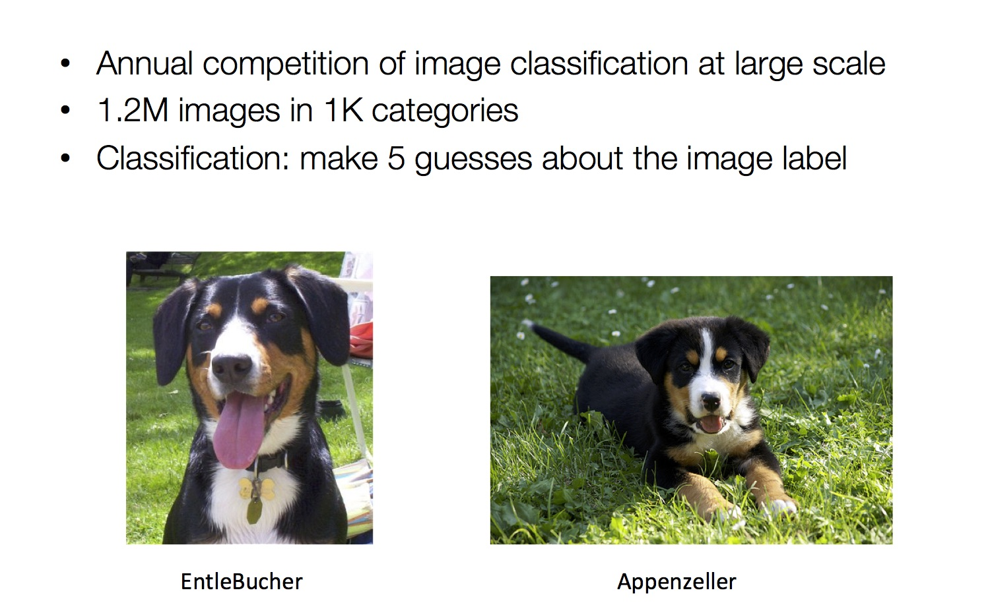
ILSVRC Image net Large Scale Vision Recognition Competition
RGB: 224 x 224 x 3 = 150,528 raw real valued features
Notes:
Top-5 error – Is target label one of your top 5 predictions ) Dog, dogtype, etc.
224x224x3 (RGB) input – 150,000 raw input features
Image net larger 15M and 22k classes

Slide 30
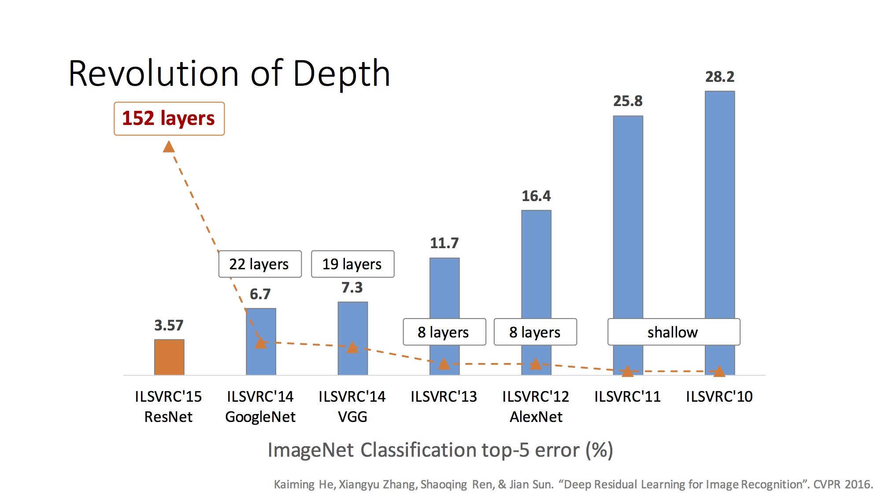
Increasing Depth
Notes:
Alex Krizhevsky w/Hinton
ResNet also used batch normalization
2015 - Ensemble of Residual Networks
Reaching human levels of discrimination
2016 – down to 3.0% with ensemble, but not a new model (boring?) – No new major architectures, reaching Bayes limit, Interest waned and many main competitors had moved on

Slide 31
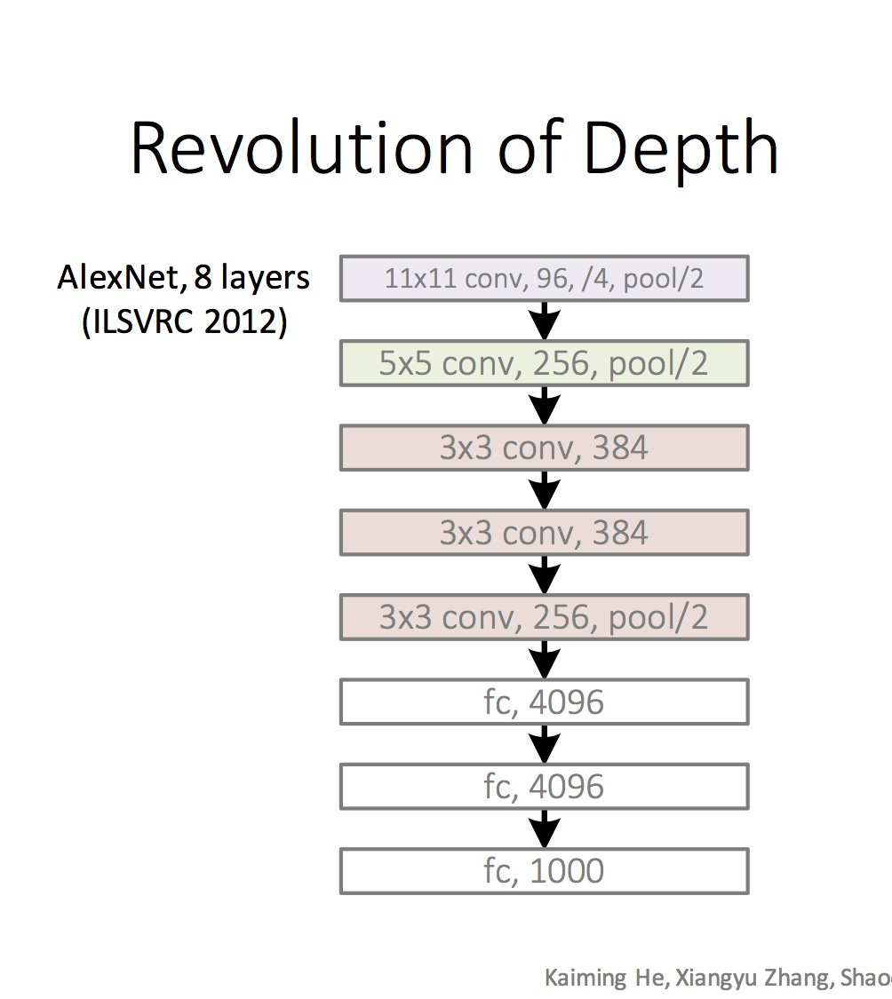
Example CNNs Structures ILSVRC winners
Note Pooling considered part of the layer
96 convolution kernels (maps), then 256, then 384
Stride of 4 for first convolution kernel, 1 for the rest
Pooling layers with 3x3 receptive fields and stride of 2 throughout
Finishes with fully connected (fc) MLP with 2 hidden layers and 1000 output nodes for classes
Notes:
Alex Krizhevsky w/Hinton
Note Convolution and Pool often considered one convolutional layer (Layers are number of layers with convolution)
96 kernels/feature maps, then 256, etc.
/4 stride of 4 for convolution first layer, 1 for rest
/2 stride 2 overlapped pooling throughout – Alex net uses 3x3 pooling receptive field
Used local response normalization – Lateral inhibition approach with ReLUs which increase highest neurons while inhibiting local neighbors

Slide 32
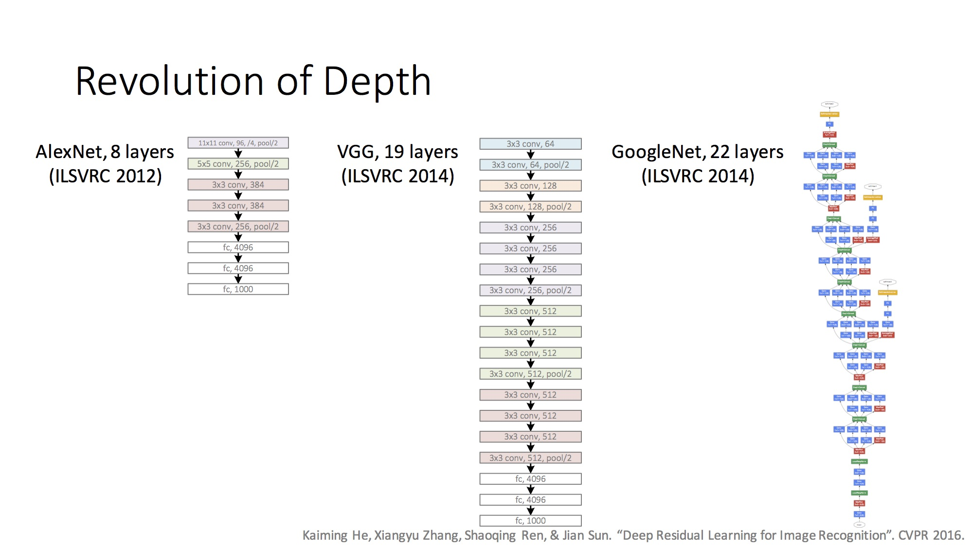
Example CNNs Structures ILSVRC winners
Notes:
VGG – Very Deep CNNs – Visual Geometry Group (VGG) Oxford, England - small filters 3x3 (smallest possible to give Up down left right) with more depth (19 layers), zero pad to maintain volume
Stride 1 for convolution, stride 2 for pooling, pooling only every 4 layers
No Batch Norm in VGG – BN not until 2015

Slide 33
CNN Summary
High accuracy for image applications – Breaking all records and doing it using just using just raw pixel features!
Special purpose net –Works for images or problems with strong grid-like local spatial/temporal correlation (Speech, games, etc.)
Once trained on one problem (e.g. vision) could use same net (often tuned) for a new similar problem – general creator of vision features, pre-trained nets
Unlike traditional nets, handles variable sized inputs
  Same filters and weights, just convolve across different sized image and dynamically scale size of sub-sampling (pooling or increase strid with convolutions), or # of nodes, to normalize
  Different sized images, different length speech segments, etc.
Lots of hand crafting and CV tuning to find the right recipe of receptive fields, layer interconnections, etc.
  Lots more Hyperparameters than standard nets, since the structures of CNNs are more handcrafted
  CNNs getting wider and deeper with speed-up techniques (e.g. GPU, ReLU, etc.) and lots of current research, excitement, and success
Notes:
Dynamic size – Pooling region just sums/maxes over an area with one final weight so no hard changes when we adjust pool region size
Simard 2003, Simple consistent CNN structure 5x5 with 2x2 subsampling with number of features 5 in first C-layer, 50 in next, until too small.
Don’t actually used pool layer as instead just connect every other node which samples rather than max/average.
Each layer reduces feature size by (n-3)/2. Just two layers for mnist.
They also use elastic distortions which is a type of jitter to get increased data. 99.6% - best at the time, Distortions also help a lot with standard MLP
Thus an approach with less Hyperparameter fiddling
Ciresan and Schmidhuber 2012, Multi column DNN. CNN with depth 6-10 (deeper if initial input image is bigger), and wider on fields, 1-2 hidden layers in MLP, columns are CNNs (an ensemble with different parameters, features, etc.) where their output is averaged, jitter inputs, multi-day GPU training, annealed LR (.001 dropping to .00003) 99.76% mnist

Slide 34
Unsupervised Pre-Training
Began the hype of Deep-Learning (2006)
  Before CNNs were fully recognized for what they could do
  Less popular at the moment for supervised learning, with recent supervised success, but still at the core of many new research directions
  Unsupervised Pre-Training uses unsupervised learning in the deep layers to transform the inputs into features that are easier to learn by a final supervised model
  Unsupervised training between layers can decompose the problem into distributed sub-problems (with higher levels of abstraction) to be further decomposed at subsequent layers
Often not a lot of labeled data available while there may be lots of unlabeled data. Unsupervised Pre-Training can take advantage of unlabeled data. Can be a huge issue for some tasks.

Slide 35
Self Taught vs Unsupervised Learning
When using Unsupervised Learning as a pre-processor to supervised learning you are typically given examples from the same distribution as the later supervised instances will come from
  Assume the distribution comes from a set containing just examples from a defined set of possible output classes, but the label is not available (e.g. images of car vs trains vs motorcycles)
In Self-Taught Learning we do not require that the later supervised instances come from the same distribution
  e.g., Do self-taught learning with any images, even though later you will do supervised learning with just cars, trains and motorcycles.
  These types of distributions are more readily available than ones which just have the classes of interest (i.e. not labeled as car or train or motorcycle)
  However, if distributions are very different…
New tasks share concepts/features from existing data and statistical regularities in the input distribution that many tasks can benefit from
  Can re-use well-trained nets as starting points for other tasks
  Note similarities to supervised multi-task and transfer learning
Both unsupervised and self-taught approaches reasonable in deep learning models
Notes:
Skip in 270
Can use same approaches with supervised nets (CNNs, etc.)

Slide 36
Deep Net with Greedy Layer Wise Training
Supervised
Learning
ML Model
New Feature Space
Unsupervised
Learning
Original Inputs
Notes:
Can input both new and original spaces

Slide 37
Greedy Layer-Wise Training
Train first layer using your data without the labels (unsupervised)
  Since there are no targets at this level, labels don't help. Could also use the more abundant unlabeled data which is not part of the training set
Then freeze the first layer parameters and start training the second layer using the output of the first layer as the unsupervised input to the second layer
Repeat this for as many layers as desired
  This builds the set of robust features
Use the outputs of the final layer as inputs to a supervised layer/model and train the last supervised layer(s) (leave early weights frozen)
Unfreeze all weights and fine tune the full network by training with a supervised approach, given the pre-training weight settings
Notes:
If do full supervised, we may not bet the benefits of building up the incrementally abstracted feature space
Steps 1-4 called pre-training as it gets the weights close enough so that standard training in step 5 can be effective
Do fine tuning for sure if lots of labeled data, if little labeled data, not as helpful.

Slide 38
Greedy Layer-Wise Training
Greedy layer-wise training avoids many of the problems of trying to train a deep net in a supervised fashion
  Each layer gets full learning focus in its turn since it is the only current "top" layer (no unstable gradient issues, etc.)
  Can take advantage of unlabeled data
  When you finally tune the entire network with supervised training the network weights have already been adjusted so that you are in a good error basin and just need fine tuning. This helps with problems of
    Ineffective early layer learning
    Deep network local minima
The two early landmark approaches
  Deep Belief Networks
  Stacked Auto-Encoders

Slide 39
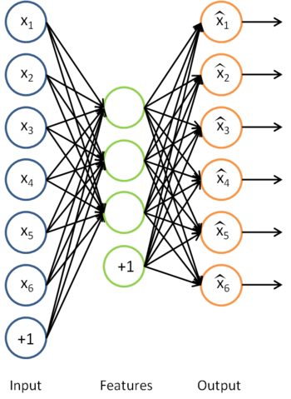
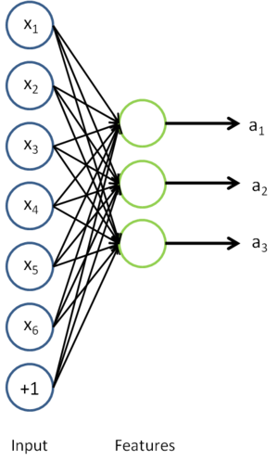
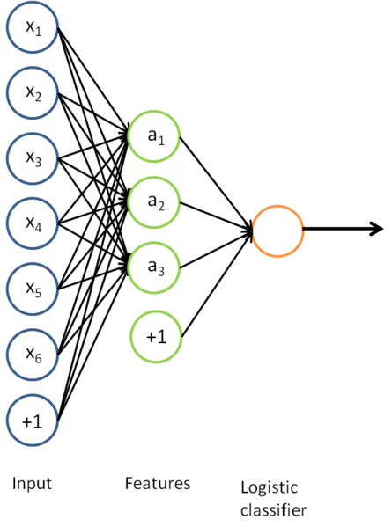
Auto-Encoders
A type of unsupervised learning which discovers generic features of the data
  Learn identity function by learning important sub-features
  Compression, etc. – Undercomplete |h| < |x|
  For |h| ≥ |x| (Overcomplete case more common in deep nets) use regularized autoencoding: Loss function includes regularizer to make sure we don’t just pass through the data (e.g. sparsity, noise robustness, etc.)
Notes:
Though Deep Nets done first, start with auto-encoders because they are simpler
Mention Zipser auotencoder with reverse engineering, then Cottrell compression where unable to reverse engineer
If h is smaller than x then “undercomplete” autoencoding – also would use “regularized” autoencoding
Can use just new features in the new training set or concatenate both original and new

Slide 40
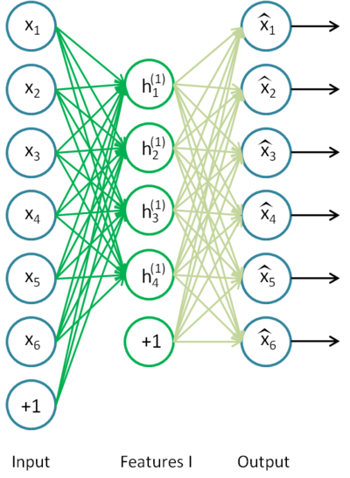
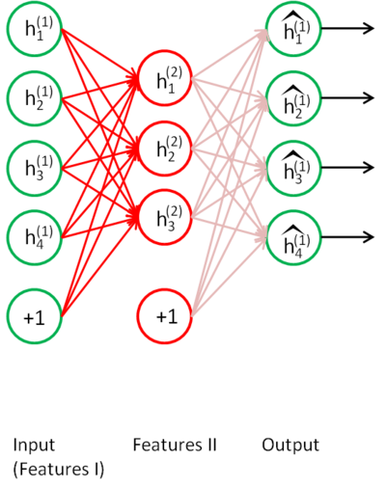
Stacked Auto-Encoders
Bengio (2007) – After Deep Belief Networks (2006)
Stack many (sparse) auto-encoders in succession and train them using greedy layer-wise training
Drop the decode output layer each time

Slide 41
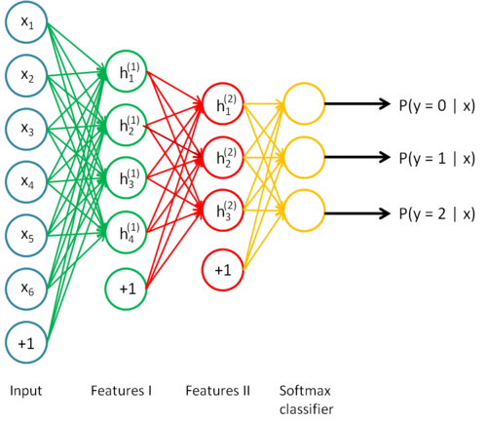
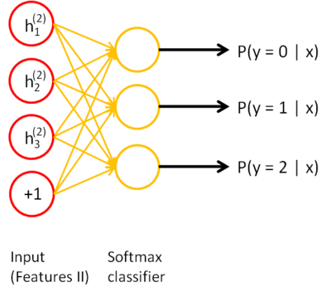
Stacked Auto-Encoders
Do supervised training (can now only used labeled examples) on the last layer using final features
Then do supervised training on the entire network to fine- tune all weights
Notes:
Shows softmax, but could use any supervised classifier
Each encoder/decoder layers could also be deep rather than one layer, empirically shown to be better vs stacking shallows to build a deep network
Stop here for 270 and jump to speed-up

Slide 42
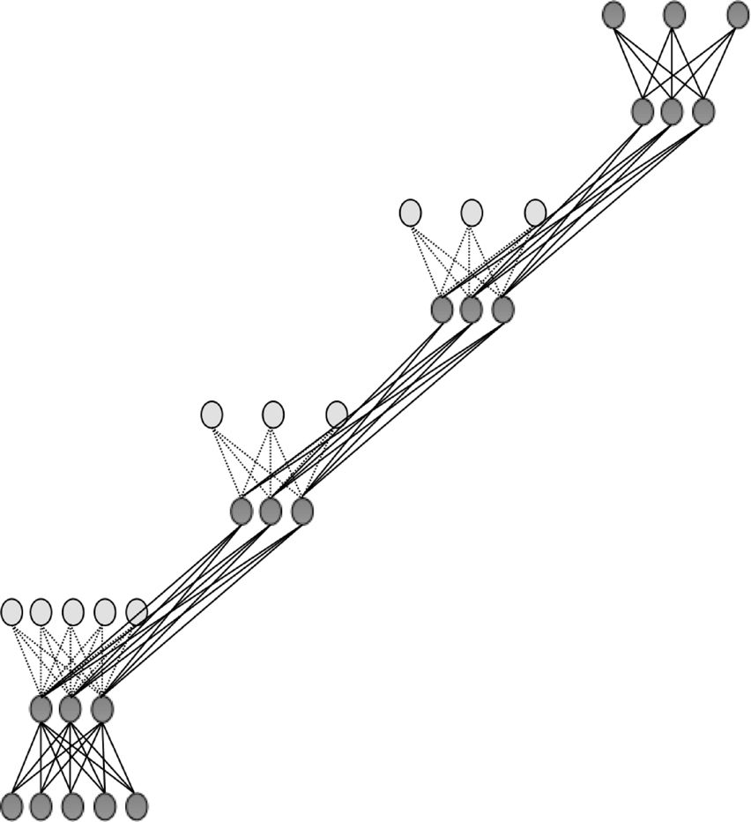

Slide 43
Sparse Encoders
Auto encoders will often do a dimensionality reduction
  PCA-like or non-linear dimensionality reduction
This leads to a "dense" representation which is nice in terms of parsimony
  All features typically have non-zero values for any input and the combination of values contains the compressed information
However, this distributed and entangled representation can often make it more difficult for successive layers to pick out the salient features
A sparse representation uses more features where at any given time many/most of the features will have a 0 value (ReLUs help)
  Thus there is an implicit compression each time but with varying nodes
  This leads to more localist variable length encodings where a particular node (or small group of nodes) with value 1 signifies the presence of a high-order feature (small set of bases)
  A type of simplicity bottleneck (regularizer)
  This is easier for subsequent layers to use for learning

Slide 44
Sparse Representation
For bases below, which is easier to see intuition for current pattern - if a few of these are on and the rest 0, or if all have some non-zero value?
Easier to learn if sparse
Notes:
Each square in the figure above shows the (norm bounded) input image that maximally activates one of 100 hidden units. We see that the different hidden units have learned to detect edges at different positions and orientations in the image.
This image if for a simple auto-encoder with 100 hidden units trained on 10x10 images (from UFLDL tutorial)

Slide 45
How do we implement a sparse Auto-Encoder?
Use more hidden nodes in the encoder
Use regularization techniques which encourage sparseness (e.g. a significant portion of nodes have 0 output for any given input)
  Penalty in the learning function for non-zero nodes
  Weight decay
  etc.
De-noising Auto-Encoder
  Stochastically corrupt training instance each time, but still train auto-encoder to decode the uncorrupted instance, forcing it to de-noise and learn conditional dependencies within the instance
  Improved empirical results, handles missing values well
Notes:
And make sure it doesn't just learn the pass through identity
Sparsity parameter (approach in UFLDL tutorial) is target average activation for all hidden nodes across training set (e.g. .05) requires a forward pass of all data first to calculate current average activation, then a penalty term on error to push avg activation towards the sparsity parameter.

Slide 46
Stacked Auto-Encoders
Concatenation approach (i.e. using both hidden features and original features in final (or other) layers) can be better if not doing fine tuning. If fine tuning, the pure replacement approach works well.
Always fine tune if there is a sufficient amount of labeled data
For real valued inputs, auto-encode training is regression and thus could use linear output node activations (thrown out after anyways), still ReLU/non-linear at hidden which are final nodes
Stacked Auto-Encoders empirically not quite as accurate as DBNs (Deep Belief Networks)
  (with De-noising auto-encoders, stacked auto-encoders competitive with DBNs)
  Not generative like DBNs, though recent work with de-noising auto-encoders may allow generative capacity
Notes:
Linear decoder, And note that with linear output activations the error signal at the output layer is (t-net)*f’(net) = t-net since f’(net)=1,
But standard MLP error, etc. at hidden nodes!

Slide 47
Deep Belief Networks (DBN)
Geoff Hinton (2006) – Beginning of Deep Learning hype – outperformed kernel methods on MNIST – Also generative
Uses Greedy layer-wise training but each layer is an RBM (Restricted Boltzmann Machine)
RBM is a constrained
Boltzmann machine with
  No lateral connections between
  hidden (h) and visible (x) nodes
  Symmetric weights
  Does not use annealing/temperature, but that is all right since each RBM not seeking a global minima, but rather an incremental transformation of the feature space
  Typically uses probabilistic logistic node, but other activations possible
Notes:
Remember Hinton was also the Boltzmann guy
RBM originally called “Harmonium”
DBN not used as much these days

Slide 48
RBM Sampling and Training
Initial state typically set to a training
example x (can be real valued)
Because of RBM, sampling is simple iterative back and forth process
  P(h_{i} = 1|x) = sigmoid(W_{i}x + c_{i}) = 1/(1+e^{-net(hi)}) // c_{i} is hidden node bias
  P(x_{i} = 1|h) = sigmoid(W'_{i}h + b_{i}) = 1/(1+e^{-net(xi)}) // b_{i} is visible node bias
Contrastive Divergence (CD-k): How much contrast (in the statistical distribution) is there in the divergence from the original training example to the relaxed version after k relaxation steps
Then update weights to decrease the divergence as in Boltzmann
Typically just do CD-1 (Good empirical results)
  Since small learning rate, doing many CD-1 updates is similar to doing fewer versions of CD-k with k > 1
  Note CD-1 just needs to get the gradient direction right, which it usually does, and then change weights in that direction according to the learning rate
Notes:
Since x starts as a training example, after a bit of training, it should already be close to/in an energy well
RBM allows a tractable block Gibbs sampling (all nodes in a layer sampled at once) because the nodes in a layer are all independent of one another given the opposite layer (i.e. no lateral connections). Otherwise sampling to get is much more complex (intractable)
CD-1 a bit like stochastic vs batch, get update quick, make small change, on average good vs longer time to still make a small change with better chance of right direction

Slide 49
Notes:
Delta wij = x1(initial x1) * h1 (initial sample) – Q(hk) (final h probablity) * xk (final x sample)
Q and P are probability distribution vectors, for hidden(h) and visible/input (x) vectors respectively
Do a small example on the board, at least one x value real and not all same weights (set it up like HW)
Why back to Q?, need a p1, q1, p2. q2 then can update
Note W update based on when they are both simultaneously on as in standard Boltzmann If h1 and x1 both 1 then weight change >= 0, else <=0, if x2 = 0, then no weight change, else change by c*Q(h2), real or sampled
Delta w works both ways for h and x. Delta w = initial product of x1 and h1 – final product of xk and Qk)
binomial is standard MLP sigmoid unit

Slide 50
RBM Update Notes and Variations
Example (based on HW with different values) and Homework
Binomial unit means the standard MLP sigmoid unit
Q and P are probability distribution vectors for hidden (h) and visible/input (x) vectors respectively
During relaxation/weight update can alternatively do updates based on the real valued probabilities (sigmoid(net)) rather than the 1/0 sampled logistic states
  Always use actual/binary values from initial x -> h
    Doing this makes the hidden nodes a sparser bottleneck and is a regularizer helping to avoid overfit
  Could use probabilities on the h -> x and/or final x -> h
    in CD-k the final update of the hidden nodes usually uses the probability value to decrease the final arbitrary sampling variation (sampling noise)
Lateral restrictions of RBM allow this fast sampling
Notes:
Example – 2 inputs 3 hiddens, all weights .5 including biases, Thus all values the same
No lateral – allows set up and back passes
Optional: Persistent MCMC for free (negative) phase – Just keep sampling from a long-term chain (ignoring the weight updates)
trade-off long term chain accuracy vs updated weights
Early sampling can be a type of de-noise which could aid sparseness

Slide 51
RBM Update Variations and Notes
Initial weights, small random, 0 mean, sd ~ .01
  Don't want hidden node probabilities early on to be close to 0 or 1, else slows learning, since less early randomness/mixing? Note that this is a bit like annealing/temperature in Boltzmann
Set initial x bias values as a function of how often node is on in the training data, and h biases to 0 or negative to encourage sparsity
Better speed when using momentum (~.5)
Weight decay good for smoothing and also encouraging more mixing (hidden nodes more stochastic when they do not have large net magnitudes)
Notes:
Also a reason to increase k over time in CD-k as mixing decreases and weight magnitudes increase

Slide 52
Deep Belief Network Training
Same greedy layer-wise approach
First train lowest RBM (h⁰ – h¹) using RBM update algorithm (note h⁰ is x)
Freeze weights and train subsequent RBM layers
Then connect final outputs to a supervised model and train that model
Finally, unfreeze all weights, and fine tune as an MLP using the initial weights found by DBN training
Can do execution as just the tuned MLP or as the RBM sampler with the tuned weights
  During execution can iterate multiple times at the top RBM layer
Notes:
Picture above is for generative model (so ignore solid vs dotted lines at this point

Slide 53
Can use DBN as a Generative model to create sample x vectors
  Initialize top layer to an arbitrary vector (commonly a training set vector)
    Gibbs sample (relaxation) between the top two layers m times
    If we initialize top layer with values obtained from a training example, then need less Gibbs samples
  Pass the vector down through the network, sampling with the calculated probabilities at each layer
  Last sample at bottom is the generated x vector (can be real valued if we use the probability vector rather than sample)
Alternatively, can start with an x at the bottom, relax to a top value, then start from that vector when generating a new x, which is the dotted lines version. More like standard Boltzmann machine processing.
Notes:
Alternatively, Can start with an x at bottom, relax to a top value, then start from that vector when generating a new x, which is the dotted lines added version

Slide 54
Middle for-loop samples from input up to current RBM layer being updated – none for 1st layer, mean_field_computation just a flag on whether to sample or use real values
Notes:
Initial x can be real valued
Note that nodes have two sets of biases. Only one is used at a time depending on if node is visible or hidden for that layer
While loop does RBM weight training until convergence for the kth layer
second for loop samples from x up to k-1 so that we can then do RBM update at the kth layer
Mean_field_computation just a flag on whether we sample or use the real values – Lots of wiggle room here, could do it different for different layers or even randomly, etc.
Follow through code for k=1 and k=3 so they see the flow

Slide 55
DBN Execution
After all layers have learned then the output of the last layer can be input to a supervised learning model
Note that at this point we could potentially throw away the downward bias weights in the network as they will not actually be used during the feedforward discriminative execution process (as we did with the Stacked Auto Encoder)
  If we are relaxing M times in the top layer then we would still need the downward weights for that layer
  Also if we are generating x values we would need all of them
The final weight tuning is usually done as an MLP with backpropagation, which only updates the feedforward weights
Can do execution as just the tuned MLP or as the RBM sampler with the tuned weights
Notes:
Downward weights were mostly necessary for training the feedforward weights

Slide 56
DBN Learning Notes
RBM stopping criteria still in issue.
Each layer updates weights so as to make training sample patterns more likely (lower energy) in the free state (and non-training sample patterns less likely).
This unsupervised approach learns broad features (in the hidden/subsequent layers of RBMs) which can aid in the process of making the types of patterns found in the training set more likely. This discovers features which can be associated across training patterns, and thus potentially helpful for other goals with the training set (classification, compression, etc.)
Note still pairwise weights in RBMs, but because we can choose the number of hidden units and layers, we can represent any arbitrary distribution
Notes:
Brief
RBM stopping criteria still in issue. One common approach is reconstruction error which is the probability that the final x after CD-k is the initial x. (i.e. P(􏰀x|E[h|x􏰈]). The other most common approach is AIC (Annealed Importance Sampling). Both have been shown to be problematic.

Slide 57
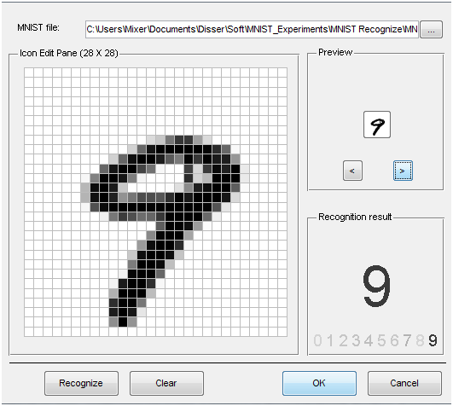
MNIST
Notes:
Go to project page
Mnist 28x28 (784) grey scale (0-255) values.
Could do some smarter preprocessing of features!
Just use straight data as our baseline.

Slide 58
DBN Project Notes
To be consistent just use 28×28 (764) data set of gray scale values (0-255)
  Normalize to 0-1
  Could try better preprocessing if want and helps in published accuracies, but start/stay with this
  Small random initial weights
Parameters
  Hinton Paper, others – do a little searching and e-mail me a reference for extra credit points
  http://yann.lecun.com/exdb/mnist/ for sample approaches
Straight 200 hidden node MLP does quite good ~98%
  Rough Hyperparameters - LR: ~.05-.1, Momentum ~.5
Best class DBN results: ~98.5% - which is competitive
  About half students never beat MLP baseline
  Can you beat the 98.5%?
Notes:
MLP results much better than that reported by LeCun and beats many of the other papers, including some of the Deep net results. BP results 1998, slower machines, higher LR, etc.??
http://yann.lecun.com/exdb/mnist/ - Show site, especially last 2 rows (outdated? – MNIST considered solved), His first row (linear classifier) is a perceptron though he calls it one layer NN)

Slide 59
Deep Learning Project Past Experience
Structure: ~3 hidden layers, ~500ish nodes/layer, more nodes/layers can be better but training is longer
Training time:
  DBN: ~10 epochs with the 60K set, small LR ~.005 often good
  Can go longer, does not seem to overfit with the large data set
  SAE: Can saturate/overfit, ~3 epochs good, but will be a function of your de-noising approach, which is essential for sparsity, use small LR ~.005, long training – up to 50 hours, got 98.55
    Larger learning rates often lead to low accuracy for both DBN and SAE
Sampling vs using real probability value in DBN
  Best results found when using real values vs. sampling
  Some found sampling on the back-step of learning helps
  When using sampling, probably requires longer training, but could actually lead to bigger improvements in the long run
  Typical forward flow non-sampled during execution, but could do some sampling on the m iterations at the top layer. Some success with back-step at the top layer iteration (most don't do this at all)
  We need to try/discover better variations
Notes:
Examples where nothing happening with quality learning, but once LR get low enough, suddenly they both learn real well.

Slide 60
Deep Learning Project Past Experience
Note: If we held out 50K of the dataset as unsupervised, then deep nets would more readily show noticeable improvement over BP
A final full network fine tune with BP always helps
  But can take 20+ hours
Key take away – Most actual time spent training with different parameters. Thus, start early, and then you will have time to try multiple long runs to see which variations work. This does not take that much personal time, as you simply start it with some different parameters and go away for a day. If you wait until the last few days, there is no time to do these experiments.
Notes:
Final BP tune only works for the feedforward weights. Ignore the others which are not used anyways during normal forward processing (unless we iterate M times at the top layer).
We also could use the downward weights for generative.
Otherwise we just drop the downward weights after learning the forward weights which is what we really wanted (ala SAE).

Slide 61
DBN Notes
Can use lateral connections in RBM (no longer RBM) but sampling becomes more difficult (intractable, approximation such as MCMC) – ala standard Boltzmann requiring longer sampling chains.
  Lateral connections can capture pairwise dependencies allowing the hidden nodes to focus on higher order issues. Can get better results.
Conditional and Temporal RBMs – allow node probabilities to be conditioned by some other inputs – context, recurrence (time series changes in input and internal state), etc.

Slide 62
Discrimination with Deep Belief Networks
Discrimination approaches with DBNs (Deep Belief Net)
  Use outputs of DBNs as inputs to supervised model (i.e. just an unsupervised preprocessor for feature extraction)
    Basic approach we have been discussing
  Train a DBN for each class. For each clamp the unknown x and iterate m times. The DBN that ends with the lowest normalized free energy (softmax variation) is the winner.
  Train just one DBN for all classes, but with an additional visible unit for each class. For each output class:
    Clamp the unknown x, relax, and then see which final state has lowest free energy – no need to normalize since all energies come from the same network.
See http://deeplearning.net/demos/
Notes:
The Demo shows generated instance first with just one iteration from the top RBN. In practice would not do bottom generation until after m iterations. (i.e. after top has settled into a lower energy state)
Should improve in the discrimination variation also after m steps, though seems to get good results sooner
Using Hinton's generating digits demo
http://www.cs.toronto.edu/~hinton/adi/index.htm
Can train supervised by setting initial patterns to digit and digit label and then do CD to updates weights if diverge

Slide 63
More Efficient Deep Learning
Recent success in doing supervised deep learning with extensions which diminish the effect of early learning difficulties (unstable gradient, etc.)
Patience (now that we know it can be worth it), faster computers, and use of GPUs/TPUs
More efficient activation functions (e.g. ReLU) in terms of both computation and avoiding f '(net) saturation
  Also can be helpful to have 0 mean activations at each level, so sigmoid is frowned upon these days. If you want a saturating activation function, tanh is often preferred.
Speed up and regularization approaches
Improved Hyperparameters
Batch Normalization – re-normalize activations at each layer
Residual Nets

Slide 64
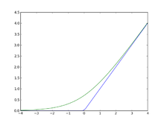
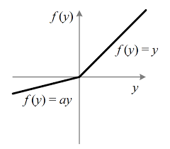
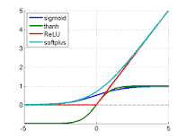
Rectified Linear Units
f(x) = Max(0,x) More efficient gradient propagation, derivative is 0 or constant, just fold into learning rate
  Helps f '(net) issue, but still left with other unstable gradient issues
More efficient computation: Only comparison, addition and multiplication.
  Leaky ReLU f(x) = x if x > 0 else ax, where 0 ≤ a <= 1, so that derivate is not 0 and can do some learning for net < 0 (does not “die”).
  Lots of other variations
Sparse activation: For example, in a randomly initialized network, only about 50% of hidden units are activated (having a non-zero output)
Learning in linear range easier for most learning models
Notes:
Green is softplus function f(x) = ls(1+e^x) (smooth version of RLU), whose derivative is the sigmoid 1/(1+e^-x)
For regular ReLU, set bias slightly positive, so that active to start with
Leaky ReLU f(x) = x if > 0 else .01x – some effect for x < 0
Note ReLU is not everywhere differentiable. At 0 just choose left or right derivative (0 or 1) and works fine empirically, though theoretically a bit bothersome – Note that since net is real number the prob(0) = 0 anyways and if computer has 0, probably just a representation issue and we would be a little to the left or right anyways in a true system.
So why not same with threshold function? Derivate would be 0 everywhere with no learning
Principle: Nets easier to optimize when there behavior is closer to linear
Still learning why ReLUs work as well as they do

Slide 65
Speed up variations of SGD
Use mini-batch rather than single instance for better gradient estimate – Helpful if using GD variation more sensitive to bad gradient, and especially for parallel implementations
Momentum (i.e. Adaptive learning rate) approaches are important since anything to speed-up learning is helpful
  Standard Momentum
    Note the these approaches already do an averaging of grading also making mini-batch less critical
  Nesterov Momentum – Calculate point you would go to if using normal momentum. Then, compute gradient at that point. Do normal update using that gradient and momentum.
  Rprop – Resilient BP, if gradient sign inverts, decrease the node’s individual LR, else increase it – common goal is faster in the flats, there are variants that backtrack a step, etc.
  Adagrad – Scale LRs inversely proportional to sqrt(sum( historical values)) – LRs with smaller derivatives are decreased less
  RMSprop – Adagrad but uses exponentially weighted moving average, older updates basically forgotten
  Adam (Adaptive moments) –Momentum terms on both gradient and squared gradient (1st and 2nd moments) – update based on both
Notes:
Already discussed. Just remind them. Momentum Hits terminal velocity of c||gradient||/(1-mom). Thus .9 gives up to 10 times increase in velocity (LR)
Be Brief after standard momentum

Slide 66
Regularization – Dropout Common
For each instance drop a node (hidden or input) and its connections with probability p and train
Final net just has all averaged weights (actually scaled by 1-p since that better matches the expected values at training time)
As if ensembling 2^{n} different network substructures
Lots of variations – Dropconnect, etc.
Notes:
Just remind. Already seen this also.
Other standard regularization approaches can be used and are needed, Dropout currently Very popular with current deep networks
Scale by 1-p – in training would be 0 p of the time so total weight should be scaled to average with the number of times it should theoretically be 0.
Won’t overfit one particular network structure
Forces to regularize
*Dropconnect – randomly drop connections
Shakeout Instead of randomly discarding units as Dropout does at the training stage, this method randomly chooses to enhance or inverse the contributions of each unit to the next layer.
Others – Dropin, Standout, etc.

Slide 67
Improved Initial Hyperparameter Settings
Deep networks are more sensitive than shallow networks to hyperparameter settings
More critical for deep learning in order to get more balanced learning across all layers
Smaller LRs – patience
To encourage sparsity sometimes initial biases set negative or more initial 0 weights are interspersed
Initial weights – initialize a little larger in effort to find a balance which learns well across all layers. Common is to select initial weights from a uniform distribution between
  -c/root(node fan-in), c/root(node fan-in) (c = 1 Xavier, c = 2 He)
  -c/root(node fan-in + fan-out), c/root(node fan-in + fan-out)
    Can do Gaussian distribution with above as variances
    Lots of other variations and current work
Notes:
Briefly – Less critical once we started using Batch Normalization

Slide 68


Batch Normalization (2015)
Rather than just guess initial parameters to maintain learning balance, renormalize activations at each layer to maintain balance
Just like it is critical to normalize our initial features, we consider each layer to be a new feature set which can also be normalized
We like 0-mean and unit variance inputs (standard 1st layer normalization), we can just re-normalize the net value (less commonly the activation value) for each input dimension k at each layer
Think of each net value as a new feature. Want mean and variance of that activation for the entire data set. Changing! Approximate the empirical mean and variance over a mini-batch of instances.
Goes beyond standard normalization by allowing scaling and shifting of the normalized values with 2 learnable weights per input, γ and β, to attain the final batch normalization (allows recovery of initial or any needed function)
Notes:
For initial feature normalization we have the full static column of the data set to find mean and variance.
With all other layers we do not have that and it is constantly changing. Thus, approximate with a moving average window (Batch)
Added after fully connected layers and convolutional layers in CNNs
Inputs whitened – transformed to have 0 means and unit variances, and decorrelated (ala PCA) – BN whitens at each layer
BN usually done on the net value before passing through a non-linearity.
Scale and shift step allows net to recover the initial identity function if necessary
During batch computation feed the batch normalized activation from lower layers up as input to the next layer to calculate their mean and variance.

Slide 69
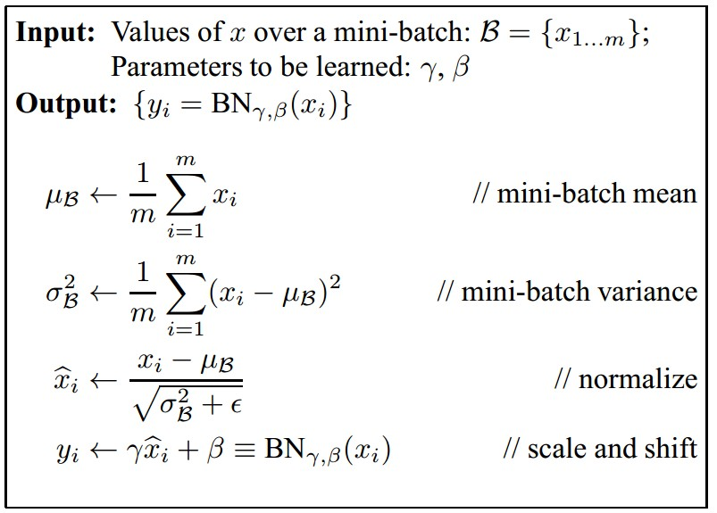
Batch Normalization
[Ioffe and Szegedy, 2015]
Note: Dropped k for simplicity
γ and β learned as part of gradient descent
At test time BatchNorm layer functions differently:
The mean/std are not computed based on a batch. Instead, we use empirical means of values found during training
(e.g. can be estimated during training with running averages)
Notes:
Drop superscript k for simplicity and looks at one activation example, separate gamma and beta for each activation
One might intuitively had thought that BN would be Layered normalization – different approach where you take the mean and variance across all nodes in the same layer and then normalize.

Slide 70
Batch Normalization
Typically normalize before the non-linearity (e.g. ReLU)
Allows larger LR (faster learning), improves gradient flow and reduces dependence on initialization
Doubles the layers, giving more learnable parameters
Notes:
Made deep net deeper with more learnable parameters to help find solution

Slide 71
Layer Normalization (2016)
Shortly after batch normalization (Ba, Kiros, and Hinton)
Rather than normalize a single feature across a batch, normalize the net value of each feature across the layer (the width of the feature vector)
No need of a batch, do normalization for each instance
Exact same at learning and execution time
More common for Recurrent neural networks and transformers

Slide 72
Deep Residual Learning
Residual Nets – 100s of layers
2015 ILSVRC winner
  CNN
  Also used Batch Normalization
Learns the residual mapping with respect to the identity – i.e. the difference (residual) between the current input and the goal mapping
Simple concept which tends to make the function to be learned simpler across depth
Notes:
DRL – Learn residual F(x) every two layers as you advance through the net – difference between current input x and the goal H(x) to get to.

Slide 73
Deep Residual Learning

Slide 74
Deep Residual Learning
Notes:
H(X) is whatever is left over (residual) from the sum of the current network output and the input x (from a few time steps back)

Slide 75
Deep Residual Learning
How many layers to add residuals, etc.? – Trial and error

Slide 76
Residual Nets
Going from an x to an H(x) which is quite different from x requires more learning, larger weights, etc.
However, if H(x) is similar to x, and assuming we start with small weights anyways, it takes a lot less updates to learn it – Easier!
Adding x to a later layer allows it to learn this simpler mapping
Also, if the net had already learned a particular feature, we can just maintain that feature with 0 weights (since x will be added to our 0 output from 0 weights), without having to relearn it all the time – avoid "feature attrition”
  Less worry about too many layers, since need enough to learn, then can retain it with residual (skip) connections

Slide 77
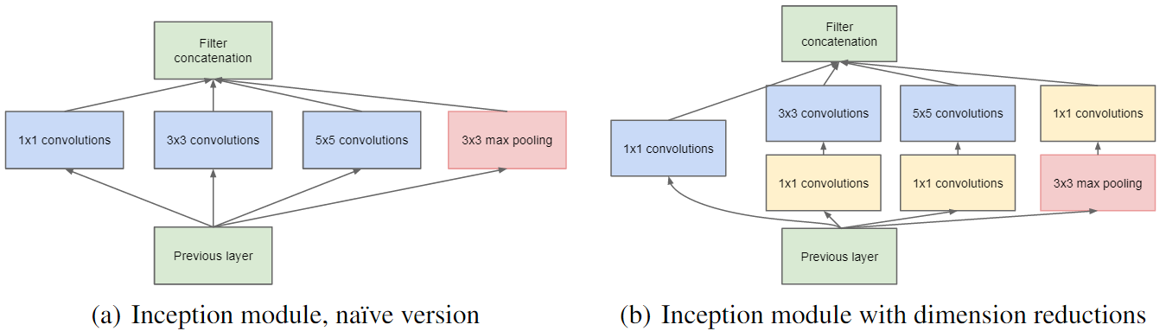
Inception - Google
"Network in a network" – CNN – Deeper and Wider - GoogLeNet
Could replace the basically linear convolution with a more complex non-linear network – e.g. MLP
Basic Inception does different size convolutions and combines results into one output
Reduces added complexity by first doing dimensionality reduction with 1x1 convolution filters – 1 input from each preceding feature map, reduced to 1 value
Notes:
Skip next 2

Slide 78
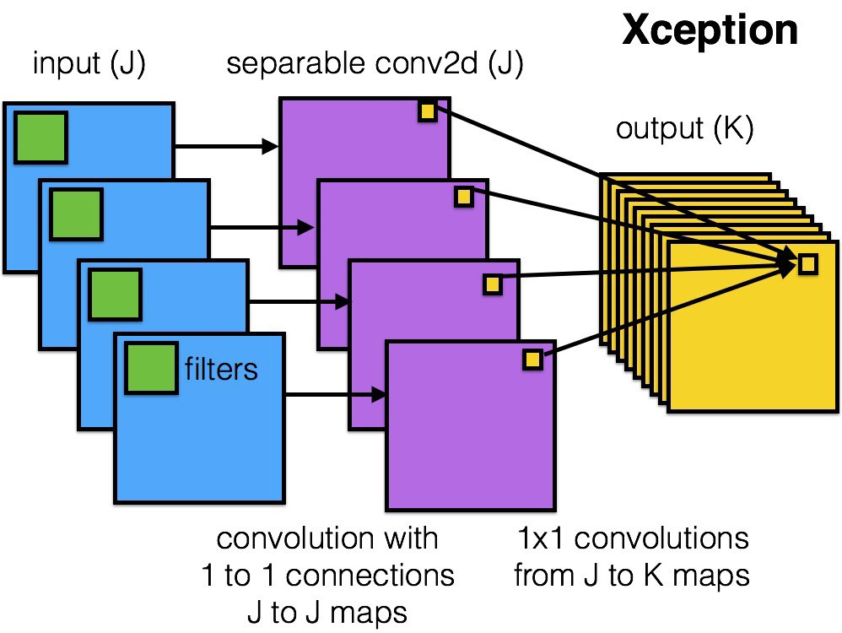
Xception
Xception (extreme inception) decouples spatial and cross-channel correlations – channels only connected at extra layers of 1x1 convolutional maps - wider

Slide 79
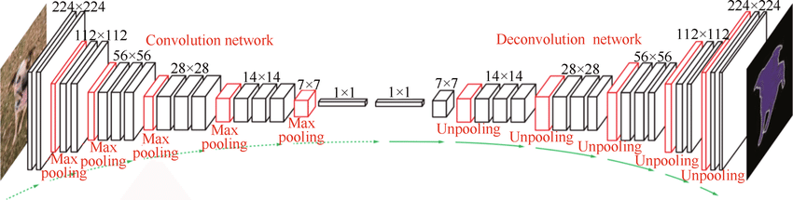
Deep Generative Models
Lots of research on generative models to create probabilistic models of training data with ability to generate new images, sentences, etc.
Deconvolutional Neural Networks can generate images (deconvolution)
Notes:
DBM – All even and odd layers can be sampled simultaneously - Not just up then down, thus more global continuous update
DBM, Often Greedy layer-wise training somewhat like DBN, Generative
DBM – Then if doing classification as typical, put an MLP at top layer for classification, then set as entire MLP for final tuning and classification
Lots of Boltzmann variations to model real values rather than probabilities over binary values
Thus GANs could be used to aid generation and/or discrimination?
Evaluating models can be a challenge, Human inspection?, Make sure not just copying training data (overfit)
Also convolutional generative models. Kind of an inverse CNN, Learn multiple things, face, face orientation, then could do random seed for face, and random or controlled seed for orientation, etc. Can show face moving by slowly changing direction input.

Slide 80
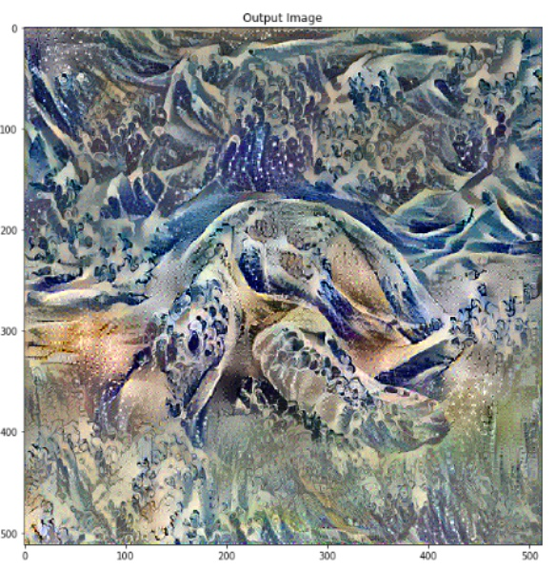
Neural Style Transfer
Neural Style Transfer
Train on lots of images and styles
CNN trained with two loss functions
  content and style
Then supply any content and style image
Creates new image of content, but in the style of the style image

Slide 81
Neural Style Transfer
Notes:
Vincent Van Gogh
Also did starry night

Slide 82
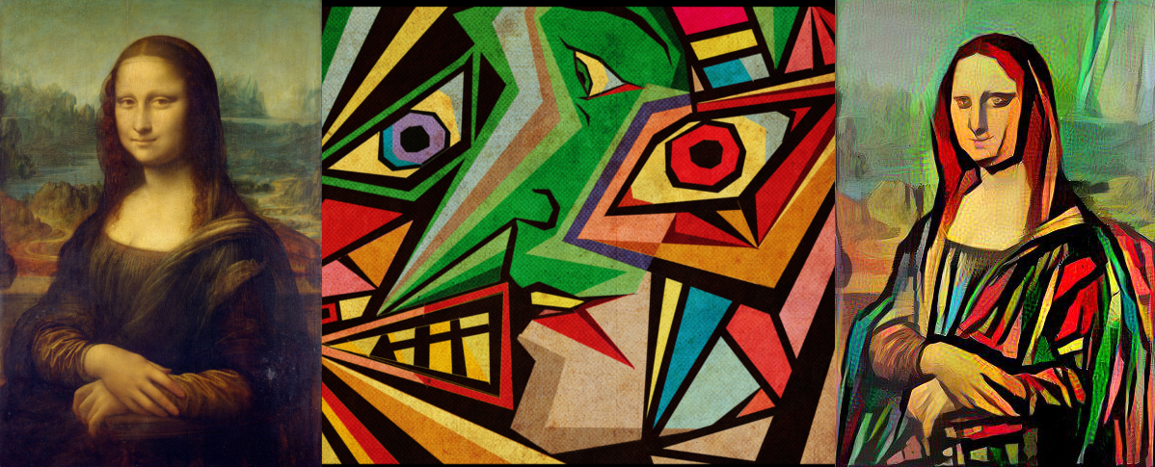
Neural Style Transfer

Slide 83
Deep Dreaming

Slide 84
Generative Adversarial Networks GANs (2014 Ian Goodfellow)
Unsupervised in that no labels needed
Generative networks which generate novel samples similar to training samples (images, text, etc.)
Discriminative net (adversary) must differentiate between samples from the generative net and the training set
Use loss feedback on discriminator net to create gradient for both nets, until discriminator can no longer distinguish, then can discard discriminator net – increasingly difficult for humans to distinguish
"Universal loss function" for lots of "difficult/creative" applications
Notes:
2014 – Ian Goodfellow - Google
Assume discriminative net output is a probability of the input being real (drawn from data set) vs fake (Generated). Since targets (1/0) use cross-entropy loss.
If input is real, then target is one and loss is –ln(z), where z is the output (probability of being real)
If input is real, then target is one and loss is –ln(1-z), where z is the output (probability of being real)
For Generative net, only train on fake (generated) data, use output of discriminative net for loss. Generative net wants discriminative net to output between .5-1 (thinking it is real), less. than .5 is bad, thus
loss for Generative net is –ln(z), where z comes from the discriminative net, big error if thinks it is not real

Slide 85
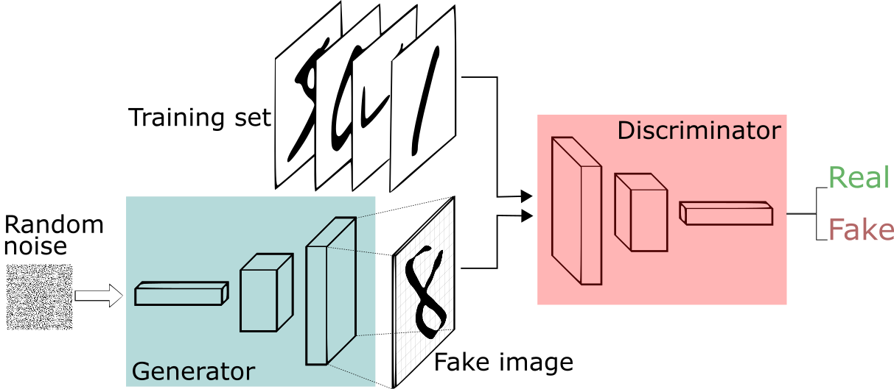
GAN - Generative Adversarial Network

Slide 86
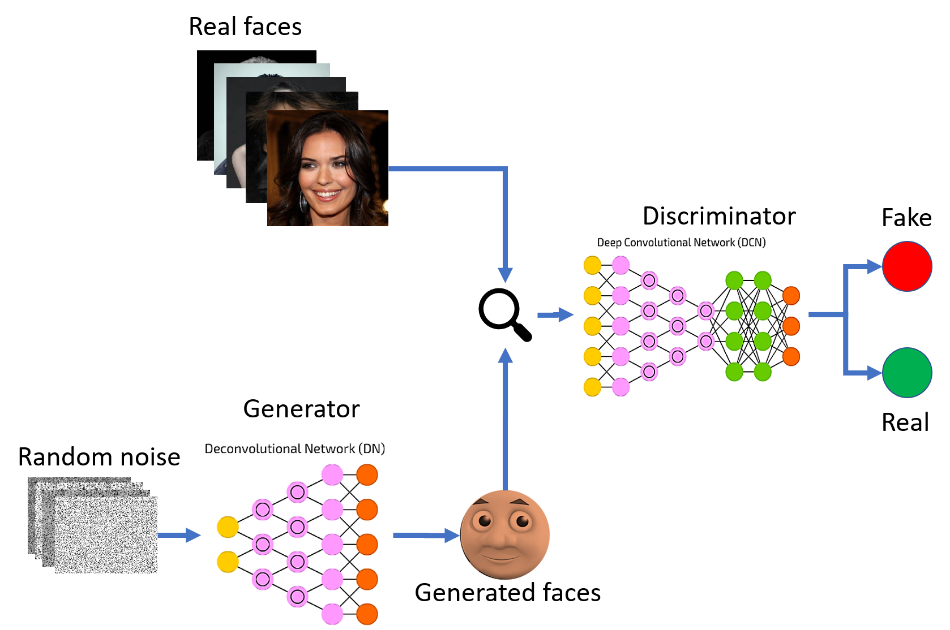
GAN - Generative Adversarial Network
Notes:
Caption creation – Describe a picture
Stories, etc.

Slide 87
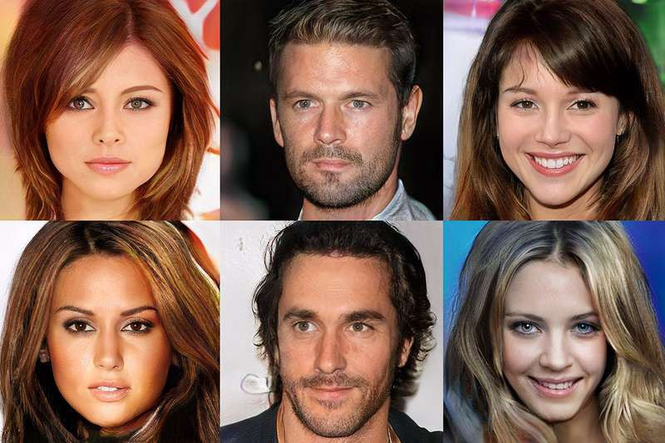
GAN – Celebrity Data Set (2017)
Notes:
Caption creation – Describe a picture
Stories, etc.

Slide 88
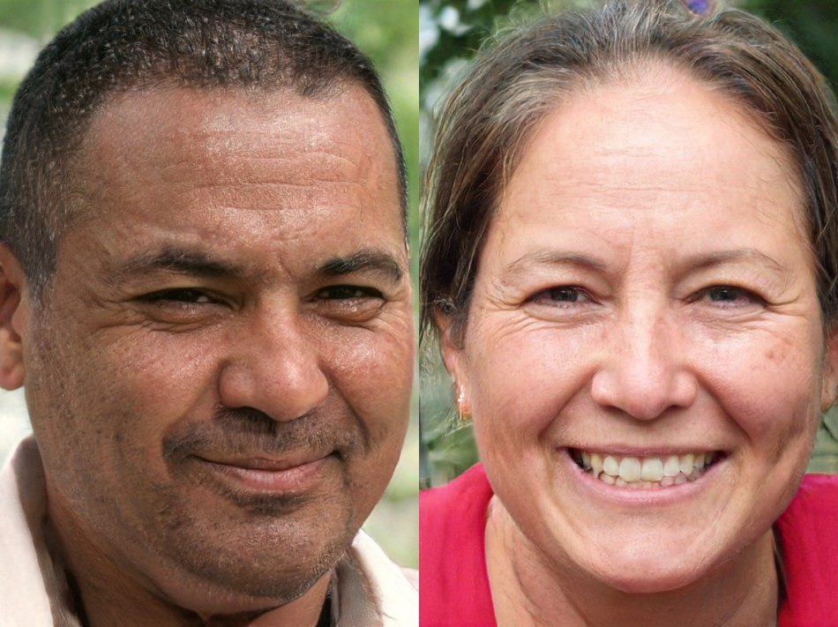
GAN 2.0 NVIDIA (2018) - Improved Face Generator
Notes:
Adds a number of new improvements
Incorporates some style transfer techniques into generator
Start with two random faces for generator, base face and style face
Style include pose, fine vs coarse features, shape, which make sure facial features fit well that style
style-mixing – styles can be changed at different points during synthesis to aid regularization
https://youtu.be/kSLJriaOumA
https://medium.com/syncedreview/gan-2-0-nvidias-hyperrealistic-face-generator-e3439d33ebaf
First two minutes – Stop at each new style to see difference, 4:20-5:00 examples, 5:30 style mixing

Slide 89
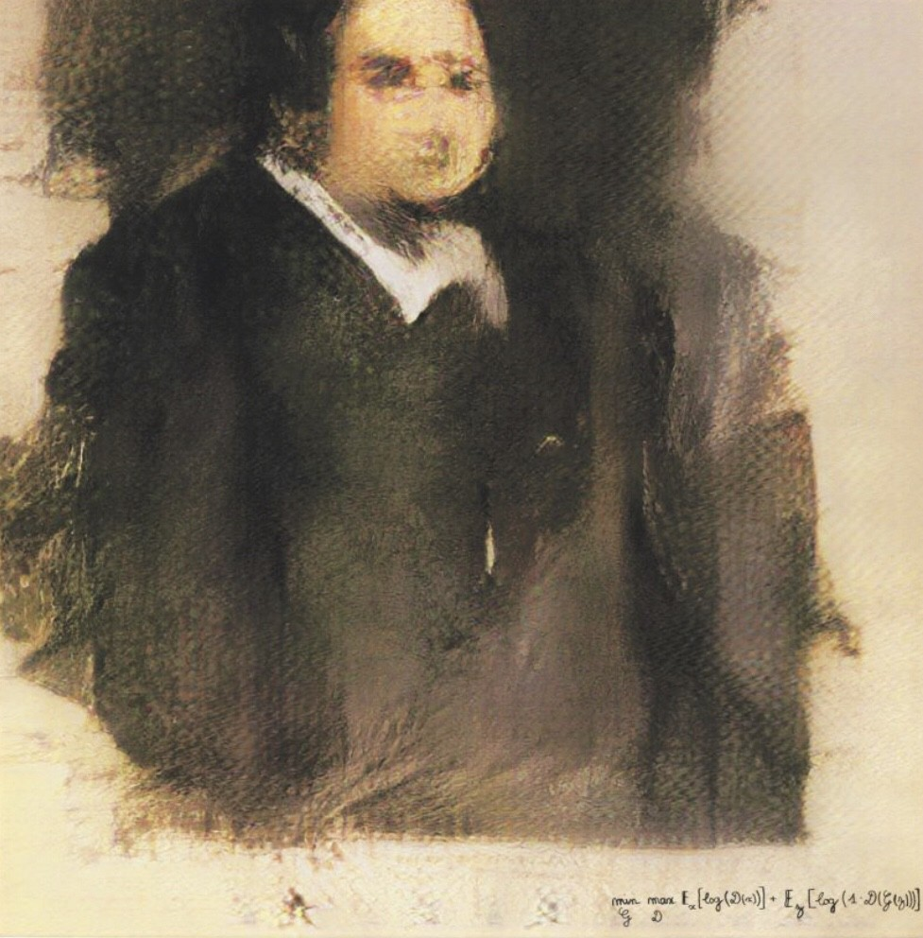
Edmond de Belamy
Created by a GAN and sold at auction in 2018 for $432,500
Note the author inscription – it is the GAN loss function
Notes:
Done by a Paris based arts-collective called obvious. Trained on 15,000 portraits from various time periods.
Printed on canvas

Slide 90

2021
GauGan2: Create your own images by sketching or by just typing in a description of the image you want to create
An output from GauGAN2 for the phrase "coast ripples cliffs."
Notes:
https://www.youtube.com/watch?v=p9MAvRpT6Cg
Just first 1.5 minutes or so

Slide 91
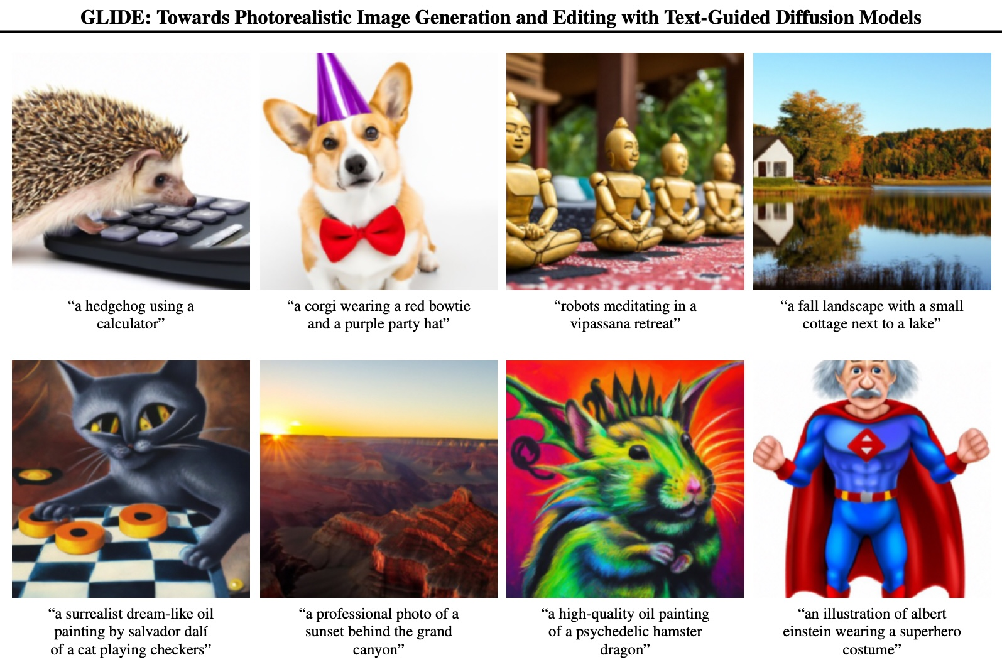
Notes:
Glide – 2021 – Guided diffusion model

Slide 92
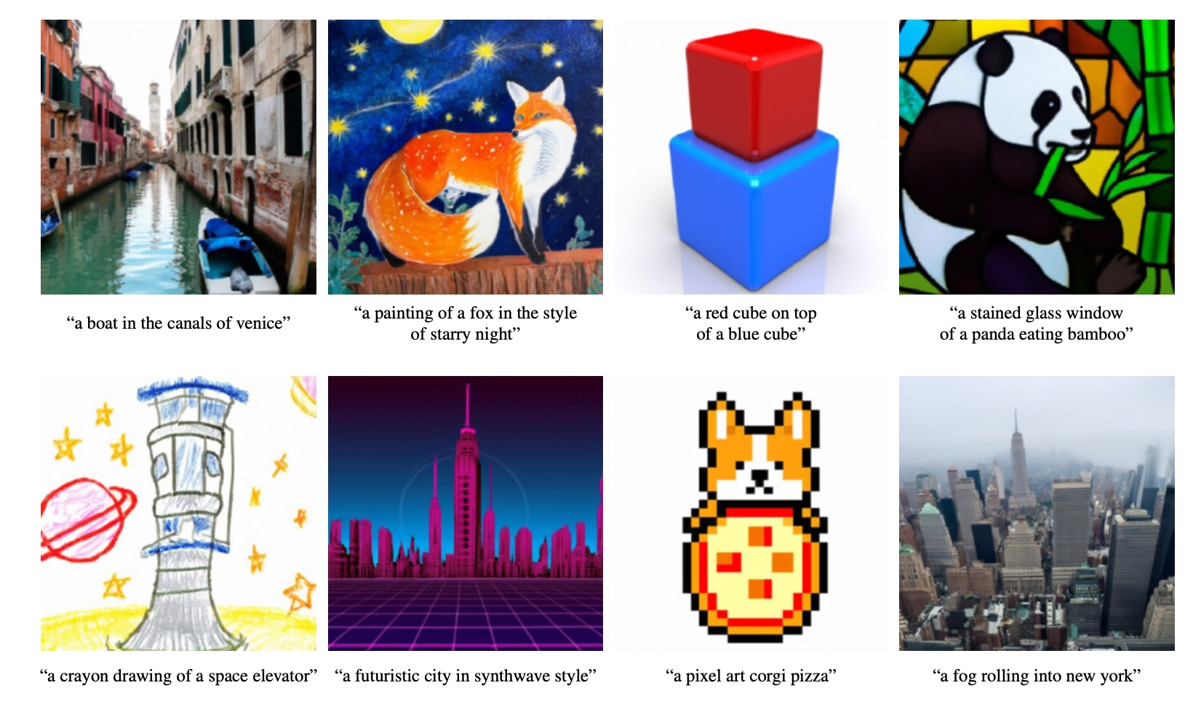
Notes:
Nelson: If we are to have any hope of sifting through the myriad of voices and the philosophies of men that attack truth, we must learn to receive revelation.
"In coming days, it will not be possible to survive spiritually without the guiding, directing, comforting, and constant influence of the Holy Ghost."

Slide 93
Real vs Fake?
President Russel M Nelson:
“If we are to have any hope of sifting through the myriad of voices and the philosophies of men that attack truth, we must learn to receive revelation.
In coming days, it will not be possible to survive spiritually without the guiding, directing, comforting, and constant influence of the Holy Ghost.”

Slide 94
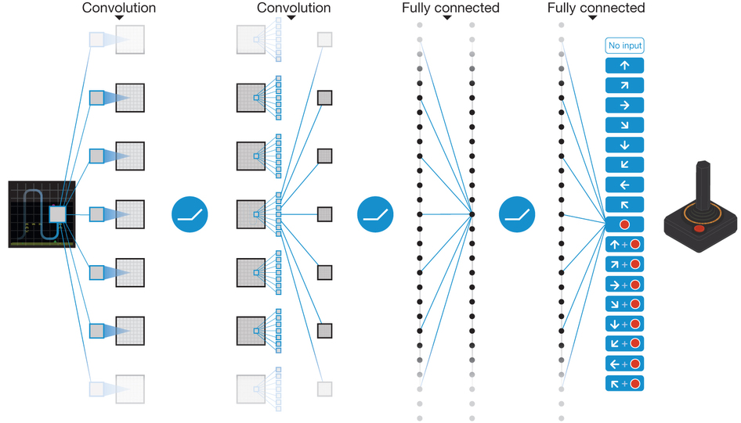
Deep Reinforcement Learning: Deep Q Network – 49 Classic Atari Games
Notes:
Overall, competitive with professional human Better than human on half. Only pixels and score. Same net, Hyperparameters, no tuning, etc.
Error – difference between current predicted Q by deep network and the actual discounted reward based on current samples and Q values from deep network for next s,a state.
Input state is made of the M=4 previous frames in order to give temporal context. One output for each action rather than needing to run net |A| times to get each Q(s,a) value.

Slide 95
AlphaGo - Google DeepMind
Notes:
19x19 = 3^361 positions
Greater than 10^172 board positions > #atoms in the known universe
https://www.youtube.com/watch?v=7L2sUGcOgh0 – Beginning LeeSeeDol – Watch first minute on Alpha Go, second minute on Alpha Zero till 2:25

Slide 96
Alpha Go
Reinforcement Learning with Deep Net learning the value and policy functions
Challenges world Champion Lee Se-dol in March 2016
  AlphaGo Movie – Netflix, check it out, fascinating man/machine interaction!
AlphaGo Master (improved with more training) then beat top masters on-line 60-0 in Jan 2017
2017 – Alpha Go Zero
  Alpha Go started by learning from 1000's of expert games before learning more on its own, and with lots of expert knowledge
  Alpha Go Zero starts from zero (Tabula Rasa), just gets rules of Go and starts playing itself to learn how to play – not patterned after human play – More creative
  Beat AlphaGo Master 100 games to 0 (after 3 days of playing itself)
Notes:
https://www.alphagomovie.com
Masters include current top Ke Jie (kah-jay) who it beats 3-0 – He said he is playing Go in a little pond it front of him (just seeing locally), and AlphaGo is seeing the whole Universe."
He said "AlphaGo is God. A being that can beat anyone or anything." Won't play it again. Said "I have no chance to beat it"
AlphaGo Zero reaches AlphaGo after 36 hours training

Slide 97
Alpha Zero
Alpha Zero (late 2017)
Generic architecture for any board game
  Compared to AlphaGo (2016 - earlier world champion with extensive background knowledge) and AlphaGo Zero (2017)
No input other than rules and self-play, and not set up for any specific game, except different board input
With no domain knowledge and starting from random weights, beats worlds best players and computer programs (which were specifically tuned for their games over many years)
  Go – after 8 hours training (44 million games) beats AlphaGo Zero (which had beat AlphaGo 100-0) – 1000's of TPU's for training
    AlphaGo had taken many months of human directed training
  Chess – after 4 hours training beats Stockfish8 28-0 (+72 draws)
    Doesn't pattern itself after human play
  Shogi (Japanese Chess) – after 2 hours training beats Elmo
Notes:
Close matches with Elmo and AlphaGo Zero
Input is just board position and previous ~7 board positions (own and opponent stones separate channels– keeps 0-1 rep) – History mainly to avoid repetitions which are illegal
Deep RL with CNN board engine, very fast hardware training, and little refinements- not a huge leap from where we have been heading in terms of basic technology, lots of TPUs for learning power
AlphaGoZero beat AlphaGo 100-0 – 80 layers with 3x3 convolutions stride 1 into 256 feature maps with batch normalization and resnet., no pooling. shared with fully connected value net and policy net. Uses Monte Carlo Tree Search (ala Alpha Beta) with node values given by deep net to decide move
Policy net outputs probability vector of all moves. Value net outputs one probability of winning from current state. Top moves from policy net are used to do a MCTS (Monte-Carlo Tree search – During learning is MC since pick one best action at each branch probabilistically – keep track of #visits for exploration/exploitation. Nodes q-value is updated to the mean of the evaluation over its visits ) using the deep net to guide the expansion of the search. This MCTS returns a final prob vector for best moves. The difference between this and the initial policy prob vector form the net is used to create the error and update weights. Whether win or loss (or the final state value) is used to update the initial state value given by the net.
64 TPUs to triain net, 5000 TPUs to generate self-play games
Alpha Zero very similar to AlphaGo Zero but drops symmetry assumption, simplifies updates (no candidate tourneys, etc.) and a few minor things
Now they've moved on to harder tasks (noise, etc)
https://www.youtube.com/watch?v=7L2sUGcOgh0 – Beginning LeeSeeDol – Watch first minute or up to 2:20

Slide 98
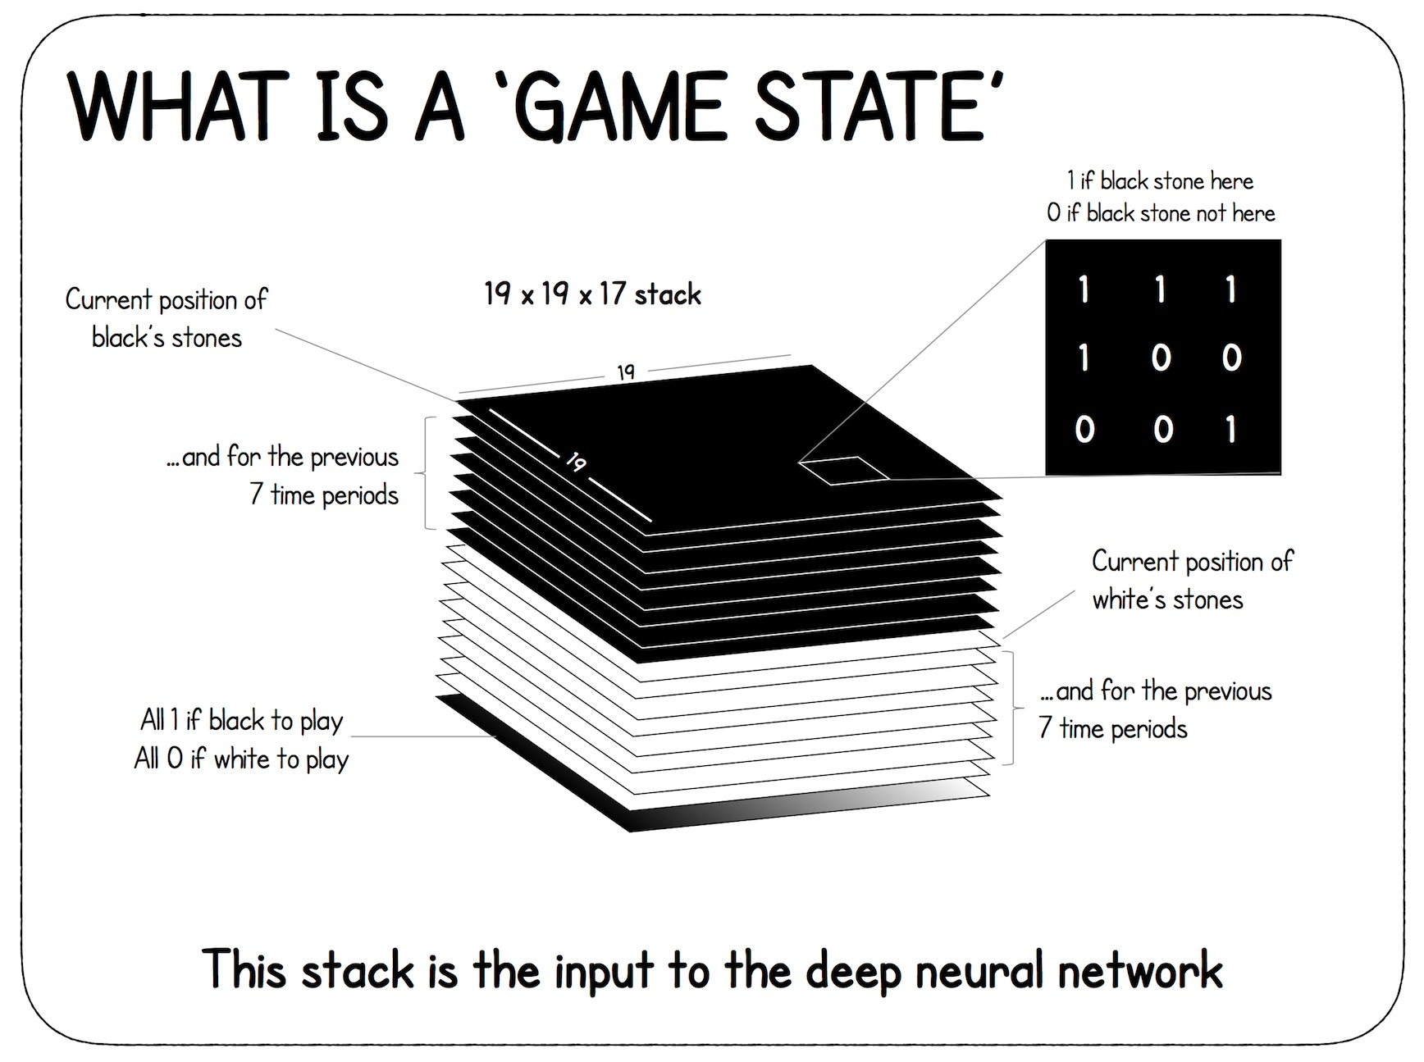
Notes:
The cheat sheet is actually for AlphaGo Zero, but is very similar to Alpha Zero
Note that for Go/chess, etc. Previous 7 time steps just to make sure no loops/repeats, stale mates. Other games however, could use that for seeing trajectory …

Slide 99
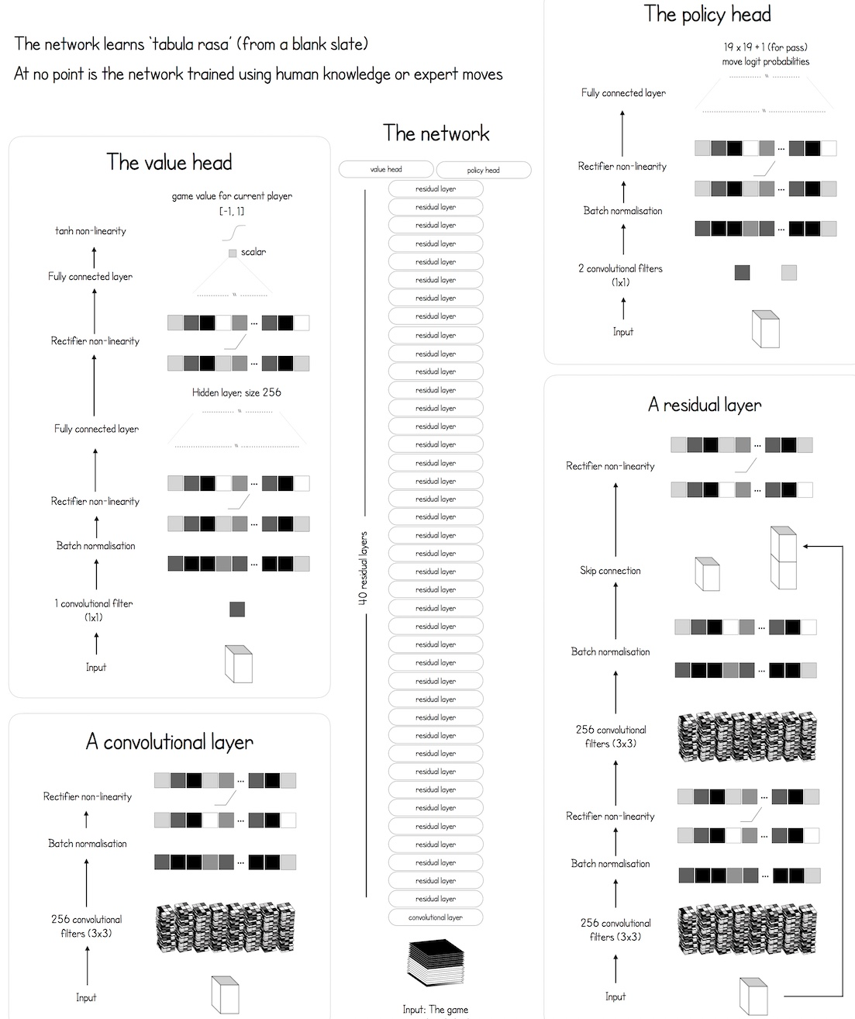
Notes:
40 residual layers, 80 convolutional layers ,160 if include BN layers
Same size feature maps throughout so zero pad each time to maintain dimensions

Slide 100
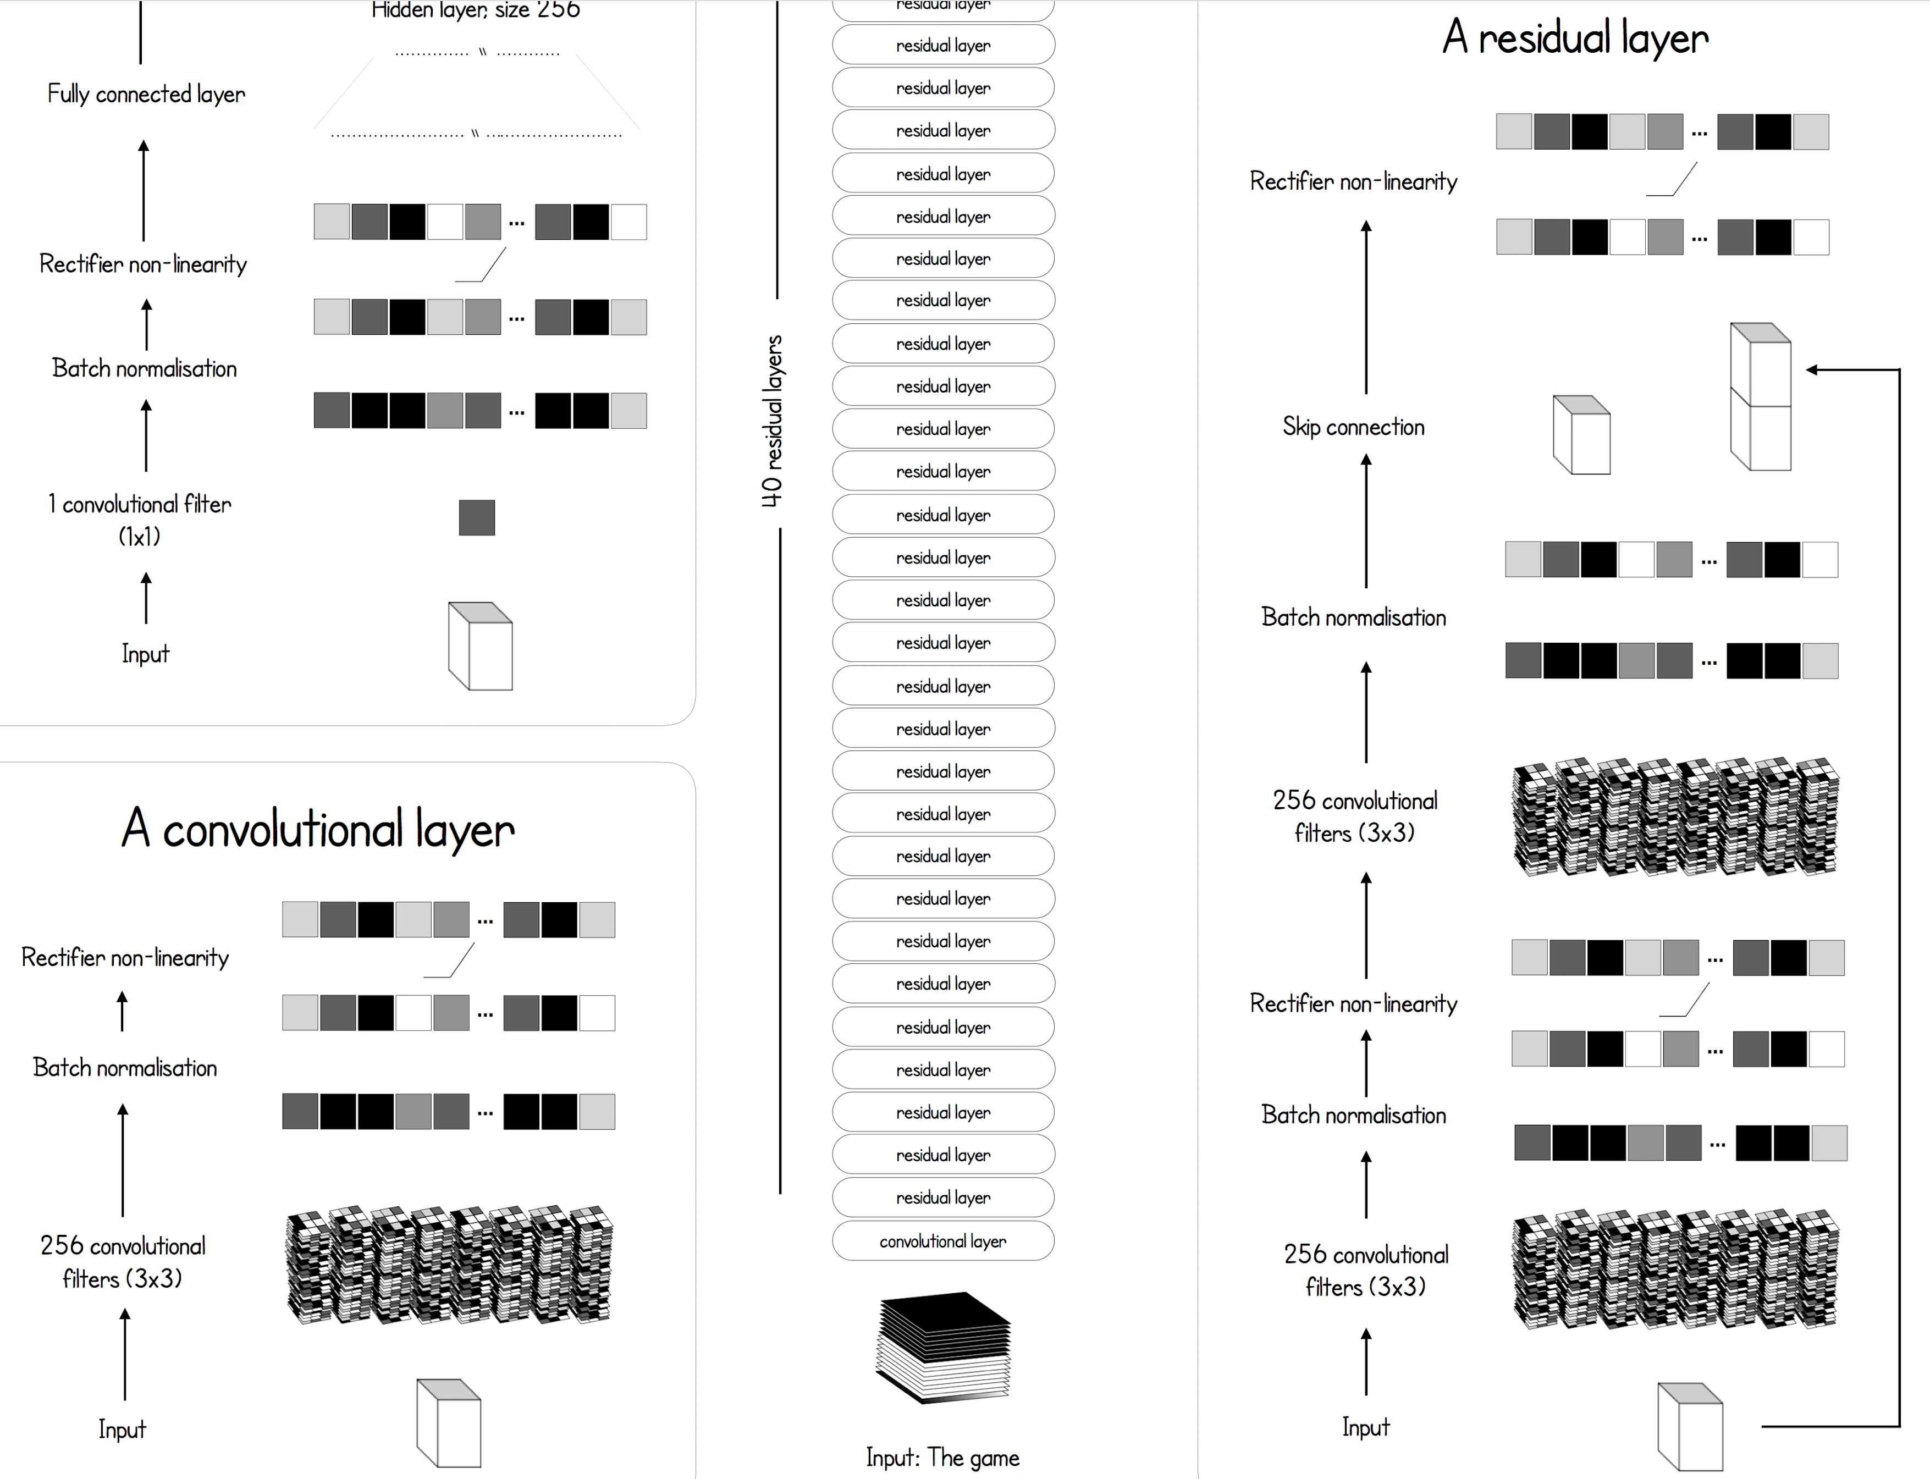

Slide 102
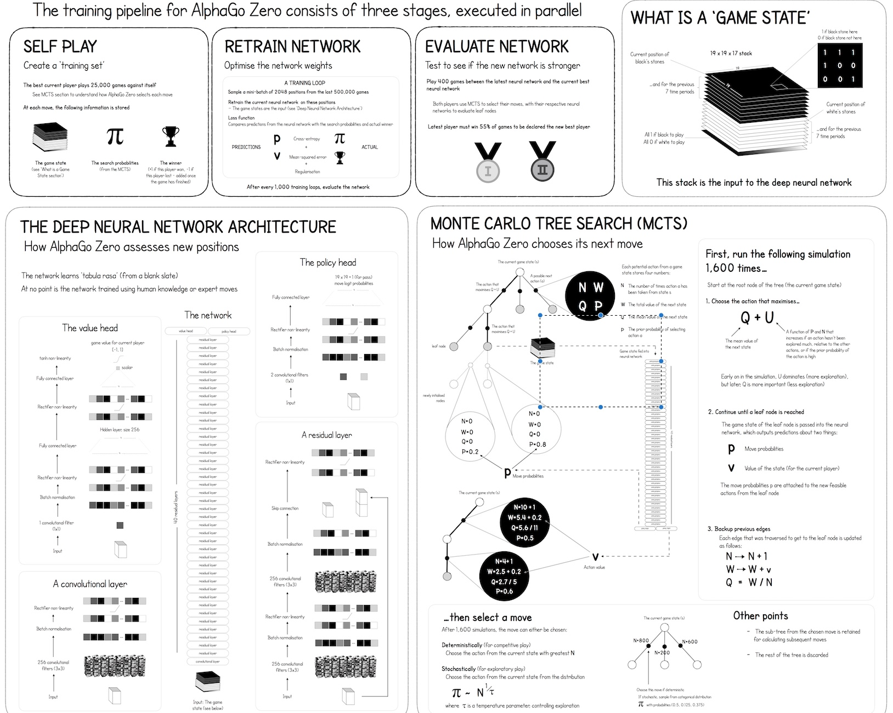
Notes:
Alpha Go Zero Cheat Sheet – David Foster
For training sample positions from recent games, and then update value head using a loss which is difference of win/loss vs current network value prediction
update policy value with loss which is difference between P value from net and MCTS value at that time. MCTS does 1600 trials of weighted moves (going until a final state) from current position returning the best predicted move at this time (using the current state of the deep network).

Slide 103
AlphaStar
DeepMind considered "perfect information" board games solved
Next step was – Starcraft II - AlphaStar
  Considered a next "Grand AI Challenge"
  Complex, long-term strategy, stochastic, hidden info, real-time
  Beats best Pros - AlphaStar limited to human speed in actions/clicks per minute – so just comparing strategy
Notes:
Dec 2018 – current – Just out
https://www.youtube.com/watch?time_continue=311&v=UuhECwm31dM - AlphaStar
https://deepmind.com/blog/alphastar-mastering-real-time-strategy-game-starcraft-ii/ ~ 5 winds around 45:20 minutes in
AlphaFold – Protein folding – Attention network

Slide 104
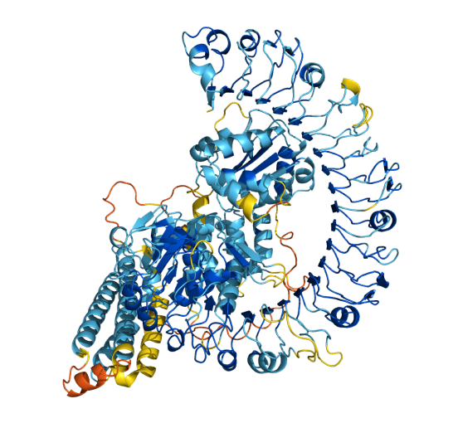
AlphaFold – Moved to Transformers, World’s most accurate protein folding

Slide 105
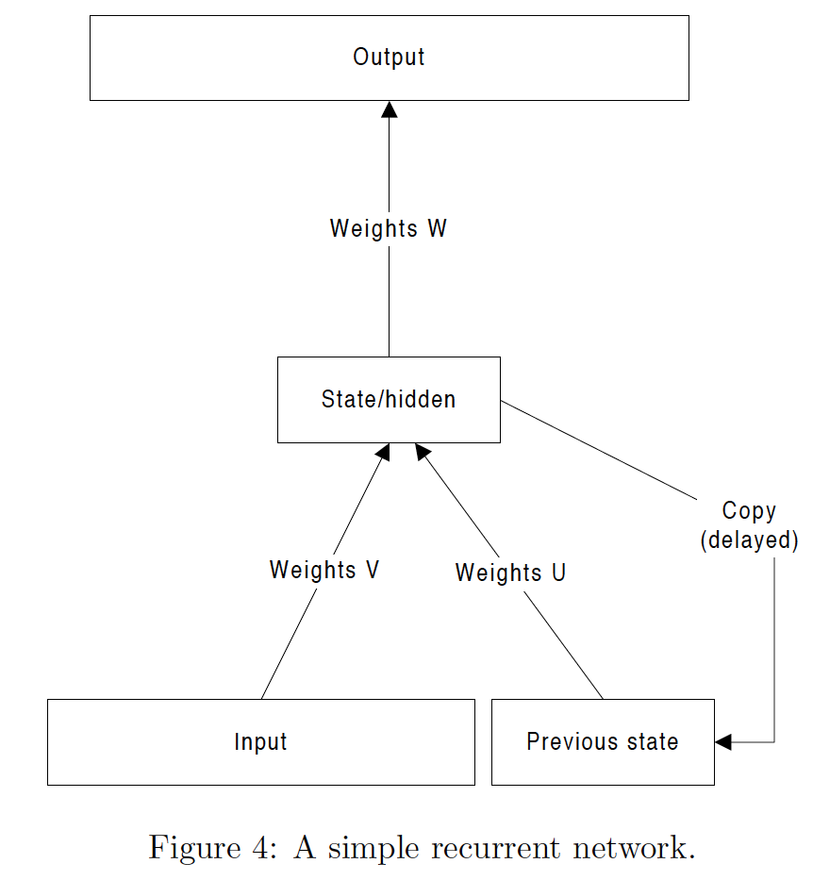
Recurrent Neural Networks
Notes:
This slide just for 478 – Speech, translation, Stock prediction, etc. BPTT next slide
High level on BPTT – Training as if unfolded – Thus a deep net with all the difficulties including vanishing gradient.
Deep in time

Slide 106
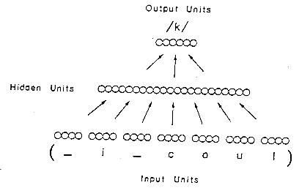
Recurrent Neural Networks
Notes:
Example where needed
Alternative: Snapshot of context – easy to train with standard BP, but have to choose fixed size context which is not always easy.

Slide 107
Unfolding Recurrent Net in Time
Can consider an equivalent feedforward network unfolded t steps in time
Then can train it as if it was a regular feedforward network – Backpropagation through Time (BPTT)
Only difference is that the weights are tied (use average)
Becomes a deep net in time –Has vanishing gradient issues
Notes:
Pictures and flow from Olah's Blog
h is output, A is middle section of MLP, hidden nodes, state
Often weight layer before between h and output though also often the same
High level on BPTT – Training as if unfolded – (but with tied weights) Thus a deep net with all the difficulties including vanishing gradient.
Usually show diagrams in the unfolded rep, though remember it is really the one recurrent net

Slide 108
LSTM/GRU
Long Short-Term Memory/Gated Recurrent Unit
LSTM – (GRU is an LSTM subset) – More powerful RNN
  LSTM replaces the standard RNN nodes (A below) with a more complicated LSTM node with more learnable parameters
  Train with BPTT but bigger k’s (a full sequence if not too large), or some pretty big chunk (25-100) since LSTM lets us avoid the vanishing gradient.
Notes:
Often weight layer before between h and output though also often the same
478: High level on BPTT – Training as if unfolded – (but with tied weights) Thus a deep net with all the difficulties including vanishing gradient.

Slide 109
LSTM – Long Short-Term Memory
LSTM unit can just plug in for a standard node in an RNN
Adds a state memory plus input, forget, and output gates
Vanishing/exploding gradient avoidance
  Cell value (state) has a self-feedback loop and can maintain its value indefinitely. Has derivate 1 with no vanishing gradient.
  The cell value is multiplied by a forget gate output (0-1), which decides when and how much to forget, giving much more power.
LSTM unit has lots more parameters but still trained with standard BP/SGD learning: typically BPTT
  Forget gates, etc. don’t know that is their job, but the capacity is there during training to learn that job as the overall network minimizes loss
  Capacity plus training finds a way to solve the problem, capacity that wasn’t there with simple network nodes
Notes:
First take quick look at next picture
Could combine G and I weights, but more power this way
In the recurrency of the LSTM the activation function is the identity function with a derivative of 1.0. So, the backpropagated gradient neither vanishes or explodes when passing through, but remains constant.
The effective weight of the recurrency is equal to the forget gate activation. So, if the forget gate is on (activation close to 1.0), then the gradient does not vanish. Since the forget gate activation is never>1.0>1.0, the gradient can't explode either.
Use Maliya slides to show gradients. Need delta c to calculate c-1, since all weight deltas are just products with c, then c keeps control of vanishing/exploding gradients for most part

Slide 110
C_{t} is cell state, h_{t} is context/output. Forget, Input, and Output gates
Notes:
Remember just one node in reality, left right are just the unfoldings in time
Show where top and bottom match, Discuss top figure as standard RNN, block/layer of nodes/inputs
define the new top horizontal arrow as Ct – Cell state, then discuss overall logic of LSTM,
Gate is sigmoid between 0 and 1, 1 remembers all, 0 forgets all, Same concept with input and output
Middle tanh is full standard RNN with LSTM making it go up and combine with C and then gate it with the output gate
note h is gated from state, so they are very coupled, GRU combines them.

Slide 111
C_{t} (state) and h_{t} (output and/or context) are vectors.
C_{t} can be maintained as long as needed. Only updated by forget and input gates, which are learned functions.
Notes:
Middle tanh is full standard RNN with LSTM making it go up and combine with C and then gate it with the output gate
with the normal output h going off to the right (context - with the outputs gate addition) and up (output) - all the extra is the LSTM additions.
Input gate – decides how much of the inputs from the context/output will be added into the state C
Tanh creates candidate state which is added into current state through input gate which decides how much to update each state value

Slide 112
Output gate above finishes full LSTM node
  tanh normalizes C to h/x scale (between -1/1) before output gate chooses what parts of state to pass on as output/context
Gated Recurrent Unit (GRU) below combines C and h
  r: reset gate – How much of context h_{t-1} to use in standard tanh
  z: update gate - Combines forget and input gates
Notes:
GRU z function decides both forget (1-sigmoid value) and the input (reg sigmoid value) – if 1 then completely replace Ci with new hi, if 0 don't change
Both work good on different problems – still open what's best – GRU a bit simpler, less parameters, but sometime the added parameters helpful
Lots of variants on both LSTM and GRU

Slide 113
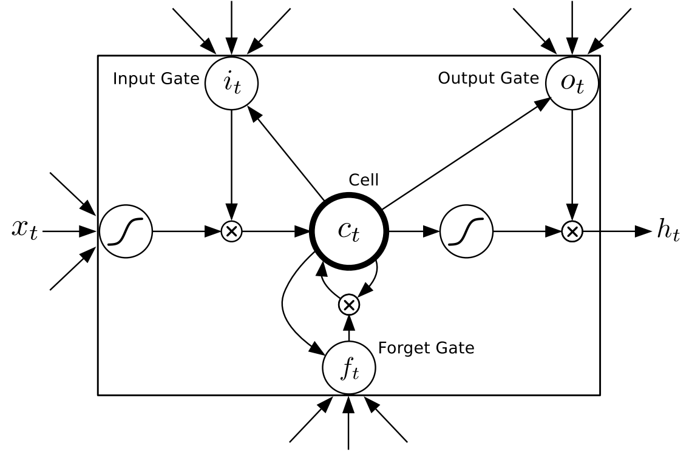
Basic Cell value has a self-feedback loop
Does not forget until told (stable gradient)
Notes:
Skip next 3 slides. All 3 gates receive input xt (only shown on left most sigmoid) and previous state ct

Slide 116
LSTM Variations
Lots of node and structural variations
Could replace any node in a deep network with LSTM node, but typically just used for sequential problems - RNN (time or space)
Bidirectional LSTMS -Unlike conventional RNNs, bidirectional RNNs utilize both the previous and future context, by processing the data from two directions with two separate hidden layers. One layer processes the input sequence in the forward direction, while the other processes the input in the reverse direction. The output of the current time step is then learned using a combination of both layer's hidden vectors
Stacked LSTMS - extra layers above (usually not many) can capture latent info (e.g. different time scales)
Notes:
MD – if image for example with 2 dimensions would have a grid –like unfolding of LSTMs
BD - Unlike conventional RNNs, bidirectional RNNs utilize both the previous and future context, by processing the data from two directions with two separate hidden layers. One layer processes the input sequence in the forward direction, while the other processes the input in the reverse direction. The output of current time step is then generated by combining both layers’ hidden vector…
Output of both hidden layers could pass through another layer or could directly use the concatenation of the two (or average, sum, product, etc.) as the output to be learned. Concatenation is the typical approach.
Stacked – still just one main recurrent layer, but have extra layers above (1 or 2, not many) can capture latent info (e.g. different time scales) which could be used to help the main recurrent layer.
RNNs with attention mechanism better for language
Best and latest for NLP/Translation are transformers, which use attention, but not the RNNs.

Slide 117
Transformers - GPT
Replacing CNNs and RNNs in many cases
Rather than use convolutional filters or recurrence to find and track relationships they use attention
We need short and long-distance relationships between features (e.g. words, pixels, atoms, etc.). What does “it” in a following sentence refer to?
Initial paper – Google 2017 - “Attention is all you need”
Immediately followed by lots of variations such as BERT (Bidirectional Representations from Transformers)
GPT 1-3 are basically the same 2017 Google model
More parameters/weights make a huge difference
  GPT 2: 1.5B parameters, GPT 3 same basic architecture as GPT 2: 175B parameters
Notes:
Transformer name? Wanted to call them “attention” networks but that didn’t seem catchy enough.

Slide 118
Transformers Intro
Long training (though with some improved efficiencies over CNNs), high power hardware, and lots of training data – big companies right now, Google, Nvidia, IBM, Microsoft, etc. coming out with their own versions
  Now developing trillion parameter models
  Latest work is increasing the ability for models to learn faster and better
Large parameter sizes make them challenging to run locally
Still not doing real reasoning, just finds patterns from lots of data and mimics those
  Which is still pretty sweet
  Don’t overestimate current wisdom of content, but it will definitely “appear” like great human style output
A future goal is to learn more like humans with less data needed

Slide 119
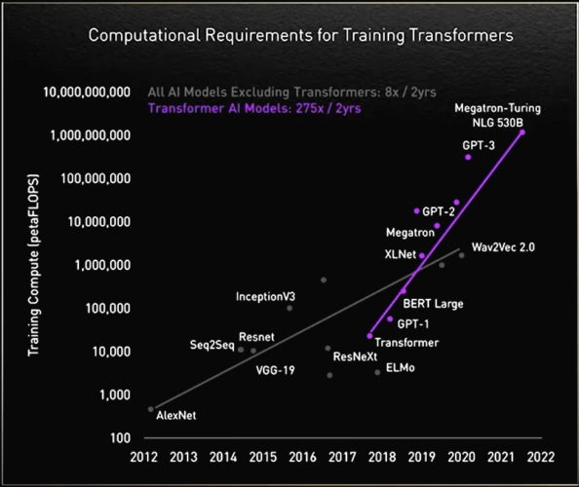
Notes:
So some say only big companies can do AI. Maybe with some of the latest models, but as we discover new models, which require less brute force, things could chagne

Slide 120
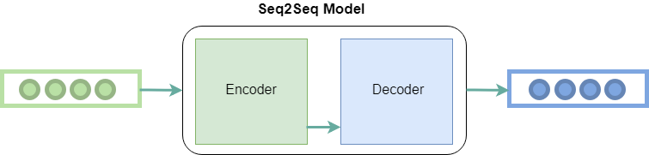
Seq2Seq (Sequence to Sequence)
Encoder and Decoder was typically done with RNN (LSTM/GRU) or CNN
Encoded hidden layer vector representation (embeddings) of current tokens (e.g. words)
Represents meaning and context of the current token – Final hidden layer (full meaning) passed to decoder
  Translating English to French
Decoder unravels embedding to create the output sequence

Slide 121
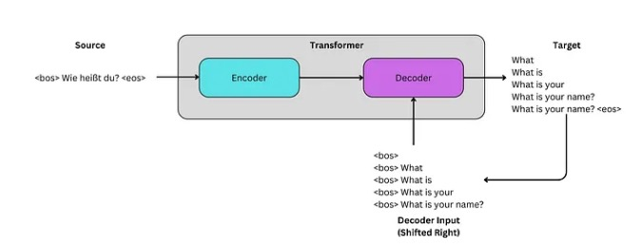
Transformers: “Attention is all you need”
Autoregressive – Just decide next word. Use the encoder embedding and the words inferred so far by the decoder as input to decide the next word
For training, the next word is the current target
Notes:
Were going to call them attention nets but not catchy enough
Transforms once sequence into another
Decoder input shifted right so see all previous but not current

Slide 122
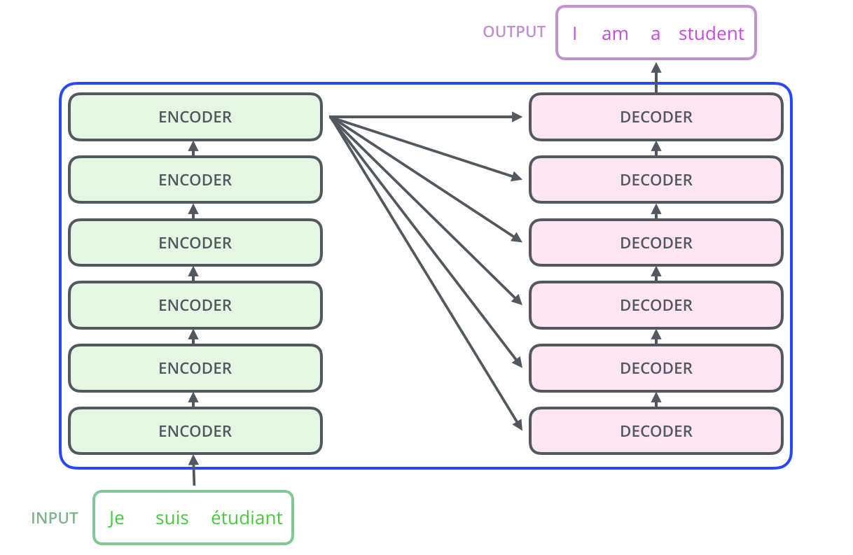
Transformer Flow

Slide 123
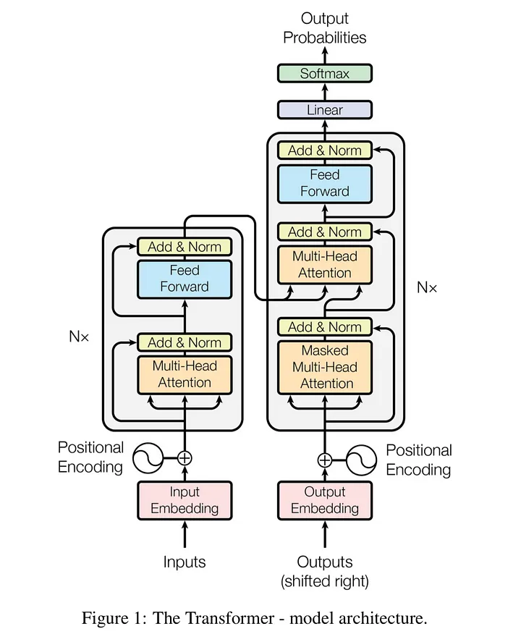
Transformer
Full input sentence entered (Tokens)
Learns embedding
Adds position
Skip connections and layer normalizations
Weights how much certain words/tokens in the sequence are tied to others
Allows more distant dependencies
Self-Attention and encoder-decoder attention
Masked on decoder so only considers past tokens
Can also just use Encoder and Decoder models
Notes:
Go back and forth between this and next slide
Just high level here. Details in Dr. Snell’s 574
Encoder learns encoding for predictive modeling like classification
Decoders generate text, etc. GPT

Slide 124

512 value token vectors in 2017 Google version (hyperparameter, 11288 in GPT)
All token vectors flow independently and in parallel through encoder/decoder and only interact in the attention block
Each token position has its own MLP with a single hidden layer with hidden nodes usually 4x the inputs - 2048
6 encoder and decoder layers for original version, (hyperparameter, 12 for GPT)
Make wide enough for longest sentence in data set, fixed token window (2k+) for GPT
Notes:
Images from Jay Alammar, the illustrated transformer https://jalammar.github.io/illustrated-transformer/

Slide 125

Attention Mechanism
For n tokens, the attention block basically builds nxn matrices measuring the relative connectedness of all the tokens
Self attention (picture)
Encoder-Decoder attention might have a sentence in French on the left and the response in English on the right
  All cells relating to tokens to the right of the latest decoded word are masked to 0
Builds matrix by doing a linear matrix multiply of the token vectors and learned arrays (Q, K, and V)
Results are dynamic weights for relative importance between tokens
Notes:
Mask – for decoder layer, masks out all future tokens so only considers previous, Adds negative infinity to all future token locations in matrix, leaving 0 probability of interaction after softmax
Next 4 slides on actual attention are the most confusing. Do you want them?

Slide 126

Attention Mechanism
The incoming token vectors are multiplied by learned arrays (the linear blocks in right part of image) to create Query, Key, and Value arrays
  For self attention the V, K, and Q matrices are all the same
  For encoder-decoder attention: Q is the matrix of decoder token vectors and, K=V=final token matrix output by the encoder
In one scaled dot-product attention the “updated” Q, K, and V arrays are begin used
Notes:
The confusing part - Skip or light
This image a bit misleading because the Q, K, V values on the left and right are not the same. The ones of the left have undergone the matrix multiply shown on the right
Mask – for decoder layer, masks out all future tokens so only considers previous, Adds negative infinity to all future token locations in matrix, leaving 0 probability of interaction after softmax

Slide 127

Initial Attention Multiplies
X is our array of token vectors (just 2 words in this example)
For self attention multiply the same token vector array X by 3 learned matrices W^{Q}, W^{K}, and W^{V} to get the updates arrays Q, K, and V
  Rows must match columns of token vectors
  We choose columns of W matrices (and thus length of attention vectors) as hyperparameter (3 here), 64 in 2017 Google version
For encoder-decoder attention X is from encoder for Q, and from decoder for K and V

Slide 128

Q, V, and K created through matrix multiples
Q*K calculates attention with dot product array multiplication
Scale divides by the square root of the size of the attention vectors (8 in this case) and leads to more stable gradients
Softmax turns the attention array in probabilities
Multiply by V. The low probability scores from the softmax basically nullify the irrelevant words for each word token

Slide 129


Multiple heads allow
learning of multiple
representations.
8 heads in 2017 version
96 in GPT3

Slide 130
Final Output
Goes through all N layers of the decoder
Final linear layer is a fully connected neural network which goes from the final vector to real value for every word in the vocabulary
Softmax turns this into a probability of each word
Add word with max probability to the output and then repeat for the next word of output
Notes:
Greedy encoding assumes we always choose the word with highest probability, Alternative is Beam search where we keep the top candidates (beam width), then combine with next top candidates, etc. to see which sequence has overall lowest error
Each word position has its own FFNN, thus position wise

Slide 131
Training
Sentence to encode on left (English)
Decode target on right (French)
Shifted right so must predict output at time i using only inferred outputs at 1 … i-1.
Target is the next word in the output sequence
During inference start with full input sequence and empty output sequence.
Add inferred word each time to output sequence which it can now use to help infer next word – Autoregressive
Loss function – cross-entropy, difference between the one-hot rep of the target output word and the softmax vector
Notes:
Decoder – Masked attention blocks out all future positions, and can only consider positions up to where it is outputting
Final linear layer projects final z into logits for all the words/tokens, the unravelling of the initial one hot encodings but this time values are real
Loss function, difference between the one-hot rep of the target output word and the softmax vector, BP back
Greedy encoding assumes we always choose the word with highest probability, Alternative is Beam search where we keep the top candidates (beam width), then combine with next top candidates, etc. to see which sequence has overall lowest error
Each word position has its own FFNN, thus position wise

Slide 132
GPT (Generative Pre-trained Transformer)
OpenAI– Some of the original Google authors, Elon Musk and others fund, Microsoft funding and Partnership
Decoder only transformer (just right side of transformer model with the encoder-decoder attention head dropped)
Autoregressive: Initialize with an initial sequence (the query), then repeatedly output the next word
Does not need labeled data! Finds associations while training with large amounts of unlabeled data. Just uses next word in text as target during training.
GPT-2 1.5B, GPT-3 similar to GPT-2 but with 175 B parameters
800GB to store
Pre-trained with a diverse corpus of unlabeled text datasets from web scraping (WebText)
No fine tuning necessary (Though you can for specific tasks)
Notes:
OpenAI – Delaware
Go back on slide to show right side, encoder
The GPT output is not just a single guess, it's a sequence (length 2048) of guesses (a probability for each likely word). One for each 'next' position in the sequence. But when generating text, we typically only look at the guess for the last word of the sequence.

Slide 133
GPT-3 Architecture
Always uses a fixed 2k word/token sequence (some can be empty)
  What is a Taco? (This would be the first 4 words of decoder. It will then Fill in the rest of the output one word at a time)
Encoding – Each of 50,257 English words/tokens GPT-3 uses has an integer code – one hot encode into 50K length vectors
Encoder transforms tokens (words or subwords) into a 12,288 real-value vector embedding (meaning, etc.) from the embedding weight matrix which is learned during training
Thus, a 2k x 12288 matrix sequence
For each token a positional encoding is calculated giving a 2k x 12288 positional encodings matrix
These 2 matrices are summed and passed into the first layer
Notes:
BPE Byte Pair Encoding

Slide 134
GPT-3 - Continued
96x wide multi-head attention in each layer
12 layer decoder only transformer – Each layer includes layer norms, skip connections, multi-head attention, and MLP
Decode – Just take the final 12288 vector after going through all the layers which represents the next word, and do the inverse encoding (NN) back into original word codes. Since real valued vector, use SoftMax to get final word probabilities and set the next word to the highest word probability
  Or choose any of the high probability words if want variety
  Actually outputs probabilities for the following word of every one of the 2K tokens, though next word is the one we concentrate on most
Initialize with the query and start generating text
Training: Small random weights (175B). Train with current target being next word in the sequence of unlabeled training data
As token windows get wider, attention matrices grow by the square – GPT-3 uses Sparse Attention to be more efficient
Notes:
Actually outputs probabilities for following word of every one of the 2K tokens though next word is the one we concentrate on most. (training speedup with more updates?)
Can also do a beam search through the outputs

Slide 135

Sparse Attention
As token window grows the attention matrices grow by the square! Expensive and slow
Most inter-word connections are about 0 so they are sparse matrices and lots of savings possible
GPT approach based on Big Bird (came after Bert)
Has complexity O(n) rather than O(n²) for the arrays
One of few differences (other than number of parameters) between GPT-2 and GPT-3
Notes:
Could skip

Slide 136
GPT/Transformer Advances
GPT 3.5
  Adds RLHF (Reinforcement Learning from Human Feedback) - Turbo
  4K token span (vs 2K for GPT 3)
GPT 4
  Multi-modal: Images, voice as part of queries and responses
  ~1.7 Trillion parameters
  32K token span
Other large companies building competitive models (Google Bard, Microsoft Bing, etc.)
Pretty amazing, but still not doing deep understanding, rather an amazingly complex statistical n-gram model – In language, coding, etc., it models what humans have demonstrated in training data. (i.e. Don’t expect it to give new wisdom yet)

Slide 137
Transformers Conclusion
Any applications with lots of examples with sequential features
  Words in text
  Atoms in protein sequences
  Notes in songs
NLP, Document generation and summarization
Language Translation
Computer Vision
Audio and Speech Generation and Processing
Computer Coding
Biological sequence analysis
Etc.

Slide 138
Deep Learning Conclusion
Much recent excitement, still much to be discovered
Impressive results
More work needed to understand how and why deep learning works so well – How deep should we go?
Potential for significant improvements
Works well in features spaces with local correlations in space and/or time – CNNs, RNNs, Transformers.
  Important research question: To what extent can we use Deep Learning in arbitrary feature spaces?

