Slide 1
Overfit and Inductive Bias: How to generalize on novel data

Slide 2
Non-Linear Tasks
Linear Regression will not generalize well to the task below
Needs a non-linear surface – Could use one of our future models
Could also do a feature pre-process like with the quadric machine
For example, we could use an arbitrary polynomial in x
Thus, it is still linear in the coefficients, and can be solved with delta rule
What order polynomial should we use? – Overfit issues can occur
y
x
Notes:
Picture is with just bias and x
What would it look like if we added x^2…

Slide 3
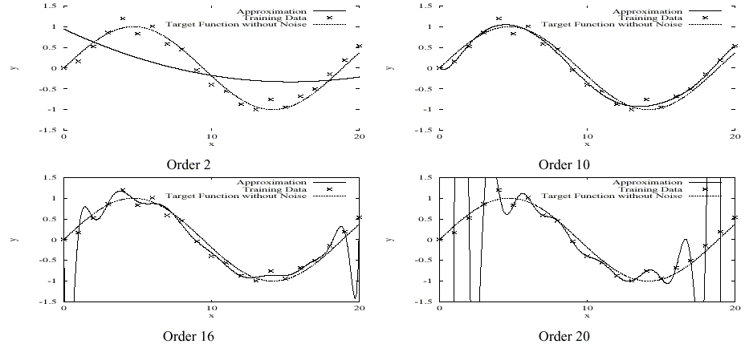
Overfitting
Typically try to learn a model just complex enough to do well and no more complex than that

Slide 4
Linear Regression Regularization
Keep the model as simple as possible while still being accurate
For regression, keep the function smooth
Regularization approach: updated loss function
Minimize F(h) = Error(h) + λ·Complexity(h)
Tradeoff training accuracy vs complexity
Ridge Regression (L2 regularization) – Minimize:
F(w) = TSS(w) + λ||w||² = Σ (predicted_{i} – actual_{i})² + λΣw_{i}²
Gradient of F(w): (Weight decay, not bias weight)
Linear regression with just the original features cannot overfit, but regularization useful when the features are a non-linear transform of the initial features (e.g. polynomials in x)
Lasso regression uses an L1 vs an L2 weight penalty: λΣ|w_{i}| and thus decay is just λ since derivative drops weight from the term
Sometimes called shrinkage models – decrease/shrink weights
Notes:
Gradient of ridge regression is normal learning plus weight decay dw^2 = w and set gradient negative
In NNs, regularization penalty (shrinkage term) just applied to normal weights and not the bias, as the bias does not need regularization and can underfit if we do
L2 regularization is mathematically cleaner and common (it is standard weight decay). Derivate of objective is original Grad + lamda*w. L1 regularization leads to more sparsity (i.e. 0 valued weights) as compared to L2 which is great in some applications. Derivate of objective is original Grad + lamda*sign(w)
Forcing Sparse representations is another regularizing approach
LASSO stands for Least Absolute Shrinkage and Selection Operator
Elastic Net – Just a linear combination of L1 and L2 shrinkage – A lambda value for each

Slide 5
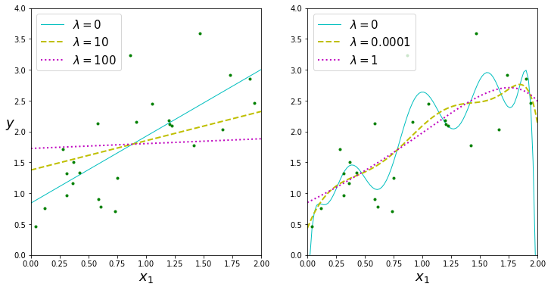
Ridge Regression Example
Notes:
Not usually used/needed with linear inputs.
Second example with higher order polynomial
Note smoothest line has close to 0 slope. (Lasso) L1 with lambda = 1 has 0 slope line

Slide 6
Hypothesis Space
The Hypothesis space H is the set of all possible models h which can be learned by the current learning algorithm
e.g. Set of possible weight settings for a perceptron
Restricted hypothesis space
Can be easier to search
May avoid overfit since they are usually simpler (e.g. linear or low order decision surface)
Often will underfit – e.g linear models
Unrestricted Hypothesis Space
Can represent any possible function and thus can fit the training set well – Includes most of the powerful ML algorithms
However, mechanisms must be used to avoid overfit

Slide 7
Avoiding Overfit
Regularization: any modiﬁcation we make to learning algorithm that is intended to reduce its generalization error but not its training error
Occam’s Razor – William of Ockham (c. 1287-1347)
Favor simplest explanation which fits the data
General Key: Focus on patterns/rules that really matter and ignore others
Simplest accurate model: accuracy vs. complexity trade-off. Find h ∈ H which minimizes an objective function of the form:
F(h) = Error(h) + λ·Complexity(h)
Complexity could be number of nodes, size of tree, magnitude of weights, etc.
More Training Data (vs. overtraining on same data)
Data set augmentation – Fake data, Can be very effective, Jitter, but take care…
Denoising – add random noise to inputs during training – can act as a regularizer
Adding noise to models. e.g. (Random Forests, Dropout , discuss with ensembles)
Early Stopping – Very common regularization approach: Start with simple model (small parameters/weights) and stop training as soon as we attain good generalization accuracy (and before parameters get large)
Common early stopping approach is to use a validation set (next slide)
We will discuss other model specific approaches with specific models
Notes:
William of Occam – Give some examples – Why no HW
In NNs, regularization penalty usually just applied to normal weights and not the bias, as the bias ties does not need regularization and can underfit if we do
L2 regularization is mathematically cleaner and common (it is standard weight decay). Derivate of objective is original Grad + lamda*w. L1 regularization leads to more sparsity (i.e. 0 valued weights) as compared to L2 which is great in some applications. Derivate of objective is original Grad + lamda*sign(w)
Forcing Sparse representations is another regularizing approach

Slide 8
Early Stopping/Model Selection with a Validation Set
SSE
Validation Set
Training Set
Epochs (new h at each)
There is a different model h after each epoch
Select a model in the area where the validation set accuracy flattens
Keep bssf (Best Solution So Far). Once you go w epochs with no improvement stop and use the parameters at the bssf w epochs ago.
The validation set comes out of training set data
Still need a separate test set to use after selecting model h to predict future accuracy
Simple and unobtrusive, does not change objective function, etc
Can be done in parallel on a separate processor
Can be used alone or in conjunction with other regularization approaches
Notes:
Test set accuracy will usually be slightly worse than VS accuracy, since selecting model based on good (overfit) VS accuracy
Parallel, can run VS simultaneously on separate processor
Can then retrain on all data using the stopping insights gained, but hard to know exactly when we should stop
Show perceptron parameters in scikit-learn – Both regularizers and validation early stopping.
Elastic Net – Just a linear combination of L1 and L2 shrinkage – A lambda value for each

Slide 9
Inductive Bias
The approach used to decide how to generalize novel cases
A common approach is Occam’s Razor – The simplest hypothesis which explains/fits the data is usually the best
Many other rationale biases and variations

Slide 10
** Inductive Bias – Challenge Question **
The approach used to decide how to generalize novel cases
A common approach is Occam’s Razor – The simplest hypothesis which explains/fits the data is usually the best
Many other rationale biases and variations
All the variables in the shown data set are binary
A = True, Ā = False
You be the machine learner, learn the data set, and decide your inductive bias
You then get the new input Ā B C. What is your generalized output?
Z is false
Z is true
I can’t decide

Slide 11
One Definition for Inductive Bias
Inductive Bias: Any basis for choosing one generalization over another, other than strict consistency with the observed training instances
Sometimes just called the Bias of the algorithm (don't confuse with the bias weight of a neural network).
Bias-Variance Trade-off – Will discuss in more detail when we discuss ensembles
Notes:
At least give brief view of bias vs variance error

Slide 12
Inductive Bias Approaches
Restricted Hypothesis Space - Can just try to minimize error since hypotheses are already simple
Linear or low order threshold function
k-DNF, k-CNF, etc.
Low order polynomial
Preference Bias – Use unrestricted hypothesis space, but “prefer” one hypothesis over another even though they have similar training accuracy
Occam’s Razor
“Smallest” DNF representation which matches well
Shallow decision tree with high information gain
Neural Network with low validation error and small magnitude weights

Slide 13
Need for Bias
2^{2n} Boolean functions of n inputs
x1 x2 x3 Class Possible Consistent Function Hypotheses
0 0 0 1
0 0 1 1
0 1 0 1
0 1 1 1
1 0 0
1 0 1
1 1 0
1 1 1 ?

Slide 14
Need for Bias
2^{2n} Boolean functions of n inputs
x1 x2 x3 Class Possible Consistent Function Hypotheses
0 0 0 1 1
0 0 1 1 1
0 1 0 1 1
0 1 1 1 1
1 0 0 0
1 0 1 0
1 1 0 0
1 1 1 ? 0

Slide 15
Need for Bias
2^{2n} Boolean functions of n inputs
x1 x2 x3 Class Possible Consistent Function Hypotheses
0 0 0 1 1 1
0 0 1 1 1 1
0 1 0 1 1 1
0 1 1 1 1 1
1 0 0 0 0
1 0 1 0 0
1 1 0 0 0
1 1 1 ? 0 1

Slide 16
Need for Bias
2^{2n} Boolean functions of n inputs
x1 x2 x3 Class Possible Consistent Function Hypotheses
0 0 0 1 1 1 1 1 1 1 1 1 1 1 1 1 1 1 1 1
0 0 1 1 1 1 1 1 1 1 1 1 1 1 1 1 1 1 1 1
0 1 0 1 1 1 1 1 1 1 1 1 1 1 1 1 1 1 1 1
0 1 1 1 1 1 1 1 1 1 1 1 1 1 1 1 1 1 1 1
1 0 0 0 0 0 0 0 0 0 0 1 1 1 1 1 1 1 1
1 0 1 0 0 0 0 1 1 1 1 0 0 0 0 1 1 1 1
1 1 0 0 0 1 1 0 0 1 1 0 0 1 1 0 0 1 1
1 1 1 ? 0 1 0 1 0 1 0 1 0 1 0 1 0 1 0 1
Without an Inductive Bias we have no rationale to choose one hypothesis over another and thus a random guess would be as good as any other option.

Slide 17
Need for Bias
2^{2n} Boolean functions of n inputs
x1 x2 x3 Class Possible Consistent Function Hypotheses
0 0 0 1 1 1 1 1 1 1 1 1 1 1 1 1 1 1 1 1
0 0 1 1 1 1 1 1 1 1 1 1 1 1 1 1 1 1 1 1
0 1 0 1 1 1 1 1 1 1 1 1 1 1 1 1 1 1 1 1
0 1 1 1 1 1 1 1 1 1 1 1 1 1 1 1 1 1 1 1
1 0 0 0 0 0 0 0 0 0 0 1 1 1 1 1 1 1 1
1 0 1 0 0 0 0 1 1 1 1 0 0 0 0 1 1 1 1
1 1 0 0 0 1 1 0 0 1 1 0 0 1 1 0 0 1 1
1 1 1 ? 0 1 0 1 0 1 0 1 0 1 0 1 0 1 0 1
Inductive Bias guides which hypothesis we should prefer?
What happens in this case if we use simplicity (Occam’s Razor) as
our inductive Bias (preference bias)?

Slide 18
Learnable Problems
“Raster Screen” Problem
Pattern Theory
Regularity in a task
Compressibility
Don’t care features and Impossible states
Interesting/Learnable Problems
What we actually deal with
Can we formally characterize them?
Learning a training set vs. generalizing
A function where each output is set randomly (coin-flip)
Output class is independent of all other instances in the data set
Computability vs. Learnability (Optional)
Notes:
Save Computability to end if there is time, skip to NFL

Slide 19
Computable and Learnable Functions
Can represent any function with a look-up table (Addition)
Finite function/table – Fixed/capped input size
Infinite function/table – arbitrary finite input size
All finite functions are computable – Why?
Infinite addition computable because it has regularity which allows us to represent the infinite table with a finite representation/program
Random function – outputs are set randomly
Can we compute these?
Can we learn these?
Assume learnability means we can get better than random when classifying novel examples
Arbitrary functions – Which are computable?
Arbitrary functions – Which are learnable?
Notes:
Save for 678. If skip go to slide 22 – NFL
Note this is just our own wording
Can compute random function if finite else no. Would need infinite state machine/table.
Arbitrary Computability– Finite or those functions which have sufficient regularity to have a finite representation which represents the entire infinite table

Slide 20
Computability and Learnability – Finite Problems
Finite problems assume finite number of mappings (Finite Table)
Fixed input size arithmetic
Random memory in a RAM
Learnable: Can do better than random on novel examples
Notes:
Save for 678. If skip go to slide 23 - NFL

Slide 21
Computability and Learnability – Finite Problems
Finite problems assume finite number of mappings (Finite Table)
Fixed input size arithmetic
Random memory in a RAM
Learnable: Can do better than random on novel examples
Finite Problems
All are Computable
Learnable Problems:
Those with Regularity

Slide 22
Computability and Learnability – Infinite Problems
Infinite number of mappings (Infinite Table)
Arbitrary input size arithmetic
Halting Problem (no limit on input size)
Do two arbitrary strings match

Slide 23
Computability and Learnability – Infinite Problems
Infinite number of mappings (Infinite Table)
Arbitrary input size arithmetic
Halting Problem (no limit on input size)
Do two arbitrary strings match
Infinite Problems
Learnable Problems:
A reasonably queried
infinite subset has sufficient regularity
to be represented with a finite model
Computable Problems:
Only those where all but a finite
set of mappings have regularity

Slide 24
No Free Lunch
Any inductive bias chosen will have equal accuracy compared to any other bias over all possible functions/tasks, assuming all functions are equally likely. If a bias is correct on some cases, it must be incorrect on equally many cases.
Is this a problem?
Random vs. Regular
Anti-Bias? (even though regular)
The “Interesting” Problems – subset of learnable?
Are all functions equally likely in the real world?

Slide 25
Interesting Problems and Biases
All Problems
Problems with Regularity
P_{I}
Interesting Problems
Inductive Bias
Inductive Bias
Inductive Bias
Inductive Bias
Inductive Bias

Slide 26
More on Inductive Bias
Inductive Bias requires some set of prior assumptions about the tasks being considered and the learning approaches available
Tom Mitchell’s definition: Inductive Bias of a learner is the set of additional assumptions sufficient to justify its inductive inferences as deductive inferences
We consider standard ML algorithms/hypothesis spaces to be different inductive biases: C4.5 (Greedy best attributes), Backpropagation (simple to complex), etc.

Slide 27
Which Bias is Best?
Not one Bias that is best on all problems
Our experiments
Over 50 real world problems
Over 400 inductive biases – mostly variations on critical variable biases vs. similarity biases
Different biases were a better fit for different problems
Given a data set, which Learning model (Inductive Bias) should be chosen?

Slide 28
Automatic Discovery of Inductive Bias
Defining and characterizing the set of Interesting/Learnable problems
To what extent do current biases cover the set of interesting problems
Automatic feature selection
Automatic selection of Bias (before and/or during learning), including all learning parameters
Dynamic Inductive Biases (in time and space)
Combinations of Biases – Ensembles, Oracle Learning
Notes:
Lighter on next 3 slides?

Slide 29
Dynamic Inductive Bias in Time
Can be discovered as you learn
May want to learn general rules first followed by true exceptions
Can be based on ease of learning the problem
Example: SoftProp – From Lazy Learning to Backprop

Slide 30
Dynamic Inductive Bias in Space

Slide 31
ML Holy Grail: We want all aspects of the learning mechanism automated, including the Inductive Bias
Outputs
Just a
Data Set
or
just an
explanation
of the problem
Automated
Learner
Hypothesis
Input Features

Slide 32
BYU Neural Network and Machine Learning Laboratory Work on Automatic Discover of Inductive Bias
Proposing New Learning Algorithms (Inductive Biases)
Theoretical issues
Defining the set of Interesting/Learnable problems
Analytical/empirical studies of differences between biases
Ensembles – Wagging, Mimicking, Oracle Learning, etc.
Meta-Learning – A priori decision regarding which learning model to use
Features of the data set/application
Learning from model experience
Automatic selection of Parameters
Constructive Algorithms – ASOCS, DMPx, etc.
Learning Parameters – Windowed momentum, Automatic improved distance functions (IVDM)
Automatic Bias in time – SoftProp
Automatic Bias in space – Overfitting, sensitivity to complex portions of the space: DMP, higher order features
Notes:
Skip

Slide 33
Your Project Proposals
Examples – Look at Irvine Data Set to get a feel of what data sets look like
Stick with supervised classification problems for the most part for the project proposals
Tasks which interest you
Too hard vs Too Easy
Data should be able to be gathered in a relatively short time
And, want you to have to battle with the data/features a bit
See description in Learning Suite
Remember your example instance!
Notes:
If time cover the remaining slides, else wait for features lecture

Slide 34
Feature Selection, Preparation, and Reduction
Learning accuracy depends on the data!
Is the data representative of future novel cases - critical
Relevance
Amount
Quality
Noise
Missing Data
Skew
Proper Representation
How much of the data is labeled (output target) vs. unlabeled
Is the number of features/dimensions reasonable?
Reduction
Notes:
Will have a lecture on features, Just a primer here to help you do your proposals
Tank Recognition

Slide 35
Gathering Data
Consider the task – What kinds of features could help
Data availability
Significant diversity in cost of gathering different features
More the better (in terms of number of instances, not necessarily in terms of number of dimensions/features)
The more features you have the more data you need
Data augmentation, Jitter – Increased data can help with overfit – handle with care!
Labeled data is best
If not labeled
Could set up studies/experts to obtain labeled data
Use unsupervised and semi-supervised techniques
Clustering
Active Learning, Bootstrapping, Oracle Learning, etc.

Slide 36
Feature Selection - Examples
Invariant Data
For character recognition: Size, Rotation, Translation Invariance
Especially important for visual tasks
Chess board features
Is vector of board state invariant?
Character Recognition Class Assignment Example
Assume we want to draw a character with an electronic pen and have the system output which character it is
What features should we use and how would we train/test the system?
Notes:
Pixels – Bad – at least before deep nets?
Box it and scale
Pen strokes info
Height/width ratio
Features of character (intersections, curve vs straight, etc.), but these might be hard problems themselves
1-d histogram
2-d histogram
Partitioning - the student's solution

Slide 37
When to Gather More Data
When trying to improve performance, you may need
More Data
Better Input Features
Different Machine learning models or hyperparameters
Etc.
One way to decide if you need more/better data
Compare your accuracy on training and test set
If bad training set accuracy then you probably need better data, features, noise handling, etc., or you might need a different learning model/hyperparameters
If test set accuracy is much worse than training set accuracy then gathering more data is usually a good direction, though overfit or learning model/hyperparameters could still be a major issue
Notes:
Save this slide for features lecture

